Slide 1
PHYSICS – Pressure

Slide 2
LEARNING OBJECTIVES
1.8 Pressure Core • Recall and use the equation p = F / A • Relate pressure to force and area, using appropriate examples • Describe the simple mercury barometer and its use in measuring atmospheric pressure • Relate (without calculation) the pressure beneath a liquid surface to depth and to density, using appropriate examples • Use and describe the use of a manometer | Supplement • Recall and use the equation p = h ρ g

Slide 3
What would be more painful?
Being trodden on by a 55kg woman wearing stiletto heels?

Slide 4
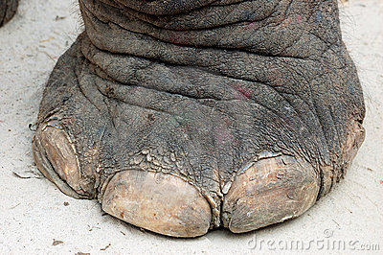
What would be more painful?
Being trodden on by a 55kg woman wearing stiletto heels?
Or being trodden on by a 3 tonne elephant?

Slide 5
What would be more painful?
Being trodden on by a 55kg woman wearing stiletto heels?
Or being trodden on by a 3 tonne elephant?
The woman’s foot in the stiletto heel! The whole of the woman’s weight is concentrated on a very small area, whereas the elephant’s weight is much more spread out – it exerts less pressure!

Slide 6
Calculating pressure
Pressure = Force
area

Slide 7
Calculating pressure
Pressure = Force
area
Force is measured in Newtons (N)

Slide 8
Calculating pressure
Pressure = Force
area
Force is measured in Newtons (N)
Area is measured in metres (m)

Slide 9
Calculating pressure
Pressure = Force
area
Force is measured in Newtons (N)
Area is measured in metres (m)
The unit of pressure is Newtons per square metre (N/m²)

Slide 10
Calculating pressure
Pressure = Force
area
Another name for Newton per metre squared is the Pascal (Pa)

Slide 11
Calculating pressure
1. A box on the floor has a weight of 250 newtons. The area that the box rests on is 0.25m². calculate the pressure under the box
2. A hose causes a force of 8000N from the water over an area of 0.5m by 0.5m. Calculate the pressure.

Slide 12
Calculating pressure
1. A box on the floor has a weight of 250 newtons. The area that the box rests on is 0.25m². calculate the pressure under the box
Pressure = F
A
= 250/0.25
= 1000N/m²
2. A hose causes a force of 8000N from the water over an area of 0.5m by 0.5m. Calculate the pressure.

Slide 13
Calculating pressure
1. A box on the floor has a weight of 250 newtons. The area that the box rests on is 0.25m². calculate the pressure under the box
Pressure = F
A
= 250/0.25
= 1000N/m²
2. A hose causes a force of 8000N from the water over an area of 0.5m by 0.5m. Calculate the pressure.
Pressure = F
A
= 8000/0.25
=32000N/m²

Slide 14
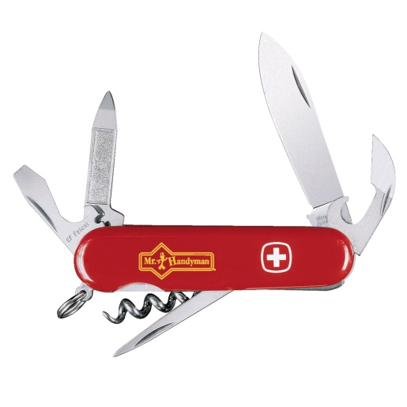
Examples of Pressure
1. Increase the pressure by reducing the area.
The area under the edge of the blade of the knife is very small. Beneath it the pressure is very high, so the blade can be pushed easily through materials such as fruit.

Slide 15
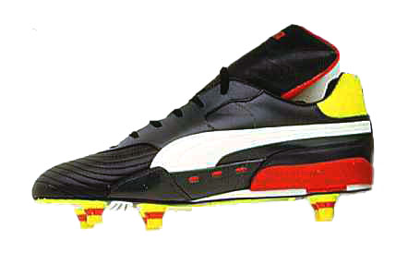
Examples of Pressure
1. Increase the pressure by reducing the area.
The area under the edge of the blade of the knife is very small. Beneath it the pressure is very high, so the blade can be pushed easily through materials such as fruit.
The studs on a football boot have a small area of contact with the ground. This means that the pressure beneath the studs is sufficient for them to sink into the ground and provide additional grip.

Slide 16
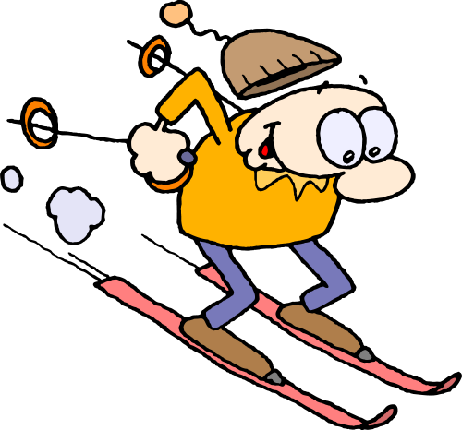
Examples of Pressure
1. Reduce the pressure by increasing the area.
Skis have a large area to reduce the pressure on the snow so they do not sink in too deep.

Slide 17
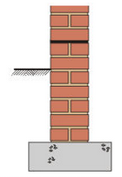
Examples of Pressure
1. Reduce the pressure by increasing the area.
Skis have a large area to reduce the pressure on the snow so they do not sink in too deep.
Wall foundations have a large horizontal area. This reduces the pressure beneath so that the wall does not sink deeper into the ground.

Slide 18
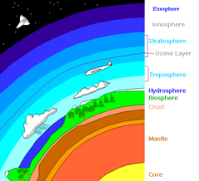
Air Pressure
Air pressure in the atmosphere acts in all directions.

Slide 19
Air Pressure
Air pressure in the atmosphere acts in all directions.
Air pressure gets less as you rise up through the atmosphere. The atmosphere is denser at lower levels.

Slide 20
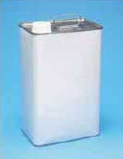
Air Pressure
Crushed can experiment

Slide 21
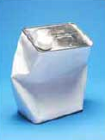
Air Pressure
Crushed can experiment
Air removed by vacuum pump
Atmospheric pressure crushes the can.

Slide 22
Air Pressure
Air pressure in the atmosphere acts in all directions.
Air pressure gets less as you rise up through the atmosphere. The atmosphere is denser at lower levels.
At sea level, atmospheric pressure is about 100 kPa

Slide 23
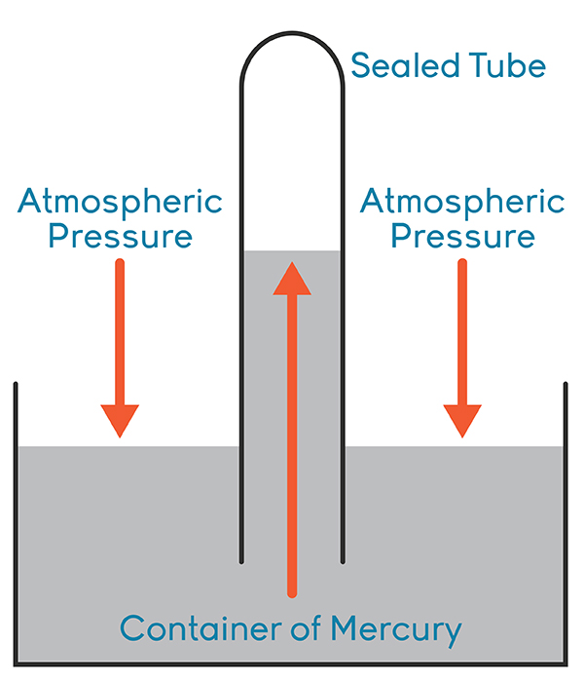
Air Pressure
We can measure atmospheric pressure using a barometer.
http://www.learner.org/courses/chemistry/visuals/visuals.html?dis=U&num=Ym5WdElUQS9NeW89

Slide 24
Air Pressure
We can measure atmospheric pressure using a barometer.
The sealed tube contains a vacuum. Air pressure will push mercury up the tube. At sea level a column of 760 mm of mercury can be supported.
http://www.learner.org/courses/chemistry/visuals/visuals.html?dis=U&num=Ym5WdElUQS9NeW89

Slide 25
Air Pressure
We can measure atmospheric pressure using a barometer.
The sealed tube contains a vacuum. Air pressure will push mercury up the tube. At sea level a column of 760 mm of mercury can be supported.
As atmospheric pressure changes, so does the height of mercury in the tube.
http://www.learner.org/courses/chemistry/visuals/visuals.html?dis=U&num=Ym5WdElUQS9NeW89

Slide 26
Pressure in liquids
Pressure acts in all directions
Pressure increases with depth

Slide 27
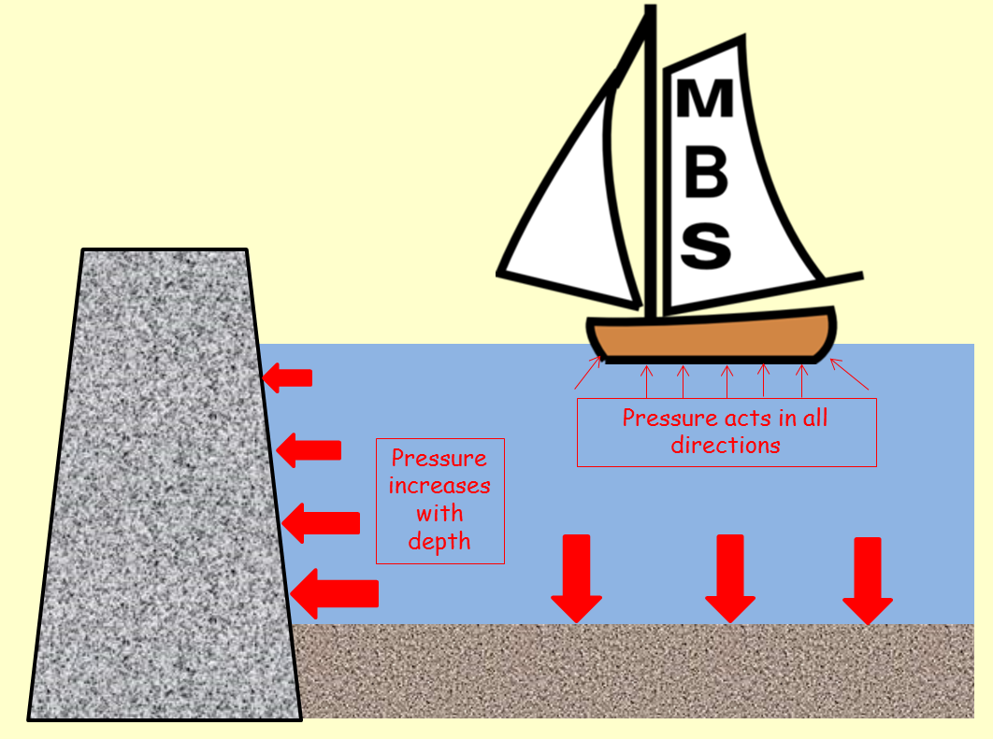
Pressure in liquids
The weight of the liquid causes pressure in the container. It also causes pressure on any object in the liquid.
Properties:

Slide 28
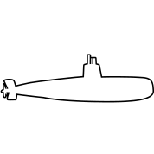
Pressure in liquids
The weight of the liquid causes pressure in the container. It also causes pressure on any object in the liquid.
Properties:
Pressure acts in all directions. The liquid pushes on all surfaces it is in contact with. For a submarine this means that pressure is being exerted equally on all parts of the hull.

Slide 29
Pressure in liquids
The weight of the liquid causes pressure in the container. It also causes pressure on any object in the liquid.
Properties:
Pressure increases with depth. The deeper a liquid, the greater the weight above and so the higher the pressure. This is why dams are built with a taper towards a thicker base.

Slide 30
Pressure in liquids
The weight of the liquid causes pressure in the container. It also causes pressure on any object in the liquid.
Properties:
Pressure increases with depth. The deeper a liquid, the greater the weight above and so the higher the pressure. This is why dams are built with a taper towards a thicker base.
Pressure depends upon the density of the liquid. The more dense a liquid, the higher the pressure at any given depth.

Slide 31
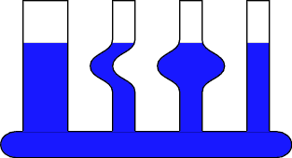
Pressure in liquids
The weight of the liquid causes pressure in the container. It also causes pressure on any object in the liquid.
Properties:
Pressure doesn’t depend upon the shape of the container. The pressure at any particular depth is the same whatever the shape or width of the container.
http://www.physics.arizona.edu/~hoffman/ua200/fluids/2b2040.gif

Slide 32
Pressure in liquids – calculations
Pressure at any given point:
Pressure = ρgh
ρ (Greek letter ‘rho’)
g = 10 N/kg
h = height of liquid
Depth = h
Density = ρ
Base area = A

Slide 33
Pressure in liquids – calculations
Pressure at any given point:
Pressure = ρgh
ρ (Greek letter ‘rho’)
g = 10 N/kg
h = height of liquid
Depth = h
Density = ρ
eg. If the density of water is 1000 kg/m³, what is the pressure due to the water at the bottom of a swimming pool 3m deep?
Pressure = ρgh
Pressure = 1000 x 10 x 3
Pressure = 30 000 Pa
Base area = A

Slide 34
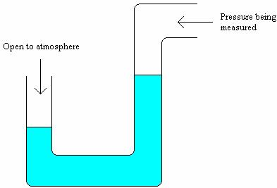
The Manometer
A manometer measures pressure difference.
The height difference (h) compares the pressure being measured with the atmospheric pressure.
In this example, the pressure being measured is less than the atmospheric pressure.
h

Slide 35
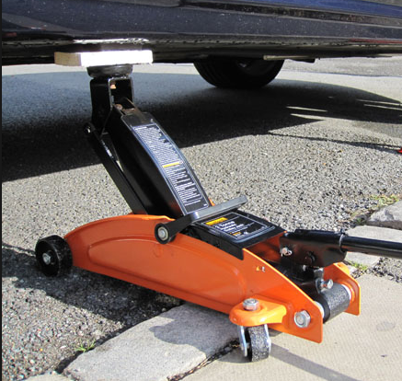
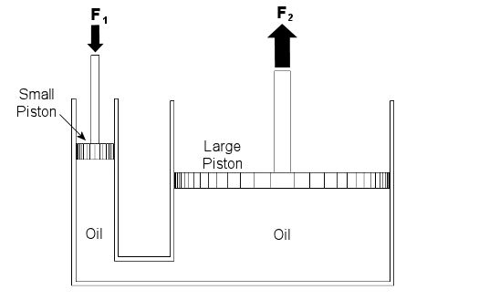
Hydraulics

Slide 36
Hydraulics

Slide 37
Hydraulics
Driver presses down on jack handle here

Slide 38
Hydraulics
Car is lifted by jack here
Driver presses down on jack handle here

Slide 39
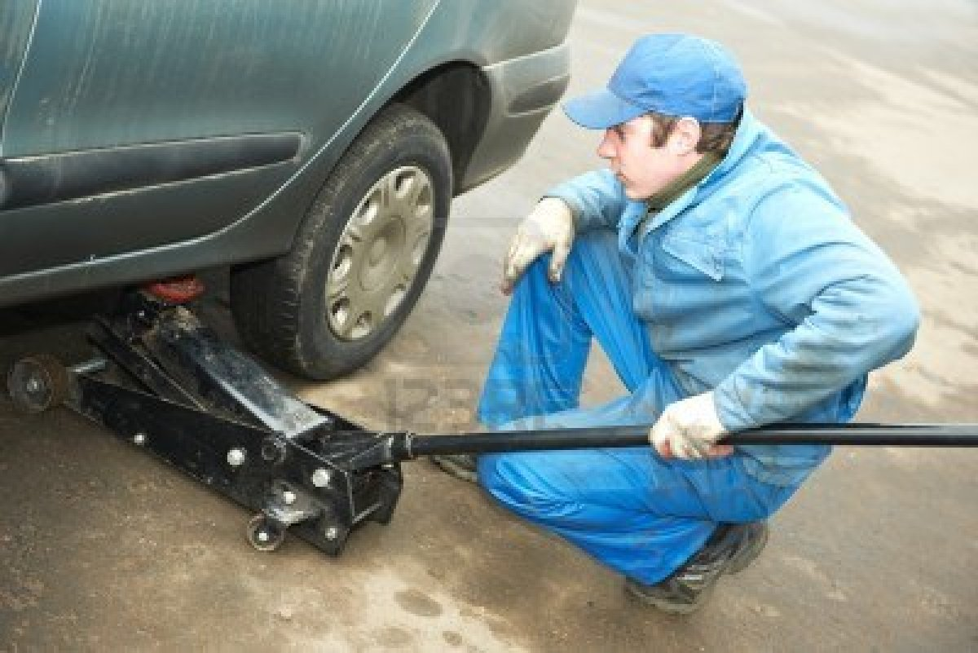
Hydraulics

Slide 40
Hydraulics
Car is lifted by jack here
Driver presses down on jack handle here
Force = 10N

Slide 41
Hydraulics
Car is lifted by jack here
Driver presses down on jack handle here
Force = 10N
Area = 10cm²

Slide 42
Hydraulics
Car is lifted by jack here
Driver presses down on jack handle here
Force = 10N
Area = 10cm²
Pressure = force
area

Slide 43
Hydraulics
Car is lifted by jack here
Driver presses down on jack handle here
Force = 10N
Area = 10cm²
Pressure = 10
10
= 1 N/cm²

Slide 44
Hydraulics
Car is lifted by jack here
Driver presses down on jack handle here
Force = 10N
Area = 10cm²
Pressure = 10
10
= 1 N/cm²
The pressure, 1 N/cm², will be the same anywhere in the system.

Slide 45
Hydraulics
Car is lifted by jack here
Driver presses down on jack handle here
Force = 10N
Area = 10cm²
Area = 40cm²
Pressure = 10
10
= 1 N/cm²
The pressure, 1 N/cm², will be the same anywhere in the system.

Slide 46
Hydraulics
Car is lifted by jack here
Driver presses down on jack handle here
Force = 10N
Force = Pressure x area
Area = 10cm²
Area = 40cm²
Pressure = 10
10
= 1 N/cm²
The pressure, 1 N/cm², will be the same anywhere in the system.

Slide 47
Hydraulics
Car is lifted by jack here
Driver presses down on jack handle here
Force = 10N
Force = Pressure x area
Force = 1 x 40 = 40N
Area = 10cm²
Area = 40cm²
Pressure = 10
10
= 1 N/cm²
The pressure, 1 N/cm², will be the same anywhere in the system.

Slide 48
Hydraulics
Using a hydraulic jack, a small force can be multiplied to lift a heavy car.
Car is lifted by jack here
Driver presses down on jack handle here
Force = 10N
Force = Pressure x area
Force = 1 x 40 = 40N
Area = 10cm²
Area = 40cm²
Pressure = 10
10
= 1 N/cm²
The pressure, 1 N/cm², will be the same anywhere in the system.

Slide 49
LEARNING OBJECTIVES
1.8 Pressure Core • Recall and use the equation p = F / A • Relate pressure to force and area, using appropriate examples • Describe the simple mercury barometer and its use in measuring atmospheric pressure • Relate (without calculation) the pressure beneath a liquid surface to depth and to density, using appropriate examples • Use and describe the use of a manometer | Supplement • Recall and use the equation p = h ρ g

Slide 50
PHYSICS – Pressure

