Slide 1
PHYSICS – Electromagnetic effects (2)

Slide 2
LEARNING OBJECTIVES
Core • Describe the pattern of the magnetic field (including direction) due to currents in straight wires and in solenoids • Describe applications of the magnetic effect of current, including the action of a relay Describe an experiment to show that a force acts on a current-carrying conductor in a magnetic field, including the effect of reversing: – the current – the direction of the field State that a current-carrying coil in a magnetic field experiences a turning effect and that the effect is increased by: – increasing the number of turns on the coil – increasing the current – increasing the strength of the magnetic field | Supplement State the qualitative variation of the strength of the magnetic field over salient parts of the pattern • State that the direction of a magnetic field line at a point is the direction of the force on the N pole of a magnet at that point • Describe the effect on the magnetic field of changing the magnitude and direction of the current State and use the relative directions of force, field and current • Describe an experiment to show the corresponding force on beams of charged particles Relate this turning effect to the action of an electric motor including the action of a split-ring commutator

Slide 3
Describe the pattern of the magnetic field (including direction) due to currents in straight wires and in solenoids

Slide 4
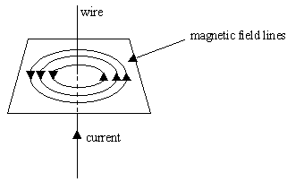
Describe the pattern of the magnetic field (including direction) due to currents in straight wires and in solenoids
If an electric current is passed through a wire, a weak magnetic field is produced.
Wire
Magnetic field lines
Current (conventional)

Slide 5
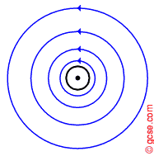
Describe the pattern of the magnetic field (including direction) due to currents in straight wires and in solenoids
If an electric current is passed through a wire, a weak magnetic field is produced.
Wire
Magnetic field lines
Current (conventional)
Field lines can be followed and plotted using a plotting compass.
The ‘dot’ represents the current flowing upwards (as shown in the diagram above)

Slide 6
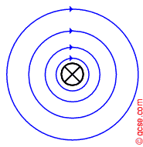
Describe the pattern of the magnetic field (including direction) due to currents in straight wires and in solenoids
If an electric current is passed through a wire, a weak magnetic field is produced.
Wire
Magnetic field lines
Current (conventional)
Field lines can be followed and plotted using a plotting compass.
The ‘cross’ represents the current flowing downwards (the field direction is reversed).

Slide 7
Describe the pattern of the magnetic field (including direction) due to currents in straight wires and in solenoids
If an electric current is passed through a wire, a weak magnetic field is produced.
Wire
Magnetic field lines
Current (conventional)
Field lines can be followed and plotted using a plotting compass.
Field features:
The magnetic field lines are circles.
The field is strongest closer to the wire.
Increasing the current increases the field strength.
The ‘cross’ represents the current flowing downwards (the field direction is reversed).

Slide 8
How do we know the direction of the magnetic field produced by a current?

Slide 9
How do we know the direction of the magnetic field produced by a current?
Remember the right-hand grip rule!

Slide 10
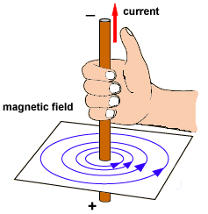
How do we know the direction of the magnetic field produced by a current?
Remember the right-hand grip rule!
Imagine gripping the wire with your right hand so that your thumb points in the current direction (conventional). Your fingers then point in the same direction as the field lines.

Slide 11
Describe the pattern of the magnetic field (including direction) due to currents in straight wires and in solenoids
What is a solenoid?

Slide 12
Describe the pattern of the magnetic field (including direction) due to currents in straight wires and in solenoids
What is a solenoid?
A solenoid is a long coil of wire.

Slide 13
Describe the pattern of the magnetic field (including direction) due to currents in straight wires and in solenoids
What is a solenoid?
A solenoid is a long coil of wire.
A current produces a much stronger magnetic field if the wire it flows through is wound into a solenoid coil.

Slide 14
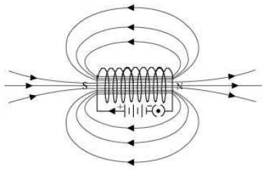
Features of the magnetic field produced:
The field is similar to that produced by a bar magnet, with North and South poles.
The strength of the field increases as the current increases.
The strength of the field increases as the number of turns on the coil increases.

Slide 15
Features of the magnetic field produced:
The field is similar to that produced by a bar magnet, with North and South poles.
The strength of the field increases as the current increases.
The strength of the field increases as the number of turns on the coil increases.
The right-hand grip rule can also be used with the solenoid.

Slide 16
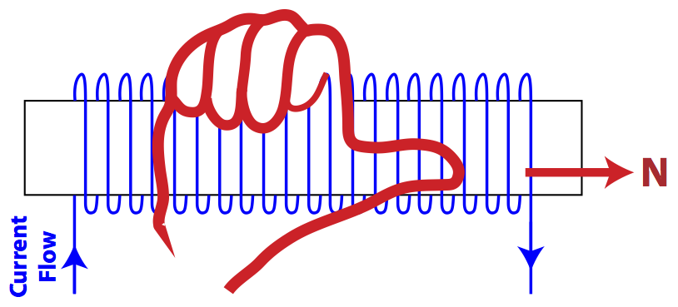
Features of the magnetic field produced:
The field is similar to that produced by a bar magnet, with North and South poles.
The strength of the field increases as the current increases.
The strength of the field increases as the number of turns on the coil increases.
The right-hand grip rule can also be used with the solenoid.
http://www.aplusphysics.com/
Imagine gripping the coil with your right hand so that your fingers point in the current direction (conventional). Your thumb then points towards the North pole of the coil.

Slide 17
Describe applications of the magnetic effect of current, including the action of a relay

Slide 18
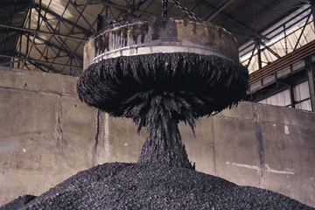
http://science.howstuffworks.com/
Describe applications of the magnetic effect of current, including the action of a relay
Electromagnets!

Slide 19
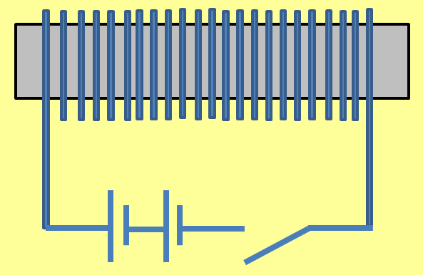
http://science.howstuffworks.com/
Describe applications of the magnetic effect of current, including the action of a relay
Electromagnets!
switch
battery
coil
Soft iron core

Slide 20
http://science.howstuffworks.com/
Describe applications of the magnetic effect of current, including the action of a relay
Electromagnets!
Unlike bar magnets, which are permanent magnets, the magnetism of electromagnets can be turned on and off.
switch
battery
coil
Soft iron core

Slide 21
http://science.howstuffworks.com/
Describe applications of the magnetic effect of current, including the action of a relay
Electromagnets!
Unlike bar magnets, which are permanent magnets, the magnetism of electromagnets can be turned on and off.
switch
battery
When a current flows through the coil it produces a magnetic field. This field is temporary and is lost when the current is switched off.
coil
Soft iron core

Slide 22
http://science.howstuffworks.com/
Describe applications of the magnetic effect of current, including the action of a relay
Electromagnets!
Unlike bar magnets, which are permanent magnets, the magnetism of electromagnets can be turned on and off.
switch
battery
When a current flows through the coil it produces a magnetic field. This field is temporary and is lost when the current is switched off.
Strength increased by:
Increasing the current
Increasing number of turns
coil
Soft iron core

Slide 23
http://science.howstuffworks.com/
Describe applications of the magnetic effect of current, including the action of a relay
Electromagnets!
Unlike bar magnets, which are permanent magnets, the magnetism of electromagnets can be turned on and off.
The core is usually made of a soft metal such as iron or Mumetal.
switch
battery
When a current flows through the coil it produces a magnetic field. This field is temporary and is lost when the current is switched off.
Strength increased by:
Increasing the current
Increasing number of turns
coil
Soft iron core

Slide 24
Uses of electromagnets
Describe applications of the magnetic effect of current, including the action of a relay

Slide 25
Uses of electromagnets
Describe applications of the magnetic effect of current, including the action of a relay
Electromagnets are used in RELAYS. A relay is a device which uses a low current circuit to switch a high current circuit on or off.

Slide 26
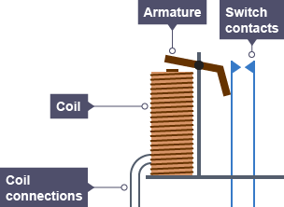
Uses of electromagnets
Describe applications of the magnetic effect of current, including the action of a relay
Electromagnets are used in RELAYS. A relay is a device which uses a low current circuit to switch a high current circuit on or off.
For example, a very big relay is used in cars for switching the starter motor, because it draws a very big current.
Low current circuit
High current circuit

Slide 27
Uses of electromagnets
Describe applications of the magnetic effect of current, including the action of a relay
Electromagnets are used in RELAYS. A relay is a device which uses a low current circuit to switch a high current circuit on or off.
For example, a very big relay is used in cars for switching the starter motor, because it draws a very big current.
When the switch in the low current circuit is closed, it turns the electromagnet on which attracts the iron armature.
Low current circuit
High current circuit

Slide 28
Uses of electromagnets
Describe applications of the magnetic effect of current, including the action of a relay
Electromagnets are used in RELAYS. A relay is a device which uses a low current circuit to switch a high current circuit on or off.
For example, a very big relay is used in cars for switching the starter motor, because it draws a very big current.
When the switch in the low current circuit is closed, it turns the electromagnet on which attracts the iron armature.
The armature pivots and closes the switch contacts in the high current circuit.
Low current circuit
High current circuit

Slide 29
Uses of electromagnets
Describe applications of the magnetic effect of current, including the action of a relay
Electromagnets are used in RELAYS. A relay is a device which uses a low current circuit to switch a high current circuit on or off.
For example, a very big relay is used in cars for switching the starter motor, because it draws a very big current.
When the switch in the low current circuit is closed, it turns the electromagnet on which attracts the iron armature.
The armature pivots and closes the switch contacts in the high current circuit.
When the low current switch is opened the electromagnet stops pulling the armature and the high current circuit is broken again.
Low current circuit
High current circuit

Slide 30
Uses of electromagnets
Describe applications of the magnetic effect of current, including the action of a relay
Electromagnets are used in CIRCUIT BREAKERS.

Slide 31
Uses of electromagnets
Describe applications of the magnetic effect of current, including the action of a relay
Electromagnets are used in CIRCUIT BREAKERS.
A circuit breaker does the same job as a fuse, but it works in a different way. Circuit breakers are automatic switches that ‘trip’ (turn off) when the current rises above a specific value. The circuit breaker can be reset by pressing a button (no need to replace).

Slide 32
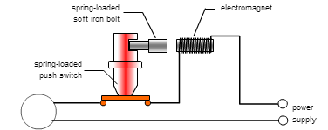
Uses of electromagnets
Describe applications of the magnetic effect of current, including the action of a relay
Electromagnets are used in CIRCUIT BREAKERS.
A circuit breaker does the same job as a fuse, but it works in a different way. Circuit breakers are automatic switches that ‘trip’ (turn off) when the current rises above a specific value. The circuit breaker can be reset by pressing a button (no need to replace).
http://www.bbc.co.uk/schools/gcsebitesize/science

Slide 33
Uses of electromagnets
Describe applications of the magnetic effect of current, including the action of a relay
Electromagnets are used in CIRCUIT BREAKERS.
A circuit breaker does the same job as a fuse, but it works in a different way. Circuit breakers are automatic switches that ‘trip’ (turn off) when the current rises above a specific value. The circuit breaker can be reset by pressing a button (no need to replace).
A spring-loaded push switch is held in the closed position by a spring-loaded soft iron bolt.
1
http://www.bbc.co.uk/schools/gcsebitesize/science

Slide 34
Uses of electromagnets
Describe applications of the magnetic effect of current, including the action of a relay
Electromagnets are used in CIRCUIT BREAKERS.
A circuit breaker does the same job as a fuse, but it works in a different way. Circuit breakers are automatic switches that ‘trip’ (turn off) when the current rises above a specific value. The circuit breaker can be reset by pressing a button (no need to replace).
A spring-loaded push switch is held in the closed position by a spring-loaded soft iron bolt.
Electromagnet arranged so it can pull the bolt away from the switch.
1
2
http://www.bbc.co.uk/schools/gcsebitesize/science

Slide 35
Uses of electromagnets
Describe applications of the magnetic effect of current, including the action of a relay
Electromagnets are used in CIRCUIT BREAKERS.
A circuit breaker does the same job as a fuse, but it works in a different way. Circuit breakers are automatic switches that ‘trip’ (turn off) when the current rises above a specific value. The circuit breaker can be reset by pressing a button (no need to replace).
A spring-loaded push switch is held in the closed position by a spring-loaded soft iron bolt.
Electromagnet arranged so it can pull the bolt away from the switch.
If current increases beyond set limit then the electromagnet pulls bolt towards itself, releasing the push switch and breaking the circuit.
1
2
3
http://www.bbc.co.uk/schools/gcsebitesize/science

Slide 36
Uses of electromagnets
Describe applications of the magnetic effect of current, including the action of a relay
Electromagnets are used in MAGNETIC STORAGE.

Slide 37
Uses of electromagnets
Describe applications of the magnetic effect of current, including the action of a relay
Electromagnets are used in MAGNETIC STORAGE.
Pictures and sound can be recorded onto magnetic tape – this consists of a long, thin plastic strip coated with a layer of iron oxide.

Slide 38
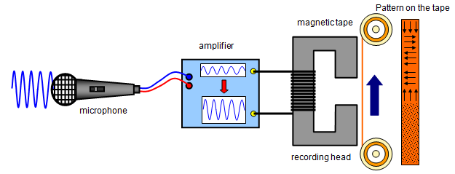
Uses of electromagnets
Describe applications of the magnetic effect of current, including the action of a relay
Electromagnets are used in MAGNETIC STORAGE.
Pictures and sound can be recorded onto magnetic tape – this consists of a long, thin plastic strip coated with a layer of iron oxide.
http://www.schoolphysics.co.uk/

Slide 39
Uses of electromagnets
Describe applications of the magnetic effect of current, including the action of a relay
Electromagnets are used in MAGNETIC STORAGE.
Pictures and sound can be recorded onto magnetic tape – this consists of a long, thin plastic strip coated with a layer of iron oxide.
Microphone picks up sound wave and converts it to small changing voltage.
1
http://www.schoolphysics.co.uk/

Slide 40
Uses of electromagnets
Describe applications of the magnetic effect of current, including the action of a relay
Electromagnets are used in MAGNETIC STORAGE.
Pictures and sound can be recorded onto magnetic tape – this consists of a long, thin plastic strip coated with a layer of iron oxide.
Microphone picks up sound wave and converts it to small changing voltage.
The amplifier amplifies this voltage.
2
1
http://www.schoolphysics.co.uk/

Slide 41
Uses of electromagnets
Describe applications of the magnetic effect of current, including the action of a relay
Electromagnets are used in MAGNETIC STORAGE.
Pictures and sound can be recorded onto magnetic tape – this consists of a long, thin plastic strip coated with a layer of iron oxide.
Microphone picks up sound wave and converts it to small changing voltage.
The amplifier amplifies this voltage.
Output from amplifier fed to recording head where changing magnetic field is produced.
2
1
3
http://www.schoolphysics.co.uk/

Slide 42
Uses of electromagnets
Describe applications of the magnetic effect of current, including the action of a relay
Electromagnets are used in MAGNETIC STORAGE.
Pictures and sound can be recorded onto magnetic tape – this consists of a long, thin plastic strip coated with a layer of iron oxide.
Microphone picks up sound wave and converts it to small changing voltage.
The amplifier amplifies this voltage.
Output from amplifier fed to recording head where changing magnetic field is produced.
Changing magnetic field arranges iron oxide grains onto pattern that mirrors changing sound input.
2
1
3
4
http://www.schoolphysics.co.uk/

Slide 43
Uses of electromagnets
Describe applications of the magnetic effect of current, including the action of a relay
Electromagnets are used in MAGNETIC STORAGE.
At the simplest level, a computer hard disk drive is not that different from a magnetic cassette tape. Both hard disks and cassette tapes use the same magnetic recording techniques previously described.

Slide 44
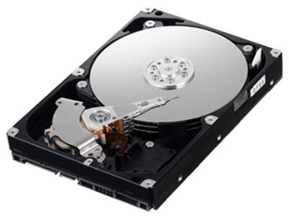
Uses of electromagnets
Describe applications of the magnetic effect of current, including the action of a relay
Electromagnets are used in MAGNETIC STORAGE.
At the simplest level, a computer hard disk drive is not that different from a magnetic cassette tape. Both hard disks and cassette tapes use the same magnetic recording techniques previously described.
The recording head contains a tiny electromagnet which is used to create tracks of varying magnetism on a spinning disc.

Slide 45
Uses of electromagnets
Describe applications of the magnetic effect of current, including the action of a relay
Electromagnets are used in MAGNETIC STORAGE.
At the simplest level, a computer hard disk drive is not that different from a magnetic cassette tape. Both hard disks and cassette tapes use the same magnetic recording techniques previously described.
The recording head contains a tiny electromagnet which is used to create tracks of varying magnetism on a spinning disc.
Hard disks and cassette tapes also share the major benefits that the magnetic medium can be easily erased and rewritten, and ‘remembered’ for many years.

Slide 46
Describe an experiment to show that a force acts on a current-carrying conductor in a magnetic field, including the effect of reversing: – the current – the direction of the field

Slide 47
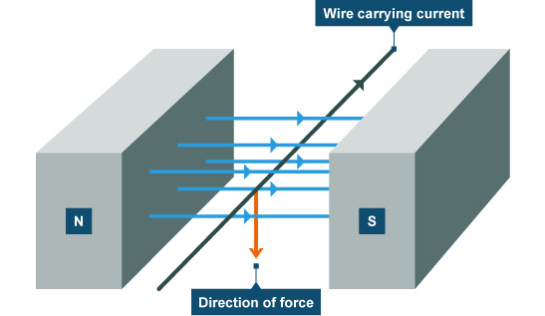
Describe an experiment to show that a force acts on a current-carrying conductor in a magnetic field, including the effect of reversing: – the current – the direction of the field
http://www.bbc.co.uk/schools/gcsebitesize

Slide 48
Describe an experiment to show that a force acts on a current-carrying conductor in a magnetic field, including the effect of reversing: – the current – the direction of the field
If a wire carrying a current is placed in a magnetic field (with lines of force at right angles to the wire) then it will experience a force:
At right angles to the current direction
http://www.bbc.co.uk/schools/gcsebitesize

Slide 49
Describe an experiment to show that a force acts on a current-carrying conductor in a magnetic field, including the effect of reversing: – the current – the direction of the field
If a wire carrying a current is placed in a magnetic field (with lines of force at right angles to the wire) then it will experience a force:
At right angles to the current direction
At right angles to the magnetic field lines.
http://www.bbc.co.uk/schools/gcsebitesize

Slide 50
Describe an experiment to show that a force acts on a current-carrying conductor in a magnetic field, including the effect of reversing: – the current – the direction of the field
If a wire carrying a current is placed in a magnetic field (with lines of force at right angles to the wire) then it will experience a force:
At right angles to the current direction
At right angles to the magnetic field lines.
The force on the wire is increased if:
The current is increased
A stronger magnet is used
The length of the wire in the field is increased
http://www.bbc.co.uk/schools/gcsebitesize

Slide 51
Describe an experiment to show that a force acts on a current-carrying conductor in a magnetic field, including the effect of reversing: – the current – the direction of the field
http://www.bbc.co.uk/schools/gcsebitesize
How can we predict the direction of the force on the wire?

Slide 52
Describe an experiment to show that a force acts on a current-carrying conductor in a magnetic field, including the effect of reversing: – the current – the direction of the field
http://www.bbc.co.uk/schools/gcsebitesize
To predict the direction we can use Fleming’s left-hand rule
How can we predict the direction of the force on the wire?

Slide 53
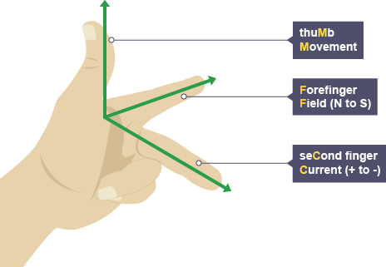
Describe an experiment to show that a force acts on a current-carrying conductor in a magnetic field, including the effect of reversing: – the current – the direction of the field
http://www.bbc.co.uk/schools/gcsebitesize
http://www.bbc.co.uk/schools/gcsebitesize

Slide 54
Describe an experiment to show that a force acts on a current-carrying conductor in a magnetic field, including the effect of reversing: – the current – the direction of the field
http://www.bbc.co.uk/schools/gcsebitesize
The forefinger represents the direction of the field between the N and S poles of the magnet.
http://www.bbc.co.uk/schools/gcsebitesize

Slide 55
Describe an experiment to show that a force acts on a current-carrying conductor in a magnetic field, including the effect of reversing: – the current – the direction of the field
http://www.bbc.co.uk/schools/gcsebitesize
The forefinger represents the direction of the field between the N and S poles of the magnet.
The second finger represents the direction of the current in the conducting wire
http://www.bbc.co.uk/schools/gcsebitesize

Slide 56
Describe an experiment to show that a force acts on a current-carrying conductor in a magnetic field, including the effect of reversing: – the current – the direction of the field
http://www.bbc.co.uk/schools/gcsebitesize
The thumb shows the resultant force acting on the wire.
The forefinger represents the direction of the field between the N and S poles of the magnet.
The second finger represents the direction of the current in the conducting wire
http://www.bbc.co.uk/schools/gcsebitesize

Slide 57
Describe an experiment to show that a force acts on a current-carrying conductor in a magnetic field, including the effect of reversing: – the current – the direction of the field
http://www.bbc.co.uk/schools/gcsebitesize
So, applying Fleming’s left-hand rule to the example given ….

Slide 58
Describe an experiment to show that a force acts on a current-carrying conductor in a magnetic field, including the effect of reversing: – the current – the direction of the field
http://www.bbc.co.uk/schools/gcsebitesize
So, applying Fleming’s left-hand rule to the example given ….
Forefinger (magnetic field)

Slide 59
Describe an experiment to show that a force acts on a current-carrying conductor in a magnetic field, including the effect of reversing: – the current – the direction of the field
http://www.bbc.co.uk/schools/gcsebitesize
So, applying Fleming’s left-hand rule to the example given ….
Second finger (current)
Forefinger (magnetic field)

Slide 60
Describe an experiment to show that a force acts on a current-carrying conductor in a magnetic field, including the effect of reversing: – the current – the direction of the field
http://www.bbc.co.uk/schools/gcsebitesize
So, applying Fleming’s left-hand rule to the example given ….
Second finger (current)
Forefinger (magnetic field)
Thumb (movement)

Slide 61
Describe an experiment to show that a force acts on a current-carrying conductor in a magnetic field, including the effect of reversing: – the current – the direction of the field
http://www.bbc.co.uk/schools/gcsebitesize
Some devices use the fact that there is a force on a current-carrying conductor in a magnetic field – for example, a loudspeaker.
Second finger (current)
Forefinger (magnetic field)
Thumb (movement)

Slide 62
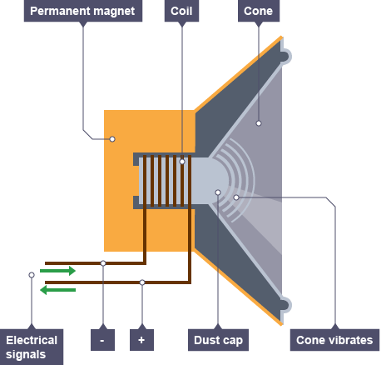
http://www.bbc.co.uk/schools/gcsebitesize
1. The cylindrical magnet produces a strong radial (‘spoke-like’) magnetic field at right angles to the wire in the coil, which is attached to a stiff paper or plastic cone.

Slide 63
http://www.bbc.co.uk/schools/gcsebitesize
1. The cylindrical magnet produces a strong radial (‘spoke-like’) magnetic field at right angles to the wire in the coil, which is attached to a stiff paper or plastic cone.
2. The loudspeaker is connected to an amplifier. The current is AC and so continually changes direction. This causes the magnetic field around the electromagnet to continually change.

Slide 64
http://www.bbc.co.uk/schools/gcsebitesize
1. The cylindrical magnet produces a strong radial (‘spoke-like’) magnetic field at right angles to the wire in the coil, which is attached to a stiff paper or plastic cone.
3. The electromagnet moves back and forth, and as a result the speaker cone also moves back and forth, generating sound waves.
2. The loudspeaker is connected to an amplifier. The current is AC and so continually changes direction. This causes the magnetic field around the electromagnet to continually change.

Slide 65
State that a current-carrying coil in a magnetic field experiences a turning effect, and describe the factors that can increase this effect.

Slide 66
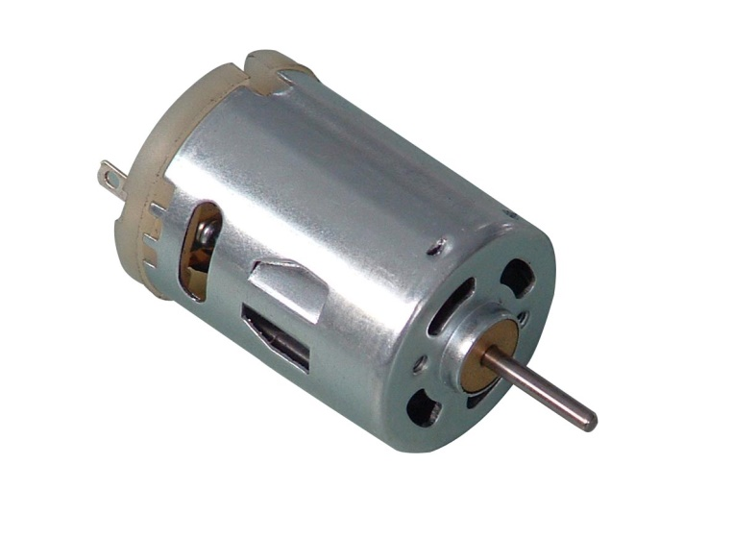
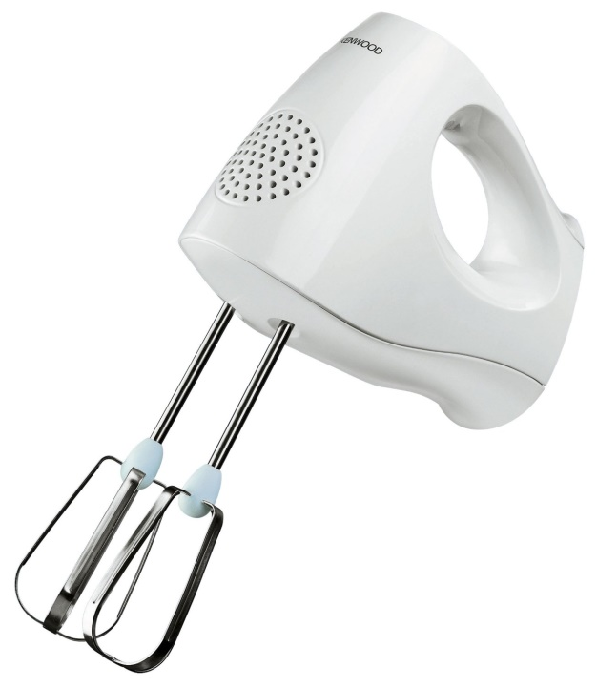
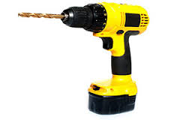
State that a current-carrying coil in a magnetic field experiences a turning effect, and describe the factors that can increase this effect.
Turning effect
Simple motor

Slide 67
State that a current-carrying coil in a magnetic field experiences a turning effect, and describe the factors that can increase this effect.
Turning effect
Current-carrying wire
Magnetic field
Force on the wire

Slide 68
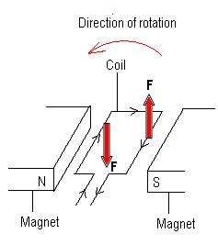
State that a current-carrying coil in a magnetic field experiences a turning effect, and describe the factors that can increase this effect.
Turning effect
Current-carrying wire
Magnetic field
Force on the wire
In the coil of wire the current flows along one side in one direction, and in the opposite direction on the other.
1

Slide 69
State that a current-carrying coil in a magnetic field experiences a turning effect, and describe the factors that can increase this effect.
Turning effect
Current-carrying wire
Magnetic field
Force on the wire
In the coil of wire the current flows along one side in one direction, and in the opposite direction on the other.
According to Fleming’s left hand rule one side is pushed up by the magnetic field, and one is pushed down.
2
1

Slide 70
State that a current-carrying coil in a magnetic field experiences a turning effect, and describe the factors that can increase this effect.
Turning effect
Current-carrying wire
Magnetic field
Force on the wire
In the coil of wire the current flows along one side in one direction, and in the opposite direction on the other.
According to Fleming’s left hand rule one side is pushed up by the magnetic field, and one is pushed down.
These opposing forces on the coil of wire will result in a turning effect.
3
2
1

Slide 71
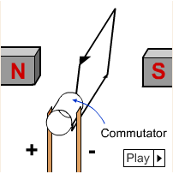
State that a current-carrying coil in a magnetic field experiences a turning effect, and describe the factors that can increase this effect.
Turning effect
Simple DC motor
Coil
Magnetic field
DC Supply
Coil is made from insulated copper wire, and is free to rotate between the poles of the magnet. The commutator (or split ring) is fixed to the coil, and is in contact with the brushes from the DC supply.

Slide 72
Turning effect
Commutator detail
coil
commutator
Simple DC motor
brush
Coil
Magnetic field
DC Supply
Coil is made from insulated copper wire, and is free to rotate between the poles of the magnet. The commutator (or split ring) is fixed to the coil, and is in contact with the brushes from the DC supply.

Slide 73
Turning effect
Commutator detail
coil
commutator
Simple DC motor
brush
Coil
Magnetic field
N
S
DC Supply
When the coil is horizontal between the poles of the magnet the forces have their maximum turning effect (leverage) on the coil.
Coil is made from insulated copper wire, and is free to rotate between the poles of the magnet. The commutator (or split ring) is fixed to the coil, and is in contact with the brushes from the DC supply.

Slide 74
Turning effect
Commutator detail
coil
commutator
Simple DC motor
brush
Coil
Magnetic field
N
S
DC Supply
Coil is made from insulated copper wire, and is free to rotate between the poles of the magnet. The commutator (or split ring) is fixed to the coil, and is in contact with the brushes from the DC supply.
If there was no change to the forces then the coil would come to rest in the vertical position

Slide 75
Turning effect
Commutator detail
coil
commutator
Simple DC motor
brush
Coil
Magnetic field
N
S
DC Supply
But the coil has momentum, so it overshoots the vertical position, the commutator changes the direction of the current through it, so the forces change direction and keep the coil turning.
Coil is made from insulated copper wire, and is free to rotate between the poles of the magnet. The commutator (or split ring) is fixed to the coil, and is in contact with the brushes from the DC supply.

Slide 76
State that a current-carrying coil in a magnetic field experiences a turning effect, and describe the factors that can increase this effect.
Turning effect
Simple DC motor
Coil
Magnetic field
DC Supply
The coil would rotate anticlockwise if either the battery or the poles of the magnet were the other way round.
Coil is made from insulated copper wire, and is free to rotate between the poles of the magnet. The commutator (or split ring) is fixed to the coil, and is in contact with the brushes from the DC supply.

Slide 77
State that a current-carrying coil in a magnetic field experiences a turning effect, and describe the factors that can increase this effect.
Turning effect
Simple DC motor
Coil
Magnetic field
The turning effect on the coil can be increased by:
Increasing the current;
Using a stronger magnet;
Increasing the number of turns on the coil;
Increasing the area of the coil.
DC Supply
Coil is made from insulated copper wire, and is free to rotate between the poles of the magnet. The commutator (or split ring) is fixed to the coil, and is in contact with the brushes from the DC supply.

Slide 78
LEARNING OBJECTIVES
Core • Describe the pattern of the magnetic field (including direction) due to currents in straight wires and in solenoids • Describe applications of the magnetic effect of current, including the action of a relay Describe an experiment to show that a force acts on a current-carrying conductor in a magnetic field, including the effect of reversing: – the current – the direction of the field State that a current-carrying coil in a magnetic field experiences a turning effect and that the effect is increased by: – increasing the number of turns on the coil – increasing the current – increasing the strength of the magnetic field | Supplement State the qualitative variation of the strength of the magnetic field over salient parts of the pattern • State that the direction of a magnetic field line at a point is the direction of the force on the N pole of a magnet at that point • Describe the effect on the magnetic field of changing the magnitude and direction of the current State and use the relative directions of force, field and current • Describe an experiment to show the corresponding force on beams of charged particles Relate this turning effect to the action of an electric motor including the action of a split-ring commutator

Slide 79
PHYSICS – Electromagnetic effects (2)

