Slide 1
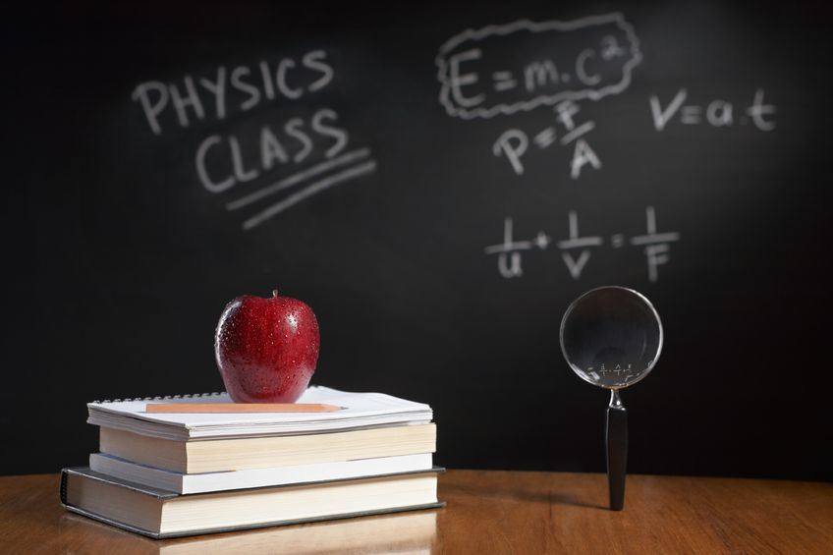
PHYSICS – Thermal properties and temperature (1).

Slide 2
LEARNING OBJECTIVES
2.2.1 Thermal expansion of solids, liquids and gases Core • Describe qualitatively the thermal expansion of solids, liquids, and gases at constant pressure • Identify and explain some of the everyday applications and consequences of thermal expansion 2.2.2 Measurement of temperature Core • Appreciate how a physical property that varies with temperature may be used for the measurement of temperature, and state examples of such properties • Recognise the need for and identify fixed points • Describe and explain the structure and action of liquid-in-glass thermometers | Supplement • Explain, in terms of the motion and arrangement of molecules, the relative order of the magnitude of the expansion of solids, liquids and gases Supplement • Demonstrate understanding of sensitivity, range and linearity • Describe the structure of a thermocouple and show understanding of its use as a thermometer for measuring high temperatures and those that vary rapidly • Describe and explain how the structure of a liquid-in-glass thermometer relates to its sensitivity, range and linearity

Slide 3
LEARNING OBJECTIVES
2.2.1 Thermal expansion of solids, liquids and gases Core • Describe qualitatively the thermal expansion of solids, liquids, and gases at constant pressure • Identify and explain some of the everyday applications and consequences of thermal expansion 2.2.2 Measurement of temperature Core • Appreciate how a physical property that varies with temperature may be used for the measurement of temperature, and state examples of such properties • Recognise the need for and identify fixed points • Describe and explain the structure and action of liquid-in-glass thermometers | Supplement • Explain, in terms of the motion and arrangement of molecules, the relative order of the magnitude of the expansion of solids, liquids and gases Supplement • Demonstrate understanding of sensitivity, range and linearity • Describe the structure of a thermocouple and show understanding of its use as a thermometer for measuring high temperatures and those that vary rapidly • Describe and explain how the structure of a liquid-in-glass thermometer relates to its sensitivity, range and linearity

Slide 4
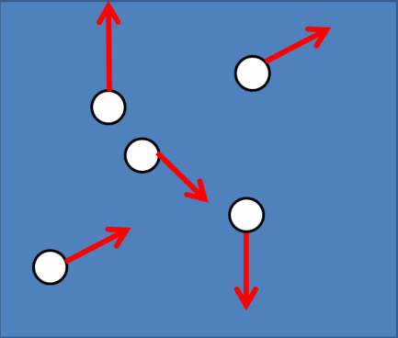
Temperature and Heat
Kinetic theory – particles are constantly moving and have kinetic energy. The higher the temperature, the faster they move, so the more kinetic energy they contain.

Slide 5
Temperature and Heat
Kinetic theory – particles are constantly moving and have kinetic energy. The higher the temperature, the faster they move, so the more kinetic energy they contain.
Higher temperature
Energy will flow from a hotter object to a colder one. Particles in the hot object will lose kinetic energy, whereas particles in the cold object will gain energy.
Energy
Lower temperature

Slide 6
Temperature and Heat
Kinetic theory – particles are constantly moving and have kinetic energy. The higher the temperature, the faster they move, so the more kinetic energy they contain.
Higher temperature
Energy will flow from a hotter object to a colder one. Particles in the hot object will lose kinetic energy, whereas particles in the cold object will gain energy.
Energy
Lower temperature
Energy will continue to flow until both objects reach the same temperature. Objects at the same temperature will have the same average kinetic energy per particle.

Slide 7
Temperature and Heat
Are temperature and heat the same?

Slide 8
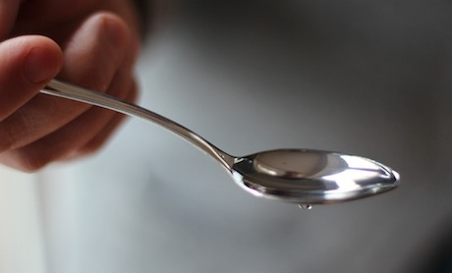
Temperature and Heat
Are temperature and heat the same?
No, because a spoonful of boiling water (100ºC) will have less thermal (heat) energy ….

Slide 9
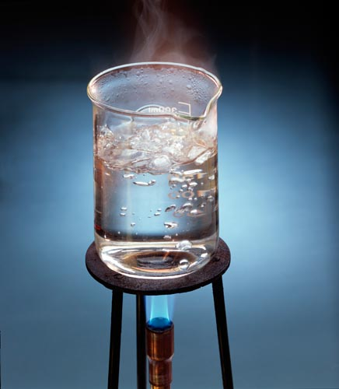
Temperature and Heat
Are temperature and heat the same?
No, because a spoonful of boiling water (100ºC) will have less thermal (heat) energy ….
… than a beaker of boiling water (at the same temperature).

Slide 10
Thermal Expansion

Slide 11
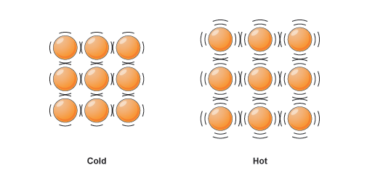
Thermal Expansion
http://www.bbc.co.uk/bitesize/ks3/science/images/expansion_solids.gif
When heated, solids (and liquids and gases) gain thermal energy. The particles start to move about more – their vibrations take up more space, so there is expansion in all directions. The opposite is true when the temperature falls – the material will get smaller (contract).

Slide 12
Thermal Expansion
Gases expand more when heated than liquids (depending upon P, V and T)
Liquids expand more when heated than solids.
http://www.bbc.co.uk/bitesize/ks3/science/images/expansion_solids.gif
When heated, solids (and liquids and gases) gain thermal energy. The particles start to move about more – their vibrations take up more space, so there is expansion in all directions. The opposite is true when the temperature falls – the material will get smaller (contract).
Material | Coefficient of expansion
Glass | 8.5
Concrete | 12
Brass | 19
Steel | 11
Aluminium | 23

Slide 13
Thermal Expansion
- observing expansion
Steel bar
Cast iron peg
A strong steel bar is fixed within the apparatus frame by a large nut at one end and a cast iron peg at the other. When the bar is heated the cast iron peg snaps because of the huge force in the bar. It is also possible to make another peg break when the bar contracts on cooling by tightening the nut when the bar expands.

Slide 14
Thermal Expansion
- examples
Girders in buildings and bridges are made with gaps at the ends.
Glass to be used in cooking has to be a low expansion type such as Pyrex otherwise it would shatter as it got hot.
Rivets are heated before they are put in place to hold two metal plates together.

Slide 15
Thermal Expansion
- examples
Girders in buildings and bridges are made with gaps at the ends.
Glass to be used in cooking has to be a low expansion type such as Pyrex otherwise it would shatter as it got hot.
Rivets are heated before they are put in place to hold two metal plates together.
High-speed planes are warmed by air friction and so get longer.

Slide 16
Thermal Expansion
- examples
Girders in buildings and bridges are made with gaps at the ends.
Glass to be used in cooking has to be a low expansion type such as Pyrex otherwise it would shatter as it got hot.
Rivets are heated before they are put in place to hold two metal plates together.
High-speed planes are warmed by air friction and so get longer.
rollers
Bridges have gaps to allow for expansion. Rollers may be used at one end so that movement can take place.

Slide 17
Thermal Expansion
- examples
Girders in buildings and bridges are made with gaps at the ends.
Glass to be used in cooking has to be a low expansion type such as Pyrex otherwise it would shatter as it got hot.
Rivets are heated before they are put in place to hold two metal plates together.
High-speed planes are warmed by air friction and so get longer.
Suspended overhead cables are left slack to allow for contraction that could happen on a very cold day.
rollers
Cold day
Bridges have gaps to allow for expansion. Rollers may be used at one end so that movement can take place.
Hot day

Slide 18
Thermal Expansion
- applications
Thermometer
As the temperature rises, the liquid in the bulb expands, and so rises up the narrow tube which is calibrated to fixed points (eg. 0ºC, 100ºC)
Calibration scale
Expanding liquid
Mercury or alcohol

Slide 19
Thermal Expansion
- applications
Thermometer
Bimetallic strip
As the temperature rises, the liquid in the bulb expands, and so rises up the narrow tube which is calibrated to fixed points (eg. 0ºC, 100ºC)
http://www.schoolphysics.co.uk/age11-14/Heat%20energy/Expansion/text/Expansion_of_solids/index.html
In a bimetallic strip, a low expansion metal (eg. Invar) is bonded to a high expansion metal (eg. Brass). As the strip is heated, the brass expands more than the invar, causing the strip to bend.
Calibration scale
Expanding liquid
Mercury or alcohol

Slide 20
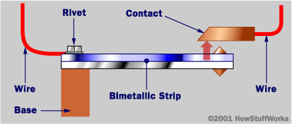
Thermal Expansion
- applications
Thermometer
Bimetallic strip
As the temperature rises, the liquid in the bulb expands, and so rises up the narrow tube which is calibrated to fixed points (eg. 0ºC, 100ºC)
http://www.schoolphysics.co.uk/age11-14/Heat%20energy/Expansion/text/Expansion_of_solids/index.html
In a bimetallic strip, a low expansion metal (eg. Invar) is bonded to a high expansion metal (eg. Brass). As the strip is heated, the brass expands more than the invar, causing the strip to bend.
Calibration scale
Expanding liquid
Bimetallic strips may be used in thermostats – devices for maintaining a steady temperature, such as in water heaters.
Mercury or alcohol

Slide 21
Thermal Expansion
… and the mystery of floating ice!

Slide 22
Thermal Expansion
… and the mystery of floating ice!
As hot water cools, so it contracts (gets smaller). However, as water freezes it actually expands as ice is formed. This expansion can be enough to split water pipes (and rocks).

Slide 23
Thermal Expansion
… and the mystery of floating ice!
As hot water cools, so it contracts (gets smaller). However, as water freezes it actually expands as ice is formed. This expansion can be enough to split water pipes (and rocks).
Why does this happen?

Slide 24
Thermal Expansion
… and the mystery of floating ice!
As hot water cools, so it contracts (gets smaller). However, as water freezes it actually expands as ice is formed. This expansion can be enough to split water pipes (and rocks).
Why does this happen?
In liquid water the water molecules are close together. In ice the water molecules link up in a very open structure that takes up more space than in the liquid.

Slide 25
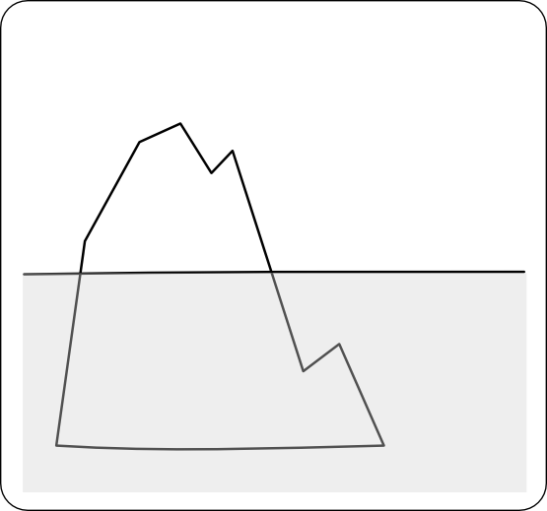
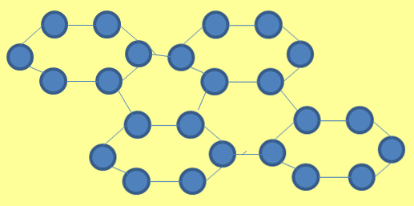
Thermal Expansion
… and the mystery of floating ice!
The density of ice is lower than that of liquid water, and so ice floats on water. The open structure molecules start to form at about 4ºC, just above the freezing point of water.
Water therefore expands very slightly between 4ºC and 0ºC.

Slide 26
Thermal Expansion and gases

Slide 27
Thermal Expansion and gases
So what is the relationship between gas pressure and temperature?
At constant volume!

Slide 28
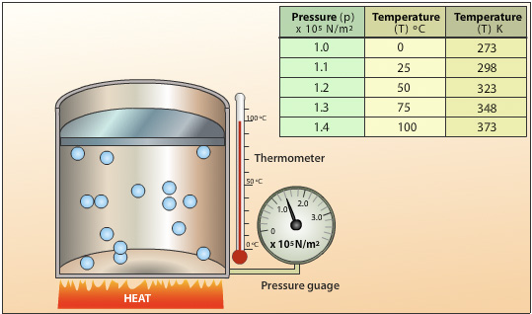
Thermal Expansion and gases
Using the apparatus below, a fixed volume of gas is heated. At each temperature point, pressure is measured on the gauge. As the temperature of the gas increases, so does the pressure. Molecules are moving faster, so are hitting the side of the container with greater force.
So what is the relationship between gas pressure and temperature?
At constant volume!
http://www.passmyexams.co.uk/GCSE/physics/pressure-temperature-relationship-of-gas-pressure-law.html

Slide 29
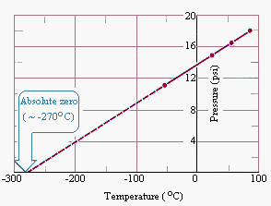
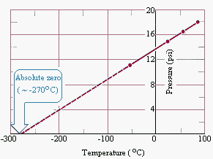
Thermal Expansion and gases
Using the apparatus below, a fixed volume of gas is heated. At each temperature point, pressure is measured on the gauge. As the temperature of the gas increases, so does the pressure. Molecules are moving faster, so are hitting the side of the container with greater force.
So what is the relationship between gas pressure and temperature?
If a graph is plotted of P against T, the graph is a straight line. If extended backwards, it cuts the temperature axis at
-273ºC (absolute zero)
At constant volume!
http://www.passmyexams.co.uk/GCSE/physics/pressure-temperature-relationship-of-gas-pressure-law.html

Slide 30
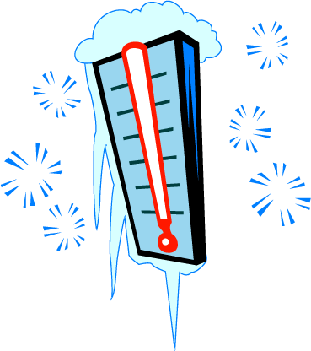
Thermal Expansion and gases
Absolute zero ….. Brrr!
If the temperature of a gas is reduced, the particles have less energy and move more slowly. Eventually, at a particular temperature, the particles stop moving completely. This temperature is the lowest possible temperature, and is known as absolute zero.

Slide 31
Thermal Expansion and gases
Absolute zero ….. Brrr!
Absolute zero is -273ºC. This is also known as zero kelvin, or 0 K. To convert from ºC to K, just add 273.
If the temperature of a gas is reduced, the particles have less energy and move more slowly. Eventually, at a particular temperature, the particles stop moving completely. This temperature is the lowest possible temperature, and is known as absolute zero.
Eg. Converting 120ºC to kelvin, add 273.
273 + 120 = 393K

Slide 32
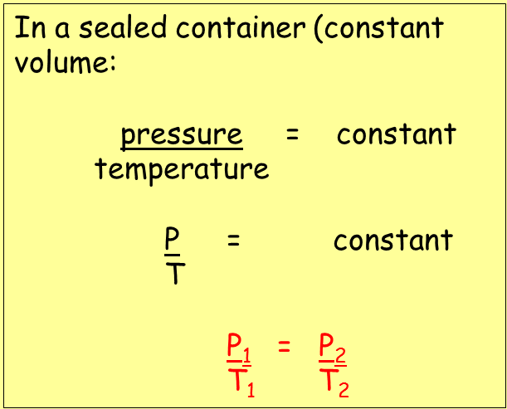
Thermal Expansion and gases
The pressure law
For a fixed mass of gas at constant volume, the pressure is directly proportional to the Kelvin temperature.

Slide 33
Thermal Expansion and gases
The pressure law
For a fixed mass of gas at constant volume, the pressure is directly proportional to the Kelvin temperature.

Slide 34
Thermal Expansion and gases
Charles’s law
Links together volume and temperature

Slide 35
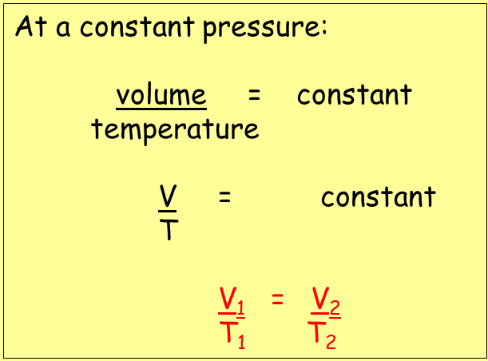
Thermal Expansion and gases
Charles’s law
Links together volume and temperature
For a fixed mass of gas at constant pressure, the volume is directly proportional to the Kelvin temperature.

Slide 36
Thermal Expansion and gases
Charles’s law
Links together volume and temperature
For a fixed mass of gas at constant pressure, the volume is directly proportional to the Kelvin temperature.
Eg: a gas at constant pressure has a volume of 22 litres with a temperature of 280 K. What will the volume be if the temperature increases to 320 K?
Answer: V₁ = V₂ 22 = V₂
T₁ = T₂ 280 320
V₂ = 22 x 320 = 25.1 litres
280

Slide 37
LEARNING OBJECTIVES
2.2.1 Thermal expansion of solids, liquids and gases Core • Describe qualitatively the thermal expansion of solids, liquids, and gases at constant pressure • Identify and explain some of the everyday applications and consequences of thermal expansion 2.2.2 Measurement of temperature Core • Appreciate how a physical property that varies with temperature may be used for the measurement of temperature, and state examples of such properties • Recognise the need for and identify fixed points • Describe and explain the structure and action of liquid-in-glass thermometers | Supplement • Explain, in terms of the motion and arrangement of molecules, the relative order of the magnitude of the expansion of solids, liquids and gases Supplement • Demonstrate understanding of sensitivity, range and linearity • Describe the structure of a thermocouple and show understanding of its use as a thermometer for measuring high temperatures and those that vary rapidly • Describe and explain how the structure of a liquid-in-glass thermometer relates to its sensitivity, range and linearity

Slide 38
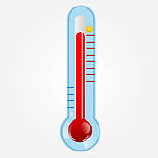
Measuring temperature
Temperatures in everyday situations are usually measured in degrees Celsius (ºC) – also referred to sometimes as the ‘centigrade scale’.

Slide 39
Measuring temperature
Temperatures in everyday situations are usually measured in degrees Celsius (ºC) – also referred to sometimes as the ‘centigrade scale’.
Two fixed points

Slide 40
Measuring temperature
Temperatures in everyday situations are usually measured in degrees Celsius (ºC) – also referred to sometimes as the ‘centigrade scale’.
Two fixed points
0ºC, the freezing point of pure water.

Slide 41
Measuring temperature
Temperatures in everyday situations are usually measured in degrees Celsius (ºC) – also referred to sometimes as the ‘centigrade scale’.
Two fixed points
0ºC, the freezing point of pure water.
100ºC, the boiling point of pure water.

Slide 42
Measuring temperature
Temperatures in everyday situations are usually measured in degrees Celsius (ºC) – also referred to sometimes as the ‘centigrade scale’.
Sun’s surface | 6000ºC
Bunsen flame | 1500ºC
Human body | 37ºC
Freezer food | -20ºC
Absolute zero | -273ºC
Two fixed points
0ºC, the freezing point of pure water.
100ºC, the boiling point of pure water.

Slide 43
Measuring temperature
So how exactly is the thermometer calibrated?

Slide 44
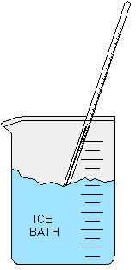
Measuring temperature
So how exactly is the thermometer calibrated?
Lower fixed point, 0ºC
0 degrees Celsius is defined as the melting point of pure ice. Any impurities will affect the value obtained.
http://jan.ucc.nau.edu/~jkn/235L2ppt1_files/slide0002_image002.gif

Slide 45
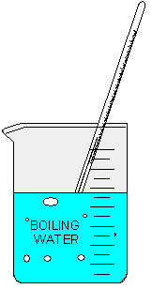
Measuring temperature
So how exactly is the thermometer calibrated?
Lower fixed point, 0ºC
Upper fixed point, 100ºC
0 degrees Celsius is defined as the melting point of pure ice. Any impurities will affect the value obtained.
100 degrees Celsius is defined as the boiling point of pure ice. Boiling must be at standard atmospheric pressure.
http://jan.ucc.nau.edu/~jkn/235L2ppt1_files/slide0002_image002.gif
http://jan.ucc.nau.edu/~jkn/235L2ppt1_files/slide0002_image002.gif

Slide 46
Measuring temperature
So how exactly is the thermometer calibrated?
Lower fixed point, 0ºC
Upper fixed point, 100ºC
0 degrees Celsius is defined as the melting point of pure ice. Any impurities will affect the value obtained.
100 degrees Celsius is defined as the boiling point of pure ice. Boiling must be at standard atmospheric pressure.
Having fixed the 0ºC and 100ºC the rest of the scale is made by dividing the length into 100 equal divisions or degrees.
http://jan.ucc.nau.edu/~jkn/235L2ppt1_files/slide0002_image002.gif
http://jan.ucc.nau.edu/~jkn/235L2ppt1_files/slide0002_image002.gif

Slide 47
Measuring temperature
So how exactly is the thermometer calibrated?
If the scale is divided up into equal divisions then it is known as a linear scale.
Lower fixed point, 0ºC
Upper fixed point, 100ºC
0 degrees Celsius is defined as the melting point of pure ice. Any impurities will affect the value obtained.
100 degrees Celsius is defined as the boiling point of pure ice. Boiling must be at standard atmospheric pressure.
Having fixed the 0ºC and 100ºC the rest of the scale is made by dividing the length into 100 equal divisions or degrees.
http://jan.ucc.nau.edu/~jkn/235L2ppt1_files/slide0002_image002.gif
http://jan.ucc.nau.edu/~jkn/235L2ppt1_files/slide0002_image002.gif

Slide 48
Measuring temperature
Features of liquid-in-glass thermometers

Slide 49
Measuring temperature
Features of liquid-in-glass thermometers
Most liquids expand slightly when heated. This property is put to use in thermometers filled with alcohol or mercury.

Slide 50
Measuring temperature
Features of liquid-in-glass thermometers
Most liquids expand slightly when heated. This property is put to use in thermometers filled with alcohol or mercury.
Sensitivity.
- The narrower the tube, the more the liquid inside moves, making the thermometer more sensitive to changes in temperature. Alcohol expands more than mercury, so a mercury thermometer must have a narrower tube than an alcohol one.
At any given temperature same increase in volume of liquid alcohol.

Slide 51
Measuring temperature
Features of liquid-in-glass thermometers
Most liquids expand slightly when heated. This property is put to use in thermometers filled with alcohol or mercury.
Sensitivity.
- The narrower the tube, the more the liquid inside moves, making the thermometer more sensitive to changes in temperature. Alcohol expands more than mercury, so a mercury thermometer must have a narrower tube than an alcohol one.
Range – mercury has a freezing point of -39ºC and a boiling point of 356ºC. Alcohol freezes at -115ºC, but boils at 78ºC.
At any given temperature same increase in volume of liquid alcohol.

Slide 52
Measuring temperature
Features of liquid-in-glass thermometers
Most liquids expand slightly when heated. This property is put to use in thermometers filled with alcohol or mercury.
Sensitivity.
- The narrower the tube, the more the liquid inside moves, making the thermometer more sensitive to changes in temperature. Alcohol expands more than mercury, so a mercury thermometer must have a narrower tube than an alcohol one.
Range – mercury has a freezing point of -39ºC and a boiling point of 356ºC. Alcohol freezes at -115ºC, but boils at 78ºC.
At any given temperature same increase in volume of liquid alcohol.
Responsiveness – thermometers with large bulbs or thicker glass around the bulb respond less quickly to changes in temperature.

Slide 53
Measuring temperature
Features of liquid-in-glass thermometers
Most liquids expand slightly when heated. This property is put to use in thermometers filled with alcohol or mercury.
Sensitivity.
- The narrower the tube, the more the liquid inside moves, making the thermometer more sensitive to changes in temperature. Alcohol expands more than mercury, so a mercury thermometer must have a narrower tube than an alcohol one.
Range – mercury has a freezing point of -39ºC and a boiling point of 356ºC. Alcohol freezes at -115ºC, but boils at 78ºC.
At any given temperature same increase in volume of liquid alcohol.
Responsiveness – thermometers with large bulbs or thicker glass around the bulb respond less quickly to changes in temperature.
Linearity – the expansion of mercury is not quite linear compared with alcohol – they differ slightly, but these differences are not significant between 0ºC and 100ºC.

Slide 54
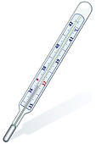
Measuring temperature
- Examples of thermometers
Clinical thermometer.
- Measures human temperatures very accurately. Scale is restricted to a few degrees either side of the normal body temperature (37ºC). A restriction in the neck stops the mercury from dropping until the reading is taken.

Slide 55
Measuring temperature
- Examples of thermometers
Clinical thermometer.
- Measures human temperatures very accurately. Scale is restricted to a few degrees either side of the normal body temperature (37ºC). A restriction in the neck stops the mercury from dropping until the reading is taken.
Digital Clinical thermometer.
- Contains a thermistor inside the probe. As the temperature rises the thermistor becomes a much better conductor, causing a higher current to flow, and so a higher reading on the meter.

Slide 56
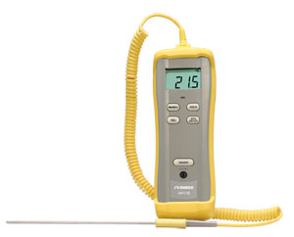
Measuring temperature
- Examples of thermometers
Thermocouple thermometer.
- Two different metals are joined together to form two junctions in the probe. A temperature difference between the two junctions causes a tiny voltage, resulting in the flow of current. The greater the temperature difference between the two junctions, the bigger the current.
X
X
http://www.omega.com/pptst/HH11B.html

Slide 57
LEARNING OBJECTIVES
2.2.1 Thermal expansion of solids, liquids and gases Core • Describe qualitatively the thermal expansion of solids, liquids, and gases at constant pressure • Identify and explain some of the everyday applications and consequences of thermal expansion 2.2.2 Measurement of temperature Core • Appreciate how a physical property that varies with temperature may be used for the measurement of temperature, and state examples of such properties • Recognise the need for and identify fixed points • Describe and explain the structure and action of liquid-in-glass thermometers | Supplement • Explain, in terms of the motion and arrangement of molecules, the relative order of the magnitude of the expansion of solids, liquids and gases Supplement • Demonstrate understanding of sensitivity, range and linearity • Describe the structure of a thermocouple and show understanding of its use as a thermometer for measuring high temperatures and those that vary rapidly • Describe and explain how the structure of a liquid-in-glass thermometer relates to its sensitivity, range and linearity

Slide 58
PHYSICS – Thermal properties and temperature (1).

