Slide 1
PHYSICS – Simple kinetic molecular model of matter (1)

Slide 2
LEARNING OBJECTIVES
2.1.1 States of matter Core • State the distinguishing properties of solids, liquids and gases 2.1.2 Molecular model Core • Describe qualitatively the molecular structure of solids, liquids and gases in terms of the arrangement, separation and motion of the molecules • Interpret the temperature of a gas in terms of the motion of its molecules • Describe qualitatively the pressure of a gas in terms of the motion of its molecules • Show an understanding of the random motion of particles in a suspension as evidence for the kinetic molecular model of matter • Describe this motion (sometimes known as Brownian motion) in terms of random molecular bombardment | Supplement • Relate the properties of solids, liquids and gases to the forces and distances between molecules and to the motion of the molecules Explain pressure in terms of the change of momentum of the particles striking the walls creating a force • Show an appreciation that massive particles may be moved by light, fast- moving molecules

Slide 3
What’s the difference?
 | Solids | Liquids | Gases
Shape
Can you pour?
Can you stir?
Can you squash?

Slide 4
What’s the difference?
 | Solids | Liquids | Gases
Shape | Fixed | Can be changed | No shape
Can you pour? | No | Yes | Yes?
Can you stir? | No | Yes | Yes?
Can you squash? | No | Yes? | Yes

Slide 5
Changes of State
Gas
Liquid
Solid

Slide 6
Changes of State
Gas
Liquid
{
melting
Solid

Slide 7
Changes of State
Gas
{
Boiling
(evaporating)
Liquid
{
melting
Solid

Slide 8
Changes of State
Gas
{
}
Boiling
(evaporating)
condensing
Liquid
{
melting
Solid

Slide 9
Changes of State
Gas
{
}
Boiling
(evaporating)
condensing
Liquid
{
}
melting
freezing
Solid

Slide 10
Changes of State
Gas
Liquid
Solid
Particles are fixed in place and cannot move

Slide 11
Changes of State
Gas
Liquid
Particles are free to move within a container
Solid
Particles are fixed in place and cannot move

Slide 12
Changes of State
Gas
Particles are free to move about
Liquid
Particles are free to move within a container
Solid
Particles are fixed in place and cannot move

Slide 13
SOLIDS
Strong forces of attraction
held in fixed position
lattice arrangement
don’t move, so have definite shape and volume
vibrate

Slide 14
SOLIDS
as they become hotter, the particles vibrate more.
so they expand
can’t be compressed
generally very dense

Slide 15
SOLIDS
when heated, molecules gain energy.
they vibrate more and more
strong forces are overcome, molecules start to move = MELTED

Slide 16
LIQUIDS
Some attraction between molecules.
free to move
no definite shape, but take shape of container
molecules in constantly random motion

Slide 17
LIQUIDS
when heated, they move faster and expand
can’t be compressed
quite dense

Slide 18
LIQUIDS
heat makes the molecules move faster as they gain energy.
fast moving molecules at the surface will overcome forces of attraction and escape = EVAPORATION

Slide 19
GASES
no force of attraction
free to move, travel in straight lines
sometimes collide
no definite shape or volume, expand to fill space

Slide 20
GASES
exert pressure on wall of container
constantly moving randomly
move faster when heated
can be compressed
very low densities

Slide 21
GASES
when heated enough, molecules have enough speed and energy to overcome forces and escape each other.
molecules break away in big bubbles of gas = BOILING

Slide 22
Heating
Temperature
Gas
Boiling point
Liquid
Melting point
Solid
Time

Slide 23
Cooling
Temperature
Gas
Condensing
Liquid
Freezing
Solid
Time

Slide 24
So what evidence is there for moving particles?

Slide 25
So what evidence is there for moving particles?
Brownian motion!

Slide 26
BROWNIAN motion
microscope
Glass cover
Glass cell
lamp
smoke

Slide 27
BROWNIAN motion
Microscope view
microscope
Glass cover
Zig-zag paths of smoke particles
Glass cell
lamp
smoke

Slide 28
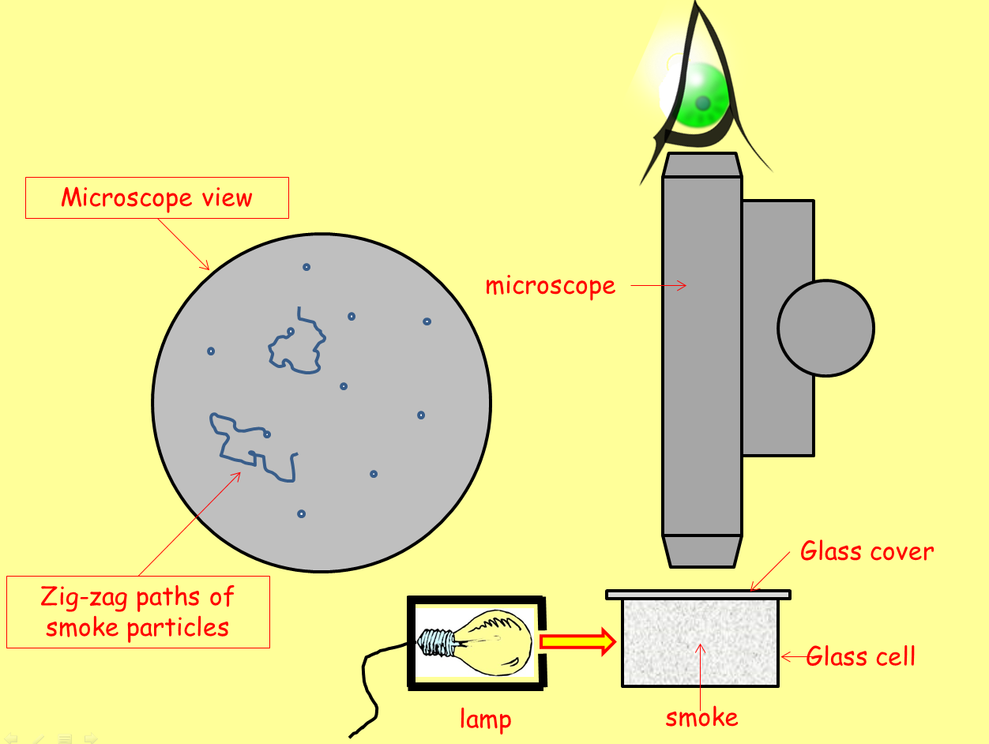
BROWNIAN motion
Explanation
Viewed through a microscope, smoke can be seen to be made up of millions of tiny bits or particles. The bits of smoke glint in the light from the lamp.

Slide 29
BROWNIAN motion
Explanation
Viewed through a microscope, smoke can be seen to be made up of millions of tiny bits or particles. The bits of smoke glint in the light from the lamp.
As they drift through the air they are seen to wobble in zig-zag paths. This was first noticed in 1827 by Robert Brown. The effect is called Brownian motion.

Slide 30
BROWNIAN motion
Explanation
Viewed through a microscope, smoke can be seen to be made up of millions of tiny bits or particles. The bits of smoke glint in the light from the lamp.
Kinetic theory can explain Brownian motion – the bits of smoke, just large enough to be seen, have so little mass that they are ‘jostled’ about by thousands of surrounding gas particles that bump into them at random.
As they drift through the air they are seen to wobble in zig-zag paths. This was first noticed in 1827 by Robert Brown. The effect is called Brownian motion.

Slide 31
Internal energy
Particles in solids, liquids and gases have kinetic energy (movement) and stored potential energy. Gases have the most PE.

Slide 32
Internal energy
Particles in solids, liquids and gases have kinetic energy (movement) and stored potential energy. Gases have the most PE.
The total KE and PE of all atoms and molecules in a material is called the internal energy. The hotter a material, the faster the particles move, and the more internal energy it has.

Slide 33
Internal energy
Particles in solids, liquids and gases have kinetic energy (movement) and stored potential energy. Gases have the most PE.
The total KE and PE of all atoms and molecules in a material is called the internal energy. The hotter a material, the faster the particles move, and the more internal energy it has.
If a hot material is in contact with a cold material, energy is transferred = HEAT. The hot material loses internal energy, the cold material gains internal energy.

Slide 34
Internal energy
Particles in solids, liquids and gases have kinetic energy (movement) and stored potential energy. Gases have the most PE.
The total KE and PE of all atoms and molecules in a material is called the internal energy. The hotter a material, the faster the particles move, and the more internal energy it has.
The term thermal energy is often used for both internal energy and heat.
If a hot material is in contact with a cold material, energy is transferred = HEAT. The hot material loses internal energy, the cold material gains internal energy.

Slide 35
LEARNING OBJECTIVES
2.1.1 States of matter Core • State the distinguishing properties of solids, liquids and gases 2.1.2 Molecular model Core • Describe qualitatively the molecular structure of solids, liquids and gases in terms of the arrangement, separation and motion of the molecules • Interpret the temperature of a gas in terms of the motion of its molecules • Describe qualitatively the pressure of a gas in terms of the motion of its molecules • Show an understanding of the random motion of particles in a suspension as evidence for the kinetic molecular model of matter • Describe this motion (sometimes known as Brownian motion) in terms of random molecular bombardment | Supplement • Relate the properties of solids, liquids and gases to the forces and distances between molecules and to the motion of the molecules Explain pressure in terms of the change of momentum of the particles striking the walls creating a force • Show an appreciation that massive particles may be moved by light, fast- moving molecules

Slide 36
Gases and Pressure
Kinetic theory tells us that gases consist of very small particles that are constantly moving in completely random directions.

Slide 37
Gases and Pressure
Kinetic theory tells us that gases consist of very small particles that are constantly moving in completely random directions.
The particles have mass, so whenever they collide with something they exert a force on it. In sealed containers, gas particles will smash against the walls of the container – creating an outward pressure.

Slide 38
Gases and Pressure
Kinetic theory tells us that gases consist of very small particles that are constantly moving in completely random directions.
The particles have mass, so whenever they collide with something they exert a force on it. In sealed containers, gas particles will smash against the walls of the container – creating an outward pressure.
If the same amount of gas is put into a bigger container, there will be fewer collisions with the walls of the container, so the pressure will decrease.

Slide 39
Gases and Pressure
Kinetic theory tells us that gases consist of very small particles that are constantly moving in completely random directions.
The particles have mass, so whenever they collide with something they exert a force on it. In sealed containers, gas particles will smash against the walls of the container – creating an outward pressure.
If the same amount of gas is put into a bigger container, there will be fewer collisions with the walls of the container, so the pressure will decrease.
If a smaller container is used then there will be more collisions with the walls as the particles are being squashed closer together. The pressure will increase.

Slide 40
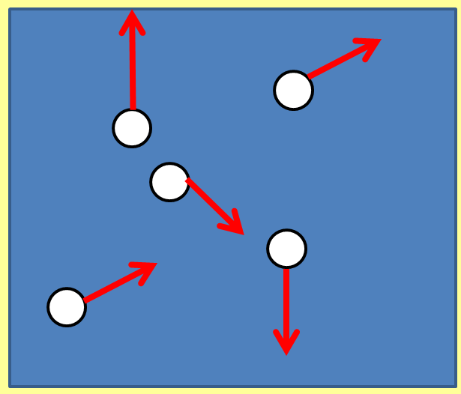
Gases and Pressure
The volume of a gas is inversely proportional to its pressure (at a constant temperature).

Slide 41
Gases and Pressure
The volume of a gas is inversely proportional to its pressure (at a constant temperature).
As the volume gets bigger, the gas pressure goes down (and vice versa).

Slide 42
LEARNING OBJECTIVES
2.1.1 States of matter Core • State the distinguishing properties of solids, liquids and gases 2.1.2 Molecular model Core • Describe qualitatively the molecular structure of solids, liquids and gases in terms of the arrangement, separation and motion of the molecules • Interpret the temperature of a gas in terms of the motion of its molecules • Describe qualitatively the pressure of a gas in terms of the motion of its molecules • Show an understanding of the random motion of particles in a suspension as evidence for the kinetic molecular model of matter • Describe this motion (sometimes known as Brownian motion) in terms of random molecular bombardment | Supplement • Relate the properties of solids, liquids and gases to the forces and distances between molecules and to the motion of the molecules Explain pressure in terms of the change of momentum of the particles striking the walls creating a force • Show an appreciation that massive particles may be moved by light, fast- moving molecules

Slide 43
PHYSICS – Simple kinetic molecular model of matter (1).

