Slide 1
PHYSICS – Density

Slide 2
LEARNING OBJECTIVES
1.4 Density Core • Recall and use the equation ρ = m/V • Describe an experiment to determine the density of a liquid and of a regularly shaped solid and make the necessary calculation • Describe the determination of the density of an irregularly shaped solid by the method of displacement • Predict whether an object will float based on density data

Slide 3
SI units
(Le Systeme International d’Unites)

Slide 4
SI units
1m
(Le Systeme International d’Unites)
Volume → cubic metre (m³)
1m
1m

Slide 5
SI units
1m
(Le Systeme International d’Unites)
Volume → cubic metre (m³)
1m
1 cubic metre = 1m x 1m x 1m
1m

Slide 6
SI units
1m
(Le Systeme International d’Unites)
Volume → cubic metre (m³)
1m
1 cubic metre (1m³)
= 1000 litres (l)
1 cubic metre = 1m x 1m x 1m
1m

Slide 7
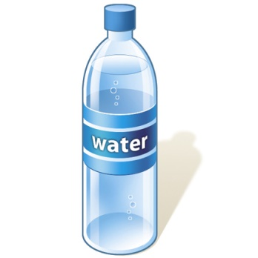
1 litre bottle = 1l
Same as 1 cubic decimetre (dm³)

Slide 8
1 litre bottle = 1l
Same as 1 cubic decimetre (dm³)
1 litre = 1000 cubic centimetres (cm³)
= 1000 millilitres (ml)

Slide 9
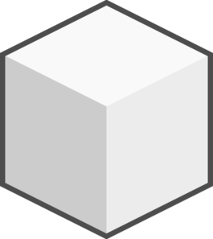
1 litre bottle = 1l
Same as 1 cubic decimetre (dm³)
1 litre = 1000 cubic centimetres (cm³)
= 1000 millilitres (ml)
1 cm
1 cm
1 cm
1 cubic centimetre (cm³) = 1 millilitre (ml)

Slide 10
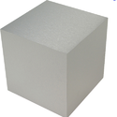
1 litre bottle = 1l
Same as 1 cubic decimetre (dm³)
1 litre = 1000 cubic centimetres (cm³)
= 1000 millilitres (ml)
1 cm
Aluminium
Lead
1 cm
1 cm
For any given volume (eg. 1cm³) lead is heavier than aluminium. It has a higher DENSITY
1 cubic centimetre (cm³) = 1 millilitre (ml)

Slide 11
DENSITY = Mass
Volume

Slide 12
DENSITY = Mass
Volume
Water has a density of
1 g/cm³
1000 cm³ of water (1 litre) therefore has a mass of 1000g (1 kilogram)

Slide 13
DENSITY = Mass
Volume
Substance | Density (g/cm³)
Wood | 0.75
Ice | 0.92
Water | 1.00
Aluminium | 2.70
Copper | 8.90
Lead | 11.4
Water has a density of
1 g/cm³
1000 cm³ of water (1 litre) therefore has a mass of 1000g (1 kilogram)

Slide 14
THINK!
A solid object with a density lower than that of water will float.
So why should a battleship made of aluminium not sink?
DENSITY = Mass
Volume
Substance | Density (g/cm³)
Wood | 0.75
Ice | 0.92
Water | 1.00
Aluminium | 2.70
Copper | 8.90
Lead | 11.4
Water has a density of
1 g/cm³
1000 cm³ of water (1 litre) therefore has a mass of 1000g (1 kilogram)

Slide 15
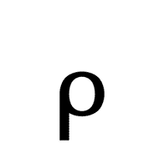
Calculating density
In the density equation, density is shown by the Greek letter ‘rho’ =
DENSITY = Mass
Volume
= m
V

Slide 16
Calculating density
In the density equation, density is shown by the Greek letter ‘rho’ =
DENSITY = Mass
Volume
= m
V
m
V = m
m = V x
V

Slide 17
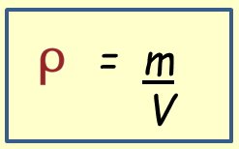
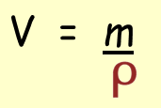
Calculating density
Eg. What is the density of a block of steel if it has a mass of 9,360g and a volume of 1,200cm³?
m
V

Slide 18
Calculating density
Eg. What is the density of a block of steel if it has a mass of 9,360g and a volume of 1,200cm³?
m
V
= 9 360
1 200
= 7.8 g/cm3

Slide 19
Calculating density
Eg. What is the density of a block of steel if it has a mass of 9,360g and a volume of 1,200cm³?
m
V
= 9 360
1 200
= 7.8 g/cm3
Eg. What is the mass of a block of gold if it has a density of 19.3 g/cm³ and a volume of 540 cm³?
m = 540 x 19.3 = 10,422g

Slide 20
Calculating density
Eg. What is the density of a block of steel if it has a mass of 9,360g and a volume of 1,200cm³?
m
V
= 9 360
1 200
= 7.8 g/cm3
Eg. What is the mass of a block of gold if it has a density of 19.3 g/cm³ and a volume of 540 cm³?
Eg. What is the volume of a block of ice if it has a density of 0.92 g/cm³ and a mass of 12,462g?
m = 540 x 19.3 = 10,422g

Slide 21
Calculating density
Eg. What is the density of a block of steel if it has a mass of 9,360g and a volume of 1,200cm³?
m
V
= 9 360
1 200
= 7.8 g/cm3
Eg. What is the mass of a block of gold if it has a density of 19.3 g/cm³ and a volume of 540 cm³?
Eg. What is the volume of a block of ice if it has a density of 0.92 g/cm³ and a mass of 12,462g?
m = 540 x 19.3 = 10,422g
V = 12 462 = 13,546cm³
0.92

Slide 22
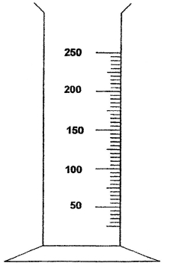
Volume and Density
Volume of a liquid
Measuring cylinder
Read off the level on the scale to get the volume of liquid

Slide 23
Volume and Density
Volume of a regular solid
Length
Height
Width
Volume of rectangular block = length x width x height

Slide 24
Volume and Density
Volume of a regular solid
Length
Radius
Height
Height
Width
Volume of rectangular block = length x width x height
Volume of a cylinder= π x radius² x height

Slide 25
Volume and Density
Volume of an irregular solid
Read off the level on the scale before adding the irregular solid, and again after the solid has been put into the measuring cylinder.
Volume of irregular solid =
Volume after – volume before
Eg. 235 – 155 = 80cm³

Slide 26
Volume and Density
Volume of an irregular solid
Using a Eureka (displacement) can
Fill the Eureka can until it stops over-flowing.
Gently lower the irregular solid into the can and measure how much displaced liquid is collected in the measuring cylinder.

Slide 27
Volume and Density
Volume of an irregular solid
Using a Eureka (displacement) can
Mass of irregular solid = 350g
Volume of irregular solid = 80cm³
Density = mass / volume
Density = 350 / 80 = 4.375g/cm³

Slide 28
LEARNING OBJECTIVES
1.4 Density Core • Recall and use the equation ρ = m/V • Describe an experiment to determine the density of a liquid and of a regularly shaped solid and make the necessary calculation • Describe the determination of the density of an irregularly shaped solid by the method of displacement • Predict whether an object will float based on density data

Slide 29
PHYSICS – Density

