Slide 1
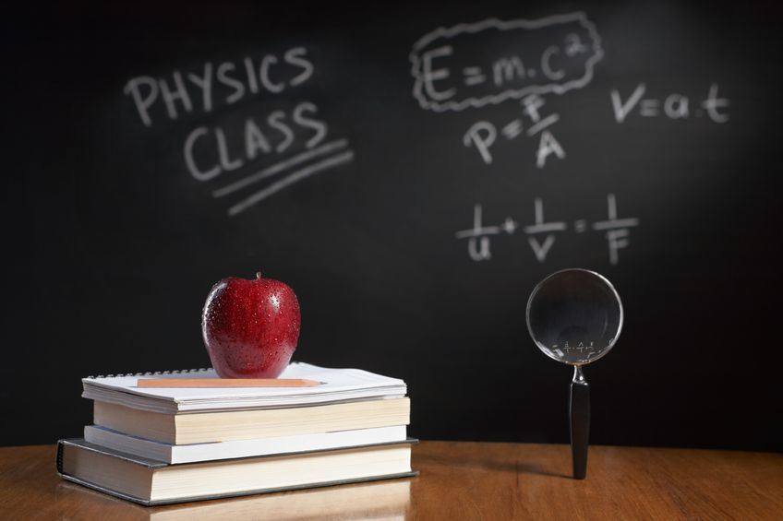
PHYSICS – Energy

Slide 2
LEARNING OBJECTIVES
1.7.1 Energy Core • Identify changes in kinetic, gravitational potential, chemical, elastic (strain), nuclear and internal energy that have occurred as a result of an event or process • Recognise that energy is transferred during events and processes, including examples of transfer by forces (mechanical working), by electrical currents (electrical working), by heating and by waves • Apply the principle of conservation of energy to simple examples | Supplement • Recall and use the expressions kinetic energy = ½mv² and change in gravitational potential energy = mg∆h • Apply the principle of conservation of energy to examples involving multiple stages • Explain that in any event or process the energy tends to become more spread out among the objects and surroundings (dissipated)

Slide 3
Work, work, work ……

Slide 4
Work, work, work ……
When a force moves an object it does work and energy is transferred to the object.

Slide 5
When a force moves an object it does work and energy is transferred to the object.
Work, work, work ……
Energy supplied
Work done
Energy transferred

Slide 6
When a force moves an object it does work and energy is transferred to the object.
Work, work, work ……
Energy supplied
Work done
Energy transferred
Amount of energy transferred (J) = Work done (J)

Slide 7
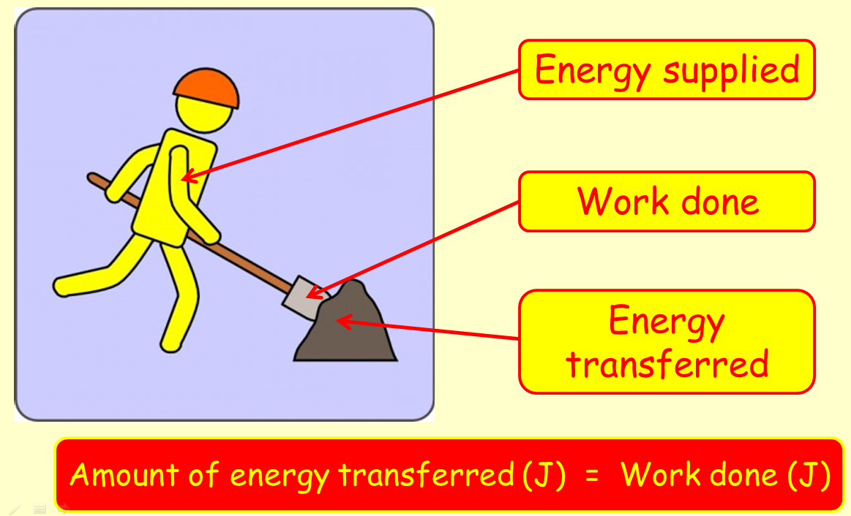
Work, work, work ……
When a force moves an object it does work and energy is transferred to the object.
The man shovelling is doing work. If he does 600J of work, then he loses 600J of energy. The substance being shovelled gains energy - but not the full 600J, as some is lost as sound and heat.

Slide 8
Work
Work is done whenever a force makes something move.

Slide 9
Work
Work is done whenever a force makes something move.
The greater the force, and the greater the distance moved, the more work is done.

Slide 10
Work
Work is done whenever a force makes something move.
The greater the force, and the greater the distance moved, the more work is done.
When work is done energy is transferred from one form into another.

Slide 11
Work
Work done = force x distance
W = F x d
Work is measured in Joules

Slide 12
Work
Work done = force x distance
Eg. if a 4 N force moves a distance of 3m
W = 4 x 3 = 12 J

Slide 13
Work
Work
W
Force
F
d
Distance

Slide 14
Work
Work
W = F x d
W
Force
F
d
Distance

Slide 15
Work
Work
W = F x d
W
F = W
d
Force
F
d
Distance

Slide 16
Work
Work
W = F x d
W
F = W
d
Force
F
d
d = W
F
Distance

Slide 17
Types of energy……

Slide 18
Types of energy……
Types of energy
Kinetic
GPE
Elastic PE
Chemical
Electrical
Nuclear
Light
Sound
Heat

Slide 19
Types of energy……
Energy in a moving object, eg. A moving car
Types of energy
Kinetic
GPE
Elastic PE
Chemical
Electrical
Nuclear
Light
Sound
Heat

Slide 20
Types of energy……
Energy in a moving object, eg. A moving car
Types of energy
Kinetic
GPE
Elastic PE
Chemical
Electrical
Nuclear
Light
Sound
Heat
Energy due to the height of an object, eg. A skier on a slope

Slide 21
Types of energy……
Energy in a moving object, eg. A moving car
Types of energy
Kinetic
GPE
Elastic PE
Chemical
Electrical
Nuclear
Light
Sound
Heat
Energy due to the height of an object, eg. A skier on a slope
Energy in a stretched or compressed object, eg. a spring

Slide 22
Types of energy……
Energy in a moving object, eg. A moving car
Types of energy
Kinetic
GPE
Elastic PE
Chemical
Electrical
Nuclear
Light
Sound
Heat
Energy due to the height of an object, eg. A skier on a slope
Energy in a stretched or compressed object, eg. a spring
Energy contained in food or fuel, eg. Food and petrol

Slide 23
Types of energy……
Energy in a moving object, eg. A moving car
Types of energy
Kinetic
GPE
Elastic PE
Chemical
Electrical
Nuclear
Light
Sound
Heat
Energy due to the height of an object, eg. A skier on a slope
Energy in a stretched or compressed object, eg. a spring
Energy contained in food or fuel, eg. Food and petrol
Energy in the flow of electrons, eg. A battery

Slide 24
Types of energy……
Energy in a moving object, eg. A moving car
Types of energy
Kinetic
GPE
Elastic PE
Chemical
Electrical
Nuclear
Light
Sound
Heat
Energy due to the height of an object, eg. A skier on a slope
Energy in a stretched or compressed object, eg. a spring
Energy contained in food or fuel, eg. Food and petrol
Energy released when the nucleus of an atom splits
Energy in the flow of electrons, eg. A battery

Slide 25
Types of energy……
Energy in a moving object, eg. A moving car
Types of energy
Kinetic
GPE
Elastic PE
Chemical
Electrical
Nuclear
Light
Sound
Heat
Energy due to the height of an object, eg. A skier on a slope
Energy in a stretched or compressed object, eg. a spring
Energy given out by any hot object, eg. The Sun, light bulb.
Energy contained in food or fuel, eg. Food and petrol
Energy released when the nucleus of an atom splits
Energy in the flow of electrons, eg. A battery

Slide 26
Types of energy……
Energy in a moving object, eg. A moving car
Types of energy
Kinetic
GPE
Elastic PE
Chemical
Electrical
Nuclear
Light
Sound
Heat
Energy due to the height of an object, eg. A skier on a slope
Energy given out by vibrating objects, eg. A loud speaker
Energy in a stretched or compressed object, eg. a spring
Energy given out by any hot object, eg. The Sun, light bulb.
Energy contained in food or fuel, eg. Food and petrol
Energy released when the nucleus of an atom splits
Energy in the flow of electrons, eg. A battery

Slide 27
Types of energy……
Energy in a moving object, eg. A moving car
Types of energy
Kinetic
GPE
Elastic PE
Chemical
Electrical
Nuclear
Light
Sound
Heat
Energy contained in any hot or warm object, eg. Burning coal
Energy due to the height of an object, eg. A skier on a slope
Energy given out by vibrating objects, eg. A loud speaker
Energy in a stretched or compressed object, eg. a spring
Energy given out by any hot object, eg. The Sun, light bulb.
Energy contained in food or fuel, eg. Food and petrol
Energy released when the nucleus of an atom splits
Energy in the flow of electrons, eg. A battery

Slide 28
Types of energy……
Gravitational Potential Energy
Kinetic energy

Slide 29
Potential Energy
Potential energy is the energy due to height.
Potential energy (PE) = mass x g x height
(g is the gravitational constant = 10 m/s²)

Slide 30
Potential Energy
Eg. A sheep of mass 47kg is slowly raised through a height of 6.3m. Find the gain in potential energy.
PE = mgh = 47 x 10 x 6.3 = 2961J
As an object falls, its potential energy is changed into kinetic energy.
Kinetic energy GAINED = Potential energy LOST

Slide 31
Kinetic Energy
Kinetic energy is the energy of movement.
Anything moving has kinetic energy.
Kinetic energy (KE) = ½ x mass x velocity²
Or KE = ½ x mass x velocity x velocity

Slide 32
Kinetic Energy
Eg. A car of mass 2450kg is travelling at 38m/s. Calculate its kinetic energy.
KE = ½ x 2450 x 38² = 1,768,900J
KE depends upon mass and speed, so a larger object travelling at greater speed has a bigger KE.

Slide 33
Types of energy……
Let’s have a look at a more challenging calculation involving GPE and KE

Slide 34
Eg. A mouldy tomato of mass 140g is dropped from a height of 1.7m. Calculate its speed as it hits the floor.
PE lost = mgh = 0.14 x 10 x 1.7 = 2.38 J
So KE gained = PE lost = 2.38 J = ½ mv²
So, 2.38 = ½ x 0.14 x v² = 0.07 x v²
So, 2.38 = v²
0.07
5. So, 34 = v² ; v = 5.38 m/s

Slide 35
LEARNING OBJECTIVES
1.7.1 Energy Core • Identify changes in kinetic, gravitational potential, chemical, elastic (strain), nuclear and internal energy that have occurred as a result of an event or process • Recognise that energy is transferred during events and processes, including examples of transfer by forces (mechanical working), by electrical currents (electrical working), by heating and by waves • Apply the principle of conservation of energy to simple examples | Supplement • Recall and use the expressions kinetic energy = ½mv² and change in gravitational potential energy = mg∆h • Apply the principle of conservation of energy to examples involving multiple stages • Explain that in any event or process the energy tends to become more spread out among the objects and surroundings (dissipated)

Slide 36
Energy transfer

Slide 37
Energy transfer
Energy is transferred from cells and other sources

Slide 38
Energy transfer
Energy is transferred from cells and other sources
Anything that supplies electricity is also supplying energy. So cells, batteries, generators, etc. all transfer energy to the charge in the wire, which then transfers it to the components or devices in the circuit:

Slide 39
M
Energy transfer
Energy is transferred from cells and other sources
Anything that supplies electricity is also supplying energy. So cells, batteries, generators, etc. all transfer energy to the charge in the wire, which then transfers it to the components or devices in the circuit:
Power supply provides the energy
M
Kinetic energy
Light energy
Heat energy
230 V
Sound energy

Slide 40
Energy transfer
We can also use a Sankey diagram to show energy transfer

Slide 41
Energy transfer
We can also use a Sankey diagram to show energy transfer
A Sankey diagram makes it easier to see how much input energy is being usefully employed compared with how much is being wasted. The thicker the arrow, the more energy it represents.

Slide 42
Energy transfer
We can also use a Sankey diagram to show energy transfer
A Sankey diagram makes it easier to see how much input energy is being usefully employed compared with how much is being wasted. The thicker the arrow, the more energy it represents.
USEFUL SOUND ENERGY
ENERGY INPUT
USEFUL LIGHT ENERGY
WASTED HEAT ENERGY
Eg. Television set

Slide 43
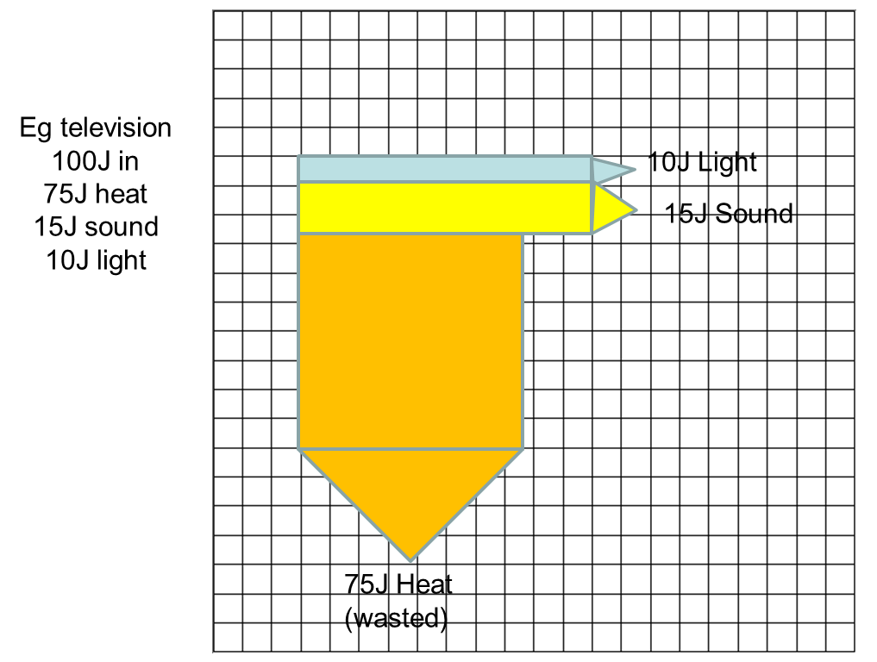
Energy transfer
We can also use a Sankey diagram to show energy transfer

Slide 44
Energy transfer
We can also use a Sankey diagram to show energy transfer
Eg. Throwing a stone
Thermal energy (wasted in body)
Thermal energy (wasted because of air resistance)
Chemical energy in muscles
Thermal energy
Sound
Kinetic energy
Potential energy
Kinetic energy
Thermal energy (in ground and stone)
Stone thrown upwards
Stone at highest point
Stone hits the ground

Slide 45
Describe the energy changes taking place in a roller coaster ride.

Slide 46
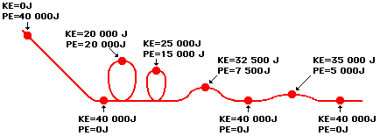
As it travels around the track, energy changes from GPE to KE and back again

Slide 47
Total energy at any one time = KE + GPE

Slide 48
When there are no resistive forces, total energy remains constant.

Slide 49
This is known as the principle of conservation of energy.

Slide 50
Energy cannot be created or destroyed, but only changed from one form into another.

Slide 51
Usually, some energy is used up doing work against friction and air resistance → lost as heat.

Slide 52
LEARNING OBJECTIVES
1.7.1 Energy Core • Identify changes in kinetic, gravitational potential, chemical, elastic (strain), nuclear and internal energy that have occurred as a result of an event or process • Recognise that energy is transferred during events and processes, including examples of transfer by forces (mechanical working), by electrical currents (electrical working), by heating and by waves • Apply the principle of conservation of energy to simple examples | Supplement • Recall and use the expressions kinetic energy = ½mv² and change in gravitational potential energy = mg∆h • Apply the principle of conservation of energy to examples involving multiple stages • Explain that in any event or process the energy tends to become more spread out among the objects and surroundings (dissipated)

Slide 53
PHYSICS – Energy

