Slide 1
PHYSICS – Energy Resources

Slide 2
LEARNING OBJECTIVES
1.7.2 Energy resources Core • Describe how electricity or other useful forms of energy may be obtained from: – chemical energy stored in fuel – water, including the energy stored in waves, in tides, and in water behind hydroelectric dams – geothermal resources – nuclear fission – heat and light from the Sun (solar cells and panels) – wind • Give advantages and disadvantages of each method in terms of renewability, cost, reliability, scale and environmental impact • Show a qualitative understanding of efficiency | Supplement • Understand that the Sun is the source of energy for all our energy resources except geothermal, nuclear and tidal • Show an understanding that energy is released by nuclear fusion in the Sun • Recall and use the equation: efficiency = useful energy output energy input × 100% • efficiency = useful power output Power input × 100%

Slide 3
Electricity
Electricity is known as a secondary energy source because it is produced using primary energy sources (eg. Coal, nuclear fuel, wind power).

Slide 4
How is electricity generated?
Hydroelectric
Electricity

Slide 5
How is electricity generated?
Wind
Hydroelectric
Electricity

Slide 6
How is electricity generated?
Wind
Hydroelectric
Nuclear
Electricity

Slide 7
How is electricity generated?
Wind
Hydroelectric
Nuclear
Electricity
Solar

Slide 8
How is electricity generated?
Wind
Hydroelectric
Nuclear
Electricity
Solar
Tidal

Slide 9
How is electricity generated?
Wind
Hydroelectric
Nuclear
Electricity
Fossil Fuels
Solar
Tidal

Slide 10
Electricity
Electricity is known as a secondary energy source because it is produced using primary energy sources (eg. Coal, nuclear fuel, wind power).
NON-RENEWABLE SOURCES
Fossil fuels – coal, oil and natural gas
Nuclear fuels (uranium and plutonium)
They will all ‘run out’ one day.
They all damage the environment
They currently provide most of our energy.

Slide 11
Electricity
Electricity is known as a secondary energy source because it is produced using primary energy sources (eg. Coal, nuclear fuel, wind power).
RENEWABLE SOURCES
Wind 2. Waves 3. Tides
Hydroelectric 5. Biofuels
Geothermal 7. Solar (from Sun)
They will never run out.
They do much less damage to the environment.
They don’t provide much energy and can be unreliable if they depend on the weather.
NON-RENEWABLE SOURCES
Fossil fuels – coal, oil and natural gas
Nuclear fuels (uranium and plutonium)
They will all ‘run out’ one day.
They all damage the environment
They currently provide most of our energy.

Slide 12
Generating electricity
3 stages:
Boiler
Turbine
Generator

Slide 13
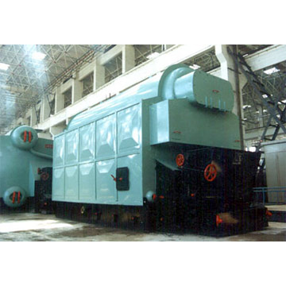
Generating electricity
In the boiler fuel burns to heat water. The water turns into steam.
Fuels used may be coal, oil or gas.

Slide 14
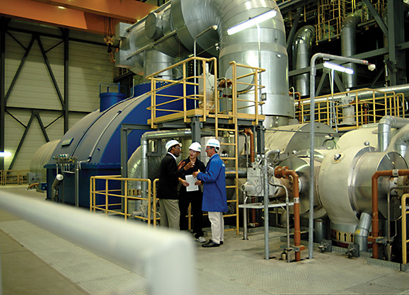
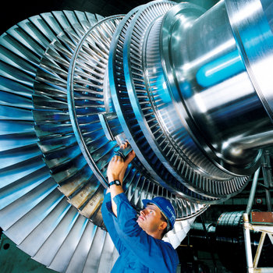
Generating electricity
Steam travels along pipes and makes the turbine spin.

Slide 15
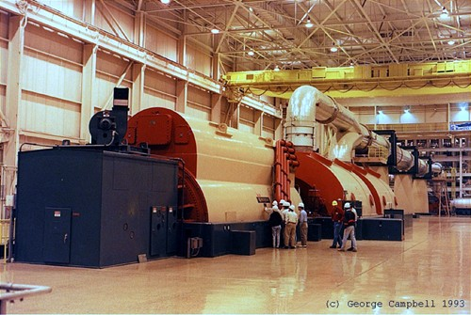
Generating electricity
The turbine turns a generator.
Inside the generator there is a magnet inside a coil of wire.
As the magnet spins, electricity is generated.

Slide 16
Let’s just repeat the basics:-
Energy source
The steam (or water / wind) turns a turbine
The generator converts the movement of the turbine (kinetic energy) into electricity.

Slide 17
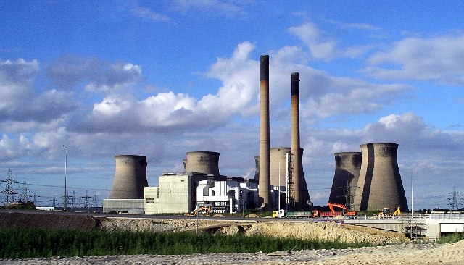
Advantages: fuels are readily available, they are relatively cheap, and are not reliant upon the weather.
Disadvantages: highly polluting, contributing to global warming and climate change. Burning fossil fuels can produce acid rain. Oil spillages cause serious damage to the environment.
Fossil fuels
The steam (or water / wind) turns a turbine
http://en.wikipedia.org/wiki/Ferrybridge_power_stations
The generator converts the movement of the turbine (kinetic energy) into electricity.
In a fossil fuel power station coal, oil or natural gas burn, releasing heat energy which is used to turn water into steam.

Slide 18
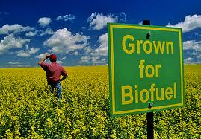
Advantages: relatively quick and natural sources of energy and are considered to be carbon neutral (do not release additional carbon dioxide into the atmosphere).
Disadvantages: natural habitats may be cleared to make way for biofuel crops, and some food crops may be lost.
Biofuels
The steam (or water / wind) turns a turbine
http://www.climatetechwiki.org/technology/agriculture-biofuel-production
Biofuels are renewable energy sources. They can be solids (eg. Straw, woodchip), liquids (eg. Ethanol) or gases (eg. Methane biogas from sludge digesters).
They are burnt to turn water into steam, which drives the turbine and producing electricity in the generator.
The generator converts the movement of the turbine (kinetic energy) into electricity.

Slide 19
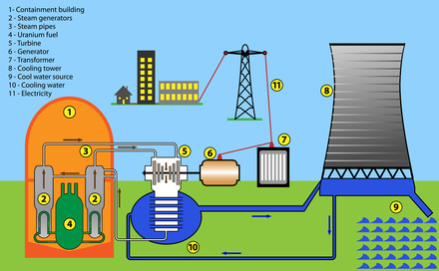
Nuclear energy
The steam (or water / wind) turns a turbine
Nuclear fission, involving the splitting of atoms of a nuclear fuel (eg. Uranium) releases a lot of heat energy.
Water is used as a coolant to take away this heat energy, which is used to produce steam to drive a turbine which then turns the generator.
The main disadvantage of a nuclear power station is that radioactive waste is produced. This can be very dangerous and difficult to dispose of.
The generator converts the movement of the turbine (kinetic energy) into electricity.

Slide 20
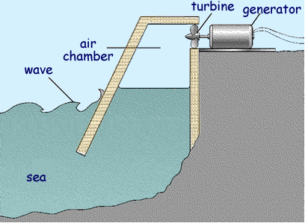
Advantages: no pollution, no fuel costs, minimal running costs. Can be very useful on small islands.
Disadvantages: hazard to boats, can be an eyesore, fairly unreliable as waves disappear when the wind drops, initial costs can be very high, environmental impact.
Wave Power
The steam (or water / wind) turns a turbine
http://www.cyberphysics.co.uk/Q&A/KS3/energy/Sources/Q5.html
The generator converts the movement of the turbine (kinetic energy) into electricity.
As waves come in to the shore they provide up and down motion which can be used to directly drive a turbine which is linked to a generator.
The waves force the air through the turbine, causing it to spin.

Slide 21
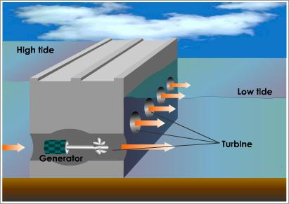
Advantages: no pollution, no fuel costs, minimal running costs. Tides are reliable, and barrages are excellent for storing energy.
Disadvantages: hazard to boats, can be an eyesore, initial costs can be very high, environmental impact. Height of the tide is variable, so energy output varies.
Tidal Power
The steam (or water / wind) turns a turbine
http://www.tutorvista.com/content/physics/physics-ii/fission-and-fusion/tidal-power.php
The generator converts the movement of the turbine (kinetic energy) into electricity.
Tidal barrages are big dams built across river estuaries. As the tide comes in it fills the estuary – the water is released so that the turbines are turned at a controlled speed. The source of the energy is the gravity of the Sun and the Moon.

Slide 22
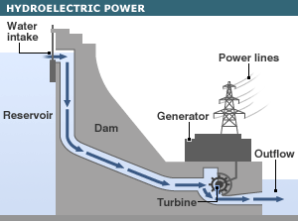
Advantages: no pollution, no fuel costs, minimal running costs. Immediate response to increased demand, and fairly reliable.
Disadvantages: flooding a valley has a big impact on the environment, with much loss of habitats. Initial costs are high. Adversely affected during times of drought.
Hydroelectric Power
The steam (or water / wind) turns a turbine
http://news.bbc.co.uk/1/shared/spl/hi/sci_nat/06/global_energy/html/hydrowind.stm
The generator converts the movement of the turbine (kinetic energy) into electricity.
Hydroelectric power usually involves flooding a valley to form a reservoir behind a big dam. As water is released from the reservoir it falls through the dam and turns the turbines, which then spin the generators which in turn produce electricity.

Slide 23
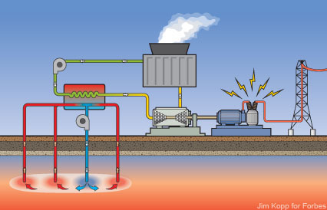
Geothermal Energy
Advantages: free, renewable energy source. No real environmental problems.
Disadvantages: cost of drilling down several km to the hot rocks.
The steam (or water / wind) turns a turbine
http://polizeros.com/2010/09/02/geothermal-power-gaining-attention/
The generator converts the movement of the turbine (kinetic energy) into electricity.
Used where hot rocks lie quite near to the surface. Cold water is pumped in pipes down to the hot rocks, and returns as steam to drive the turbines. Unfortunately there are very few places where this is an economic option.

Slide 24
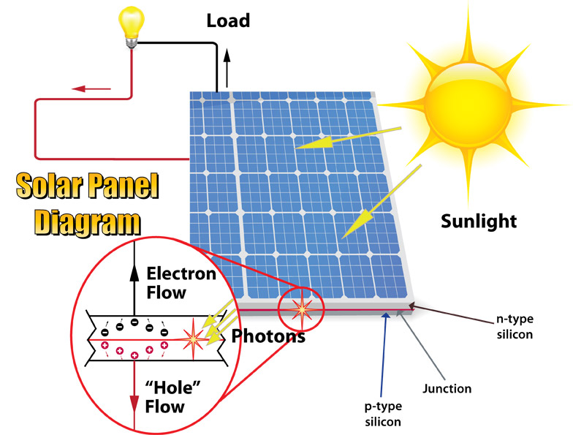
Solar cells
Advantages: no pollution, a very reliable source in sunny countries. Energy is free, and running costs are almost nil.
Disadvantages: initially very expensive, and a developing technology. Only produce electricity in daytime.
The steam (or water / wind) turns a turbine
http://etap.com/renewable-energy/photovoltaic-101.htm
The generator converts the movement of the turbine (kinetic energy) into electricity.
Solar cells generate electricity directly from sunlight. Solar cells are usually used to provide electricity on a relatively small scale, such as for individual houses. Solar cell ‘farms’ are being developed, but connecting to the National Grid can be expensive.

Slide 25
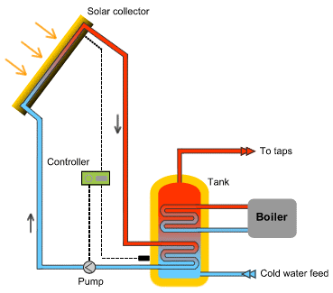
Solar panels
Advantages: no pollution, a very reliable source in sunny countries. Energy is free, and running costs are almost nil.
Disadvantages: Only heats water in daytime. Not used to produce electricity.
The steam (or water / wind) turns a turbine
http://www.west-norfolk.gov.uk/default.aspx?page=22430
The generator converts the movement of the turbine (kinetic energy) into electricity.
Solar panels use the Sun’s thermal radiation to warm up water for the house. A blackened layer behind the pipes helps the absorption of the radiant energy and the warming of the water flowing through the pipes.

Slide 26
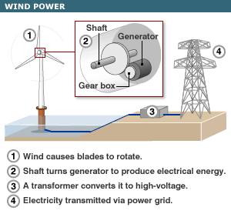
Wind Power
Advantages: no pollution. Energy is free, and running costs are almost nil.
Disadvantages: can be considered an eyesore, and there is some noise pollution. No power is produced when the wind drops.
The steam (or water / wind) turns a turbine
http://www.newhomewindpower.com/wind-power-generators.html
The generator converts the movement of the turbine (kinetic energy) into electricity.
Wind turbines are put up in exposed places, such as hilltops and around the coast. Each wind turbine has its own generator, so electricity is generated directly.

Slide 27
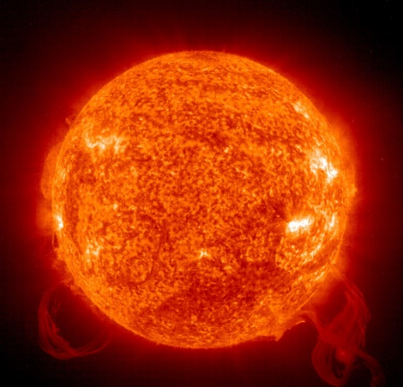
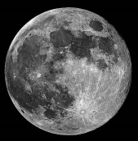
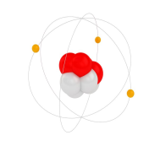
The Sun as the ultimate source of energy
The Sun radiates energy because of nuclear fusion reactions deep inside.
Tidal
Tides are created by the gravitational pull of the Moon on the Earth’s oceans.
Solar cells
Radioactive atoms release energy
Solar panels
Energy in plants
Weather systems
Nuclear
Solar panels
Wind
Geothermal
Solar panels
Waves
Hydroelectric

Slide 28
Efficiency
http://en.wikipedia.org/wiki/Ferrybridge_power_stations
A fossil fuel power station has an efficiency of about 33%.

Slide 29
Efficiency
This means that 1/3 of the heat energy released from the fuel gets turned into electricity.
http://en.wikipedia.org/wiki/Ferrybridge_power_stations
A fossil fuel power station has an efficiency of about 33%.

Slide 30
Efficiency
This means that 1/3 of the heat energy released from the fuel gets turned into electricity.
http://en.wikipedia.org/wiki/Ferrybridge_power_stations
The other 2/3 of the energy ends up as waste heat – it just warms up the power station and its surrounding environment.
A fossil fuel power station has an efficiency of about 33%.

Slide 31
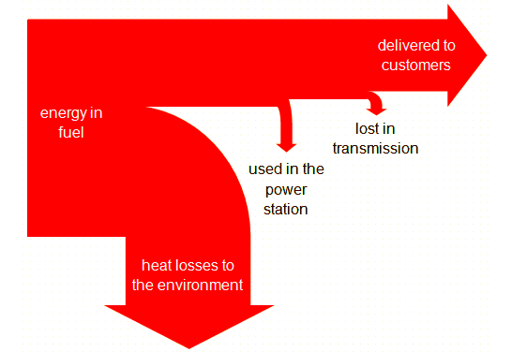
Efficiency
efficiency = useful energy output
energy input × 100%

Slide 32
Efficiency
1000J
372J
http://en.wikipedia.org/wiki/Ferrybridge_power_stations
efficiency = useful energy output
energy input × 100%
Overall efficiency = 372 x 100 = 37.2%
1000

Slide 33
Efficiency
1000J
372J
http://en.wikipedia.org/wiki/Ferrybridge_power_stations
efficiency = useful energy output
energy input × 100%
efficiency = useful power output
Power input × 100%
Overall efficiency = 372 x 100 = 37.2%
1000
You need to be aware of both equations!

Slide 34
LEARNING OBJECTIVES
1.7.2 Energy resources Core • Describe how electricity or other useful forms of energy may be obtained from: – chemical energy stored in fuel – water, including the energy stored in waves, in tides, and in water behind hydroelectric dams – geothermal resources – nuclear fission – heat and light from the Sun (solar cells and panels) – wind • Give advantages and disadvantages of each method in terms of renewability, cost, reliability, scale and environmental impact • Show a qualitative understanding of efficiency | Supplement • Understand that the Sun is the source of energy for all our energy resources except geothermal, nuclear and tidal • Show an understanding that energy is released by nuclear fusion in the Sun • Recall and use the equation: efficiency = useful energy output energy input × 100% • efficiency = useful power output Power input × 100%

Slide 35
PHYSICS – Energy Resources

