Slide 1
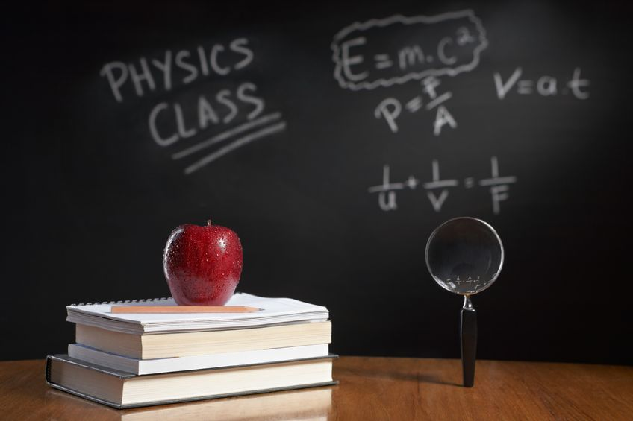
PHYSICS – Mass and Weight

Slide 2
LEARNING OBJECTIVES
1.3 Mass and weight Core • Show familiarity with the idea of the mass of a body • State that weight is a gravitational force • Distinguish between mass and weight • Recall and use the equation W = mg • Demonstrate understanding that weights (and hence masses) may be compared using a balance | Supplement • Demonstrate an understanding that mass is a property that ‘resists’ change in motion • Describe, and use the concept of, weight as the effect of a gravitational field on a mass

Slide 3
Mass, weight and gravity
‘g’ actually has two meanings:
g is the acceleration of free fall (10m/s²)

Slide 4
Mass, weight and gravity
‘g’ actually has two meanings:
g is the acceleration of free fall (10m/s²)
g is the gravitational field strength (10N/kg)

Slide 5
Mass, weight and gravity
Gravitational field strength is the force experienced by a mass due to gravitational attraction.

Slide 6
Mass, weight and gravity
Gravitational field strength is the force experienced by a mass due to gravitational attraction.
Weight is the term we use for the Earth’s gravitational force on an object.

Slide 7
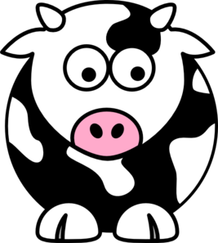
Mass, weight and gravity
Weight = mass x g
(where g = 10N/kg)

Slide 8
Mass, weight and gravity
Weight = mass x g
(where g = 10N/kg)
W = mg

Slide 9
Mass, weight and gravity
Weight = mass x g
(where g = 10N/kg)
W = mg
W = 1000 x 10

Slide 10
Mass, weight and gravity
Weight = mass x g
(where g = 10N/kg)
W = mg
W = 1000 x 10
W = 10,000N

Slide 11
Mass, weight and gravity
Weight = mass x g
(where g = 10N/kg)
W = mg
Remember: mass doesn’t change – it’s the gravitational force that may change

Slide 12
Mass, weight and gravity
 | Mass | Weight
In space | 1000kg | Zero
On the Mooon | 1000kg | 1,600N
On Earth | 1000kg | 10,000N

Slide 13
Mass, weight and gravity
6000N upward force from rocket engine
Mass 500kg
Weight

Slide 14
Mass, weight and gravity
6000N upward force from rocket engine
Mass 500kg
Weight
What is the acceleration of the rocket?

Slide 15
Mass, weight and gravity
W = mg
6000N upward force from rocket engine
Mass 500kg
Weight
What is the acceleration of the rocket?

Slide 16
Mass, weight and gravity
W = mg
W = 500 x 10
= 5000N
6000N upward force from rocket engine
Mass 500kg
Weight
What is the acceleration of the rocket?

Slide 17
Mass, weight and gravity
W = mg
W = 500 x 10
= 5000N
6000N upward force from rocket engine
Mass 500kg
Resultant force upwards
= upwards force – downwards force
Weight
What is the acceleration of the rocket?

Slide 18
Mass, weight and gravity
W = mg
W = 500 x 10
= 5000N
6000N upward force from rocket engine
Mass 500kg
Resultant force upwards
= upwards force – downwards force
= 6000 – 5000 = 1000N
Weight
What is the acceleration of the rocket?

Slide 19
Mass, weight and gravity
W = mg
W = 500 x 10
= 5000N
6000N upward force from rocket engine
Mass 500kg
Resultant force upwards
= upwards force – downwards force
= 6000 – 5000 = 1000N
Weight
Resultant force = mass x acceleration
What is the acceleration of the rocket?

Slide 20
Mass, weight and gravity
W = mg
W = 500 x 10
= 5000N
6000N upward force from rocket engine
Mass 500kg
Resultant force upwards
= upwards force – downwards force
= 6000 – 5000 = 1000N
Weight
Resultant force = mass x acceleration
1000 = 500 x a
1000 = a
500
Acceleration = 2 m/s²
What is the acceleration of the rocket?

Slide 21
LEARNING OBJECTIVES
1.3 Mass and weight Core • Show familiarity with the idea of the mass of a body • State that weight is a gravitational force • Distinguish between mass and weight • Recall and use the equation W = mg • Demonstrate understanding that weights (and hence masses) may be compared using a balance | Supplement • Demonstrate an understanding that mass is a property that ‘resists’ change in motion • Describe, and use the concept of, weight as the effect of a gravitational field on a mass

Slide 22
PHYSICS – Mass and Weight

