Slide 1
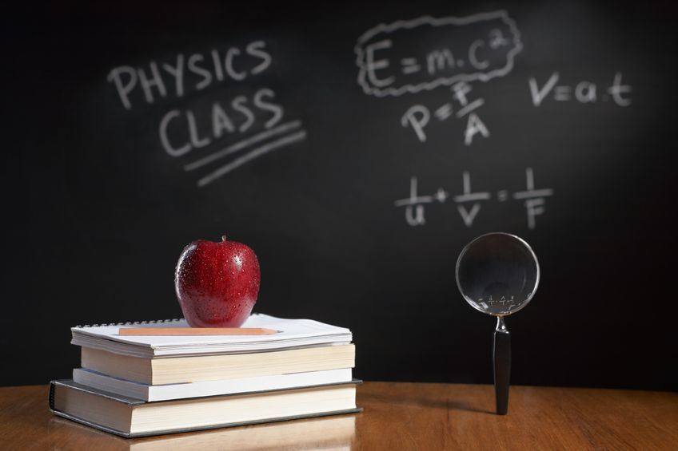
PHYSICS – Radioactivity

Slide 2
LEARNING OBJECTIVES
Core • Demonstrate understanding of background radiation • Describe the detection of α-particles, β-particles and γ-rays (β + are not included: β-particles will be taken to refer to β⁻) Discuss the random nature of radioactive emission Identify α, β and γ-emissions by recalling – their nature – their relative ionising effects – their relative penetrating abilities (β+ are not included, β-particles will be taken to refer to β–) | Supplement Describe their deflection in electric fields and in magnetic fields Interpret their relative ionising effects Give and explain examples of practical applications of α, β and γ-emissions

Slide 3
Background radiation
There is a small amount of radiation around us all the time because of radioactive materials in the environment. This is called background radiation.

Slide 4
There is a small amount of radiation around us all the time because of radioactive materials in the environment. This is called background radiation.
Background radiation
… comes from many sources

Slide 5
There is a small amount of radiation around us all the time because of radioactive materials in the environment. This is called background radiation.
Background radiation
… comes from many sources
Hold on a minute – how do we know about this ‘background radiation’ stuff?

Slide 6
There is a small amount of radiation around us all the time because of radioactive materials in the environment. This is called background radiation.
Background radiation
… comes from many sources
Hold on a minute – how do we know about this ‘background radiation’ stuff?
We can monitor levels of radiation using a Geiger-Muller tube and counter.

Slide 7
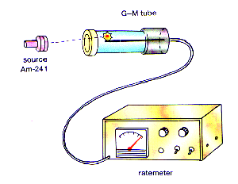
There is a small amount of radiation around us all the time because of radioactive materials in the environment. This is called background radiation.
Background radiation
… comes from many sources
Hold on a minute – how do we know about this ‘background radiation’ stuff?
When a radioactive particle enters the tube it ionises the gas inside and triggers an electrical discharge (spark) which make s a clicking sound.
We can monitor levels of radiation using a Geiger-Muller tube and counter.
http://ztopics.com/Geiger-Muller%20counter/
A signal is also sent to the electronic counter that registers an ongoing count of the number of ‘clicks’.

Slide 8
There is a small amount of radiation around us all the time because of radioactive materials in the environment. This is called background radiation.
Background radiation
… comes from many sources
Examiners are always keen to ask questions involving background radiation. Be careful, and look out for questions where you will be expected to subtract a value for background radiation!

Slide 9
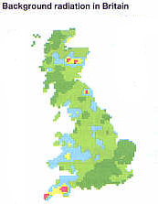
There is a small amount of radiation around us all the time because of radioactive materials in the environment. This is called background radiation.
Background radiation
… comes from many sources
……… such as naturally occurring unstable isotopes which are all around us – in the air, in food, in building materials and in the rocks under our feet.
http://www.darvill.clara.net/nucrad/sources.htm

Slide 10
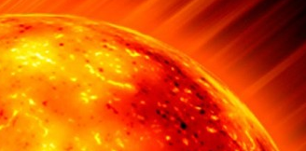
There is a small amount of radiation around us all the time because of radioactive materials in the environment. This is called background radiation.
Background radiation
… comes from many sources
……… such as naturally occurring unstable isotopes which are all around us – in the air, in food, in building materials and in the rocks under our feet.
Radiation from space, known as cosmic radiation, mostly from the Sun.
http://www.darvill.clara.net/nucrad/sources.htm

Slide 11
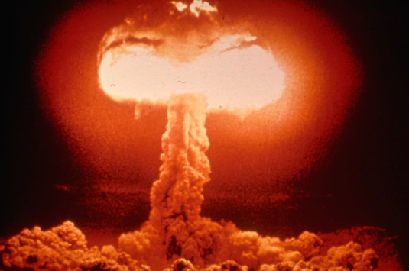
There is a small amount of radiation around us all the time because of radioactive materials in the environment. This is called background radiation.
Background radiation
… comes from many sources
……… such as naturally occurring unstable isotopes which are all around us – in the air, in food, in building materials and in the rocks under our feet.
Radiation from space, known as cosmic radiation, mostly from the Sun.
Radiation due to human activity, i.e. fallout from nuclear explosions, or dumped nuclear waste.
http://www.darvill.clara.net/nucrad/sources.htm

Slide 12
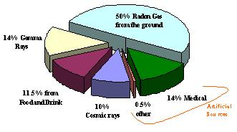
There is a small amount of radiation around us all the time because of radioactive materials in the environment. This is called background radiation.
Background radiation
… comes from many sources
http://www.brighton-hove.gov.uk/content/environment/air-quality-and-pollution/radiation-monitoring

Slide 13
There is a small amount of radiation around us all the time because of radioactive materials in the environment. This is called background radiation.
Background radiation
… comes from many sources
So what changes the level of background radiation?
At high altitudes (eg. In jet planes) it increases because of more exposure to cosmic rays.

Slide 14
There is a small amount of radiation around us all the time because of radioactive materials in the environment. This is called background radiation.
Background radiation
… comes from many sources
So what changes the level of background radiation?
Underground in mines, etc – it increases because of all the rocks around.
At high altitudes (eg. In jet planes) it increases because of more exposure to cosmic rays.

Slide 15
There is a small amount of radiation around us all the time because of radioactive materials in the environment. This is called background radiation.
Background radiation
… comes from many sources
So what changes the level of background radiation?
Underground in mines, etc – it increases because of all the rocks around.
At high altitudes (eg. In jet planes) it increases because of more exposure to cosmic rays.
Certain underground rocks can cause higher levels at the surface, especially if they release radioactive radon gas – this tends to become trapped in people’s houses. This depends upon the rock type beneath.

Slide 16
The three types of radiation

Slide 17
The three types of radiation
Alpha α
Beta β
Gamma γ

Slide 18
The three types of radiation
Alpha α
A helium nucleus, consisting of two protons and two neutrons.
A relative charge of +2.
A high mass compared with beta particles.
Speed up to 0.1 x speed of light
Strong ionizing effect
Not very penetrating (stopped by paper, or skin, or a few centimetres of air
Deflected by magnetic and electric fields
Beta β
Gamma γ

Slide 19
The three types of radiation
Alpha α
Each beta particle is an electron.
A relative charge of -1.
A low mass compared with alpha particles.
Speed up to 0.9 x speed of light
Weak ionizing effect.
Penetrating, but stopped by a few millimetres of aluminium or other metal.
Deflected by magnetic and electric fields
Beta β
Gamma γ

Slide 20
The three types of radiation
Alpha α
Not particles, but electromagnetic waves and part of the electromagnetic spectrum.
No charge.
No mass
Travel at the speed of light
Very weak ionising effect.
Very strongly penetrating – intensity reduced by lead and thick concrete, but never completely stopped.
Not deflected by magnetic or electric fields
Beta β
Gamma γ

Slide 21
The three types of radiation
Ionizing effect
Alpha α
Beta β
Gamma γ
Ionizing effect = ability to remove electrons from atoms in its path. (These atoms then become ions).

Slide 22
The three types of radiation
Penetrating effect
Alpha α
Stopped by paper or skin, or a few centimetres of air
Beta β
Stopped by a few millimetres of aluminium or other metal.
Gamma γ
Stopped by lead and thick concrete, but never completely.

Slide 23
The three types of radiation
Effect of fields
+
β
γ
-
α
α particles – positively charged, so deflected in the direction of the negative terminal (or south pole).
β particles – negatively charged, so deflected in the direction of the positive terminal (or north pole)
γ particles – no charge, so not deflected by magnetic or electric fields.

Slide 24
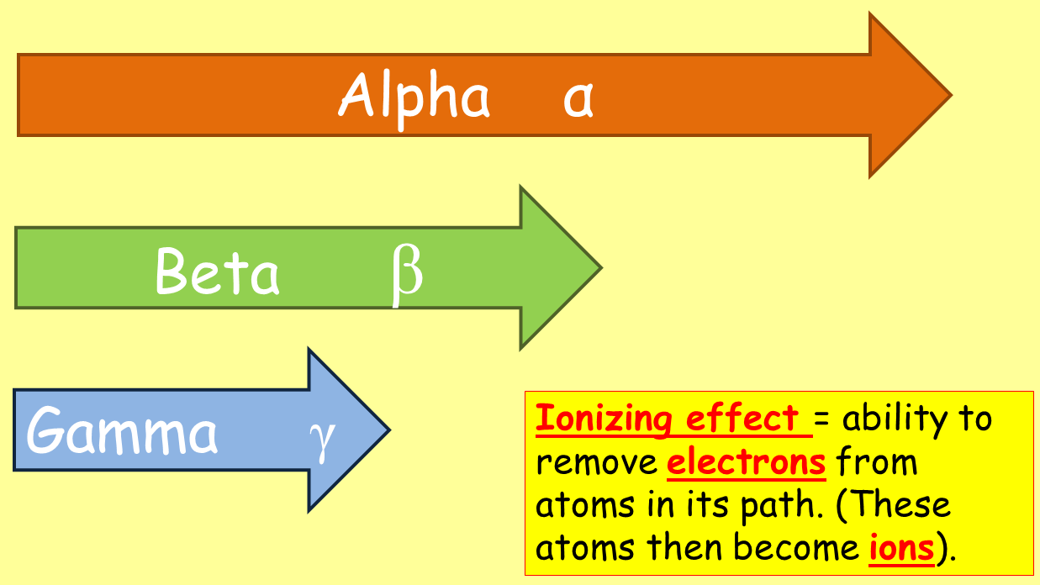
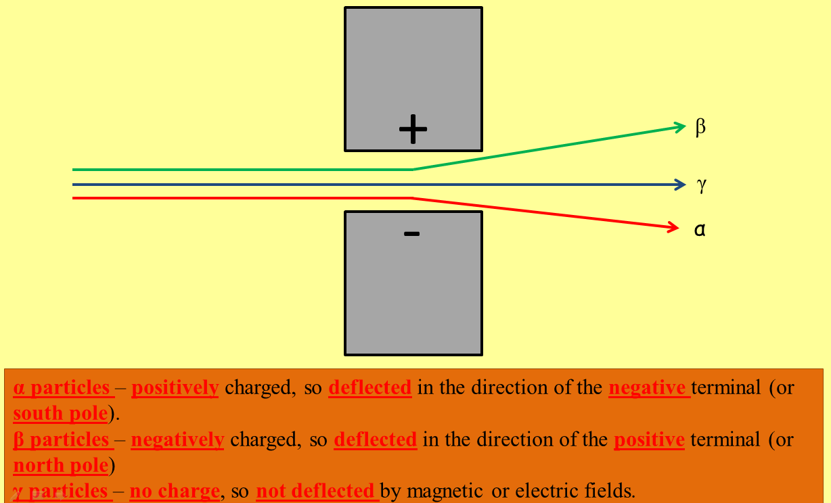
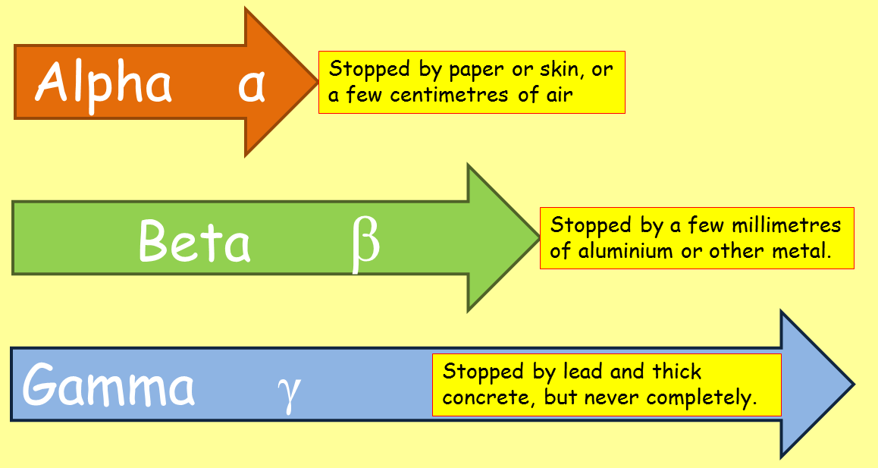
The three types of radiation
Summary of effects
Radioactive decay is a random event –
The unstable nuclei in some materials will break up, or disintegrate. It is impossible to predict exactly which nuclei will decay. This disintegration of the nuclei is called radioactive decay.

Slide 25
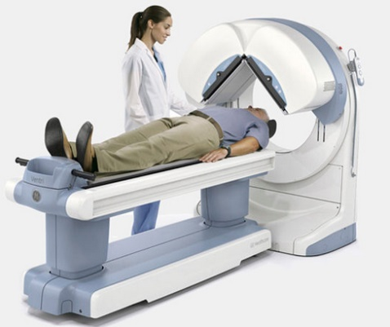
The three types of radiation
Supplement
Applications
1. Tracers in medicine. Radioisotopes can be detected in very small amounts, so are useful for checking the function of body organs. eg. Iodine-123, a gamma source, is used to check the function of the thyroid gland.

Slide 26
The three types of radiation
Supplement
Applications
1. Tracers in medicine. Radioisotopes can be detected in very small amounts, so are useful for checking the function of body organs. eg. Iodine-123, a gamma source, is used to check the function of the thyroid gland.
2. Tracers in industry. Leaks in underground pipes can be detected by adding a tracer to the fluid in the pipe.

Slide 27
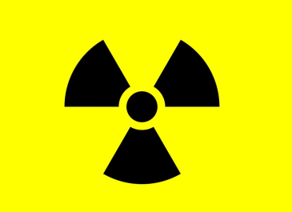
The three types of radiation
Supplement
Applications
1. Tracers in medicine. Radioisotopes can be detected in very small amounts, so are useful for checking the function of body organs. eg. Iodine-123, a gamma source, is used to check the function of the thyroid gland.
2. Tracers in industry. Leaks in underground pipes can be detected by adding a tracer to the fluid in the pipe.
3. Sterilisation of food and surgical instruments. Exposure to a high dose of gamma rays can kill all microbes, so food is kept fresher for longer and instruments will be clean for operations.
Gamma source

Slide 28
The three types of radiation
Supplement
Applications
4. Thickness control.
The source being used must be a beta source for paper and cardboard, or a gamma source for metal sheets.
Roller
Gamma source
Very popular with examiners!
Metal sheet
Detector
Roller
Feedback
In this process a steady thickness of material (paper, metal, etc) can be maintained. The isotope used must have a long half-life, so continual replacement isn’t necessary. The thinner the material, the higher the count.

Slide 29
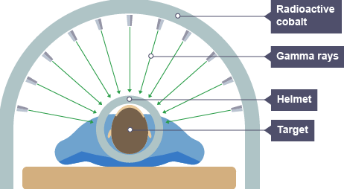
The three types of radiation
Supplement
Applications
Radiotherapy – treating cancer using gamma rays. High doses of gamma rays are directed at just the right dosage to kill cancer cells, whilst minimising damage to surrounding healthy cells.
http://www.bbc.co.uk/education/guides/zm8nb9q/revision/9

Slide 30
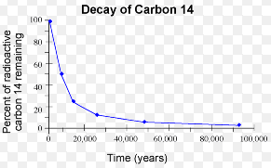
The three types of radiation
Supplement
Applications
Radiotherapy – treating cancer using gamma rays. High doses of gamma rays are directed at just the right dosage to kill cancer cells, whilst minimising damage to surrounding healthy cells.
http://www.bbc.co.uk/education/guides/zm8nb9q/revision/9
Carbon dating of rocks and archaeological specimens. Also known as carbon dating. The amount of C-14 in a material decays with time, so the relative amount of C-14 gives an indication of the age of rocks, fossils and other specimens.

Slide 31
The three types of radiation
Supplement
Applications
Radiotherapy – treating cancer using gamma rays. High doses of gamma rays are directed at just the right dosage to kill cancer cells, whilst minimising damage to surrounding healthy cells.
http://www.bbc.co.uk/education/guides/zm8nb9q/revision/9
Carbon dating of rocks and archaeological specimens. Also known as carbon dating. The amount of C-14 in a material decays with time, so the relative amount of C-14 gives an indication of the age of rocks, fossils and other specimens.
Generating power from nuclear fuel (uranium).
By purifying uranium a chain reaction can be started which generates lots of heat, which can be used to produce electricity.

Slide 32
LEARNING OBJECTIVES
Core • Demonstrate understanding of background radiation • Describe the detection of α-particles, β-particles and γ-rays (β + are not included: β-particles will be taken to refer to β⁻) Discuss the random nature of radioactive emission Identify α, β and γ-emissions by recalling – their nature – their relative ionising effects – their relative penetrating abilities (β+ are not included, β-particles will be taken to refer to β–) | Supplement Describe their deflection in electric fields and in magnetic fields Interpret their relative ionising effects Give and explain examples of practical applications of α, β and γ-emissions

Slide 33
PHYSICS – Radioactivity

