Slide 1
PHYSICS – Sound

Slide 2
LEARNING OBJECTIVES
Core •Describe the production of sound by vibrating sources • Describe the longitudinal nature of sound waves • State that the approximate range of audible frequencies for a healthy human ear is 20 Hz to 20 000 Hz • Show an understanding of the term ultrasound • Show an understanding that a medium is needed to transmit sound waves • Describe an experiment to determine the speed of sound in air • Relate the loudness and pitch of sound waves to amplitude and frequency • Describe how the reflection of sound may produce an echo | Supplement Describe compression and rarefaction State typical values of the speed of sound in gases, liquids and solids

Slide 3
Sound
What is sound?

Slide 4
Sound
What is sound?
Sound is a series of waves (sound waves) caused by vibrations.

Slide 5
Sound
What is sound?
When a drum is struck, the skin vibrates backwards and forwards very quickly, sending sound waves through the air to your ears.
Sound is a series of waves (sound waves) caused by vibrations.

Slide 6
Sound
What is sound?
When a drum is struck, the skin vibrates backwards and forwards very quickly, sending sound waves through the air to your ears.
Sound is a series of waves (sound waves) caused by vibrations.
Sound waves travel as a series of compressions and rarefactions through the air. They are longitudinal waves.

Slide 7
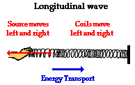
Longitudinal Waves
Eg. Sound
http://www.physicsclassroom.com/class/sound/Lesson-1/Sound-as-a-Longitudinal-Wave

Slide 8
Longitudinal Waves
Eg. Sound
http://www.physicsclassroom.com/class/sound/Lesson-1/Sound-as-a-Longitudinal-Wave
Compression
Rarefaction

Slide 9
Longitudinal Waves
Eg. Sound
http://www.physicsclassroom.com/class/sound/Lesson-1/Sound-as-a-Longitudinal-Wave
Compression
Rarefaction
In longitudinal waves the oscillations (vibrations) are backwards and forwards. The different sections are known as compressions and rarefactions.

Slide 10
Longitudinal Waves
Eg. Sound
http://www.physicsclassroom.com/class/sound/Lesson-1/Sound-as-a-Longitudinal-Wave
Compression
Rarefaction
In longitudinal waves the oscillations (vibrations) are backwards and forwards. The different sections are known as compressions and rarefactions.
The oscillations in longitudinal waves are in the direction of travel.
Sound waves are longitudinal waves.

Slide 11
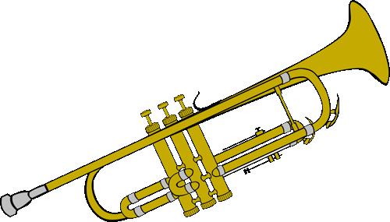
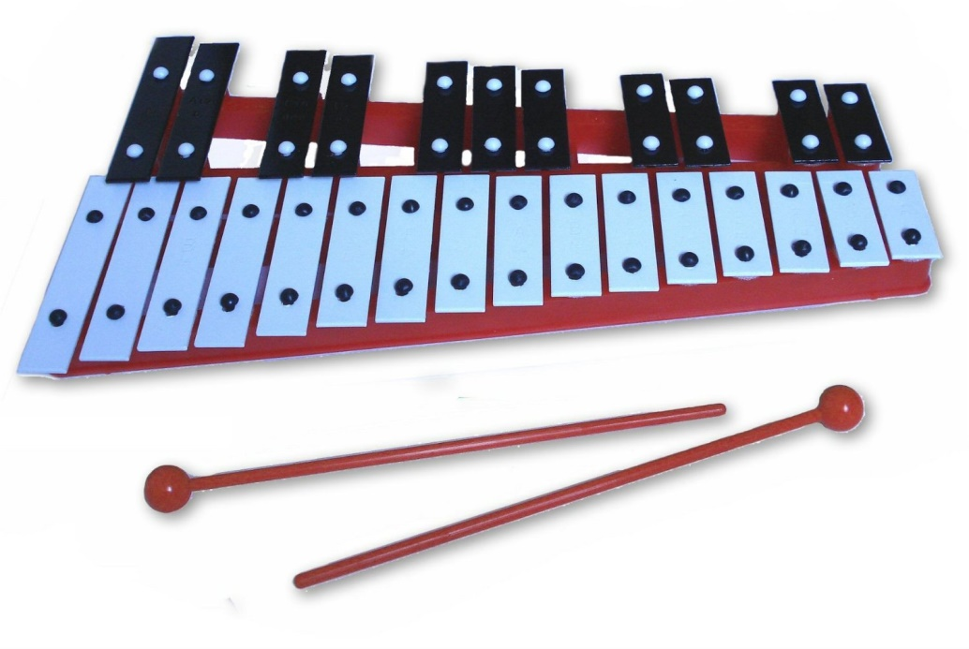
Sound Waves

Slide 12
Sound Waves
Sound Wave – Key Fact
Sound waves are longitudinal waves.

Slide 13
Sound Waves
Sound Wave – Key Fact
Sound waves need a medium (material) to travel through – they cannot travel through a vacuum (empty space)

Slide 14
Sound Waves
Sound Wave – Key Fact
Sound waves can travel through solids, liquids and gases.

Slide 15
Speed of Sound
Sound travels at 330 metres per second (330m/s), or 760 mph.

Slide 16
Speed of Sound
Lightning travels much faster than the sound of thunder.
Sound travels at 330 metres per second (330m/s), or 760 mph.
A 3 second gap between the flash of lightning and the sound of thunder means that the storm is about a kilometre away.

Slide 17
Speed of Sound
Lightning travels much faster than the sound of thunder.
Sound travels at 330 metres per second (330m/s), or 760 mph.
A 3 second gap between the flash of lightning and the sound of thunder means that the storm is about a kilometre away.
The Speed of Sound:
Depends upon the temperature of the air. Sound travels faster through hot air than through cold air.

Slide 18
Speed of Sound
Lightning travels much faster than the sound of thunder.
Sound travels at 330 metres per second (330m/s), or 760 mph.
A 3 second gap between the flash of lightning and the sound of thunder means that the storm is about a kilometre away.
The Speed of Sound:
Depends upon the temperature of the air. Sound travels faster through hot air than through cold air.
Does not depend upon the pressure of the air. If atmospheric pressure changes, speed does not.

Slide 19
Speed of Sound
Lightning travels much faster than the sound of thunder.
Sound travels at 330 metres per second (330m/s), or 760 mph.
A 3 second gap between the flash of lightning and the sound of thunder means that the storm is about a kilometre away.
The Speed of Sound:
Depends upon the temperature of the air. Sound travels faster through hot air than through cold air.
Does not depend upon the pressure of the air. If atmospheric pressure changes, speed does not.
Is different through different materials. Eg. Fastest through solids, then liquids, then gases.

Slide 20
Speed of Sound
Lightning travels much faster than the sound of thunder.
Sound travels at 330 metres per second (330m/s), or 760 mph.
A 3 second gap between the flash of lightning and the sound of thunder means that the storm is about a kilometre away.
The Speed of Sound:
Depends upon the temperature of the air. Sound travels faster through hot air than through cold air.
Does not depend upon the pressure of the air. If atmospheric pressure changes, speed does not.
Is different through different materials. Eg. Fastest through solids, then liquids, then gases.
Air (dry) at 0ºC = 330m/s, water at 0ºC = 1400m/s, concrete = 5000m/s

Slide 21
How could we calculate the speed of sound in air?

Slide 22
How could we calculate the speed of sound in air?
SPEED = DISTANCE
TIME

Slide 23
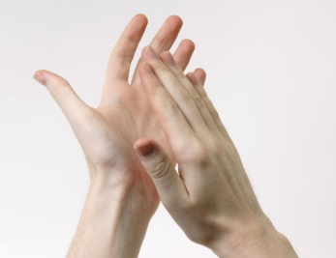
How could we calculate the speed of sound in air?
SPEED = DISTANCE
TIME
75 metres

Slide 24
How could we calculate the speed of sound in air?
SPEED = DISTANCE
TIME
75 metres
75 metres

Slide 25
How could we calculate the speed of sound in air?
SPEED = DISTANCE
TIME
75 metres
75 metres
Time

Slide 26
How could we calculate the speed of sound in air?
SPEED = DISTANCE
TIME
Speed = 150 333 m/s
0.45
75 metres
75 metres
Time

Slide 27
Are particles needed for sound to travel?

Slide 28
Are particles needed for sound to travel?

Slide 29
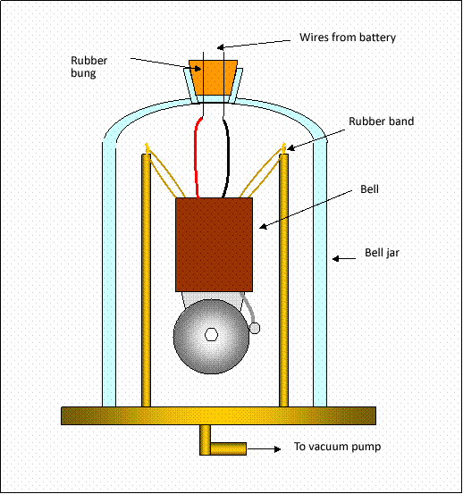
Are particles needed for sound to travel?

Slide 30
Are particles needed for sound to travel?
As the vacuum pump is switched on, air is drawn out of the bell jar. The bell begins to get quieter.

Slide 31
Are particles needed for sound to travel?
As the vacuum pump is switched on, air is drawn out of the bell jar. The bell begins to get quieter.
Eventually, all of the air particles will have been drawn out of the bell jar.
We can see the bell ringing, but we can’t hear it

Slide 32
Are particles needed for sound to travel?
Conclusions:
Sound needs particles to travel.
Sound cannot travel through a vacuum.
Sound cannot travel through space, because there are no particles.

Slide 33
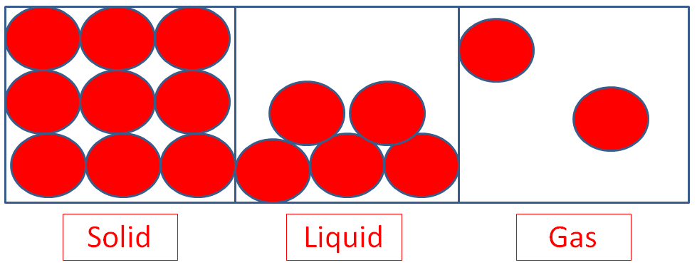
Will sound travel faster through a solid, liquid or gas?

Slide 34
Will sound travel faster through a solid, liquid or gas?

Slide 35
Will sound travel faster through a solid, liquid or gas?
Sound travels faster through a solid because the particles are more densely packed together.

Slide 36
Will sound travel faster through a solid, liquid or gas?
Concrete = 5000m/s, Water at 0ºC = 1400m/s, Air (dry) at 0ºC = 330m/s
Sound travels faster through a solid because the particles are more densely packed together.

Slide 38
An echo is a reflected sound wave.

Slide 39
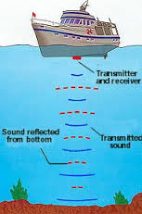
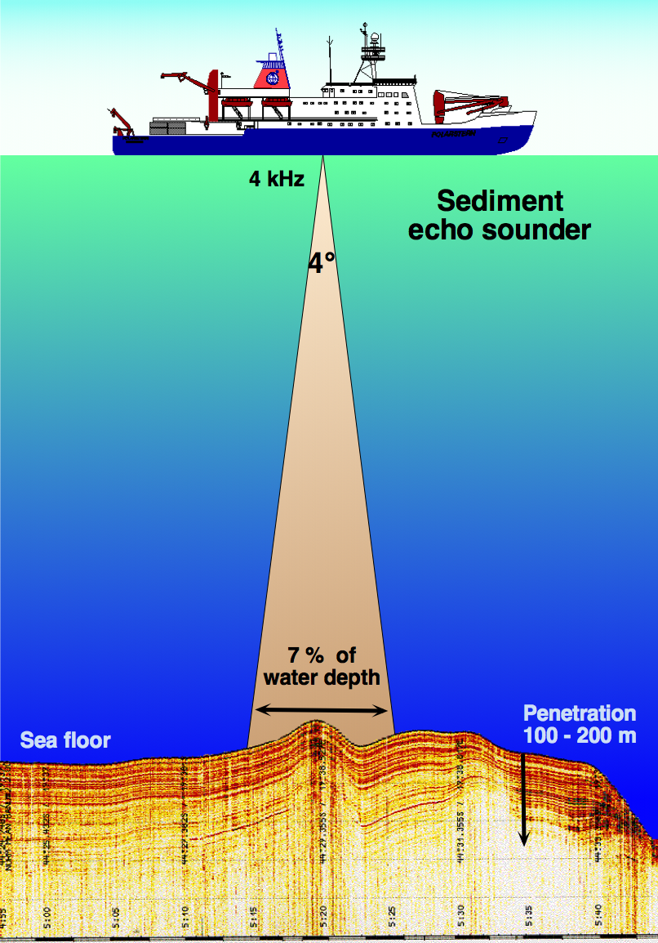
Echoes used for Navigation

Slide 40
A boat sends out a sound wave so that the captain can calculate the depth of water.
The captain knows that the speed of sound in water is 1500 m/s
Distance = speed x time

Slide 41
A boat sends out a sound wave so that the captain can calculate the depth of water.
The captain knows that the speed of sound in water is 1500 m/s
Distance = speed x time
But don’t forget that the sound has travelled there and back so we will need to divide our answer by two to get the depth.

Slide 42
Depth of water = speed x time
2
Calculate the depth if:
 | Speed (m/s) | Time (s)
1 | 1500 | 0.2
2 | 1500 | 1.1
3 | 1500 | 0.5
4 | 1500 | 1.6
5 | 1500 | 2.1
6 | 1500 | 0.8

Slide 43
Depth of water = speed x time
2
Calculate the depth if:
 | Speed (m/s) | Time (s) | Depth (m)
1 | 1500 | 0.2 | 150
2 | 1500 | 1.1 | 825
3 | 1500 | 0.5 | 375
4 | 1500 | 1.6 | 1200
5 | 1500 | 2.1 | 1575
6 | 1500 | 0.8 | 600

Slide 44
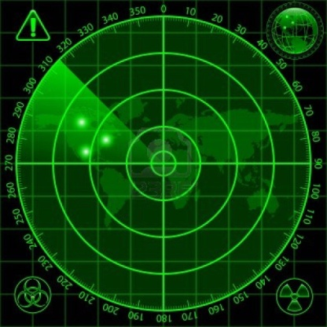
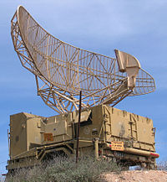
Using sound
Radar
Sonar
Used to detect objects in air, eg. aircraft.

Slide 45
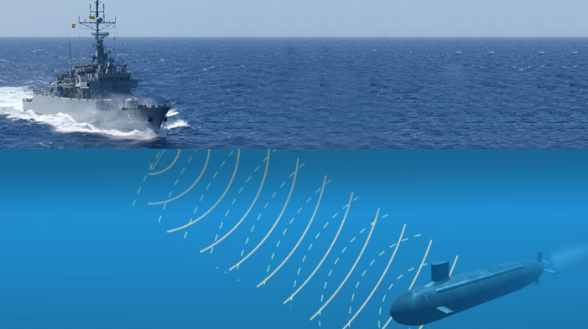
Using sound
Radar
Sonar
Used to detect objects in air, eg. aircraft.
Used to detect objects under water, eg. submarines

Slide 46
Seeing the sound
Loudspeakers convert the signal from the signal generator into sound waves.
The oscilloscope allows us to study the frequency and loudness of a sound.
Signal generators can produce signals over a range of frequencies and of varying amplitudes.

Slide 47
Pitch (or frequency)
A high pitch sound
A low pitch sound.
The shorter the wavelength of the wave on the trace; the higher the frequency of the sound.
The more waves you can see, the higher the pitch/frequency.

Slide 48
Loudness
A quiet sound
A loud sound
The larger the amplitude of the wave on the trace; the louder the sound.
The bigger the waves you can see, the louder the sound.

Slide 49
So what is our range of hearing?

Slide 50
So what is our range of hearing?
Humans
Max
20,000 Hz
Min
20 Hz

Slide 51
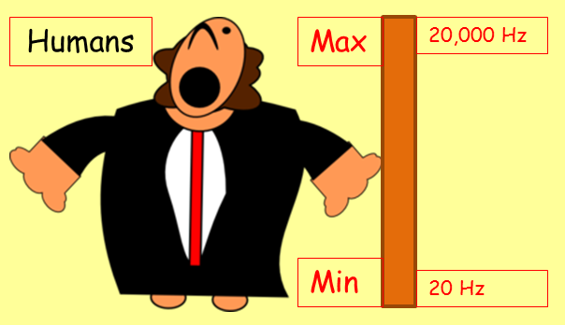
So what is our range of hearing?
Bat
Max
120,000 Hz
Min
1,000 Hz

Slide 52
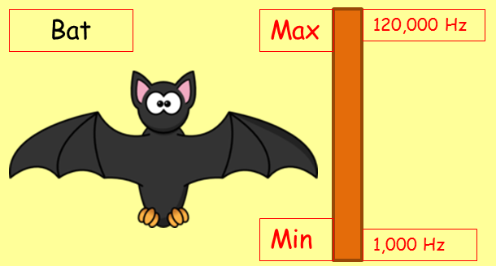
So what is our range of hearing?
Dolphin
Max
150,000 Hz
Min
150 Hz

Slide 53
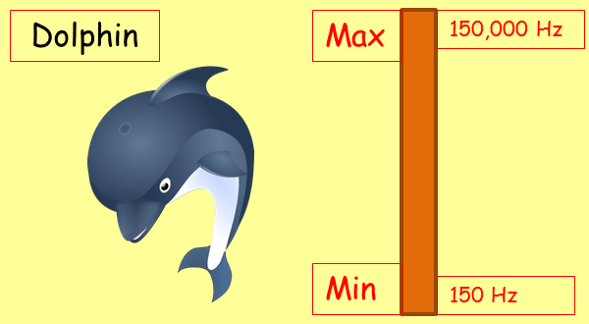
So what is our range of hearing?
Dog
Max
50,000 Hz
Min
15 Hz

Slide 54
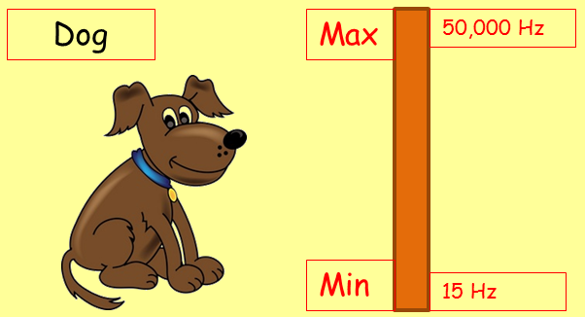
So what is our range of hearing?
Cat
Max
65,000 Hz
Min
60 Hz

Slide 55
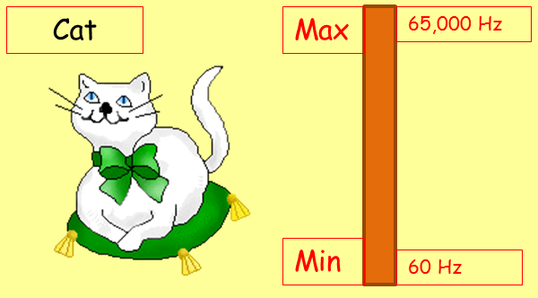
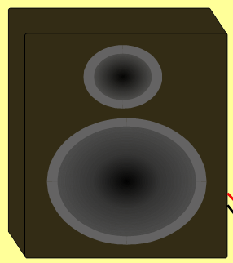
So what is our range of hearing?
Ultrasonic cat scarer (20kHz – 30kHz

Slide 56
Ultrasound
Ultrasound is any sound above the range of human hearing (i.e. above 20,000Hz)

Slide 57
Ultrasound
Ultrasound is any sound above the range of human hearing (i.e. above 20,000Hz)
Uses
Industrial cleaning – eg. of circuit boards and teeth.

Slide 58
Ultrasound
Ultrasound is any sound above the range of human hearing (i.e. above 20,000Hz)
Uses
Industrial cleaning – eg. of circuit boards and teeth.
Breaking down kidney stones.

Slide 59
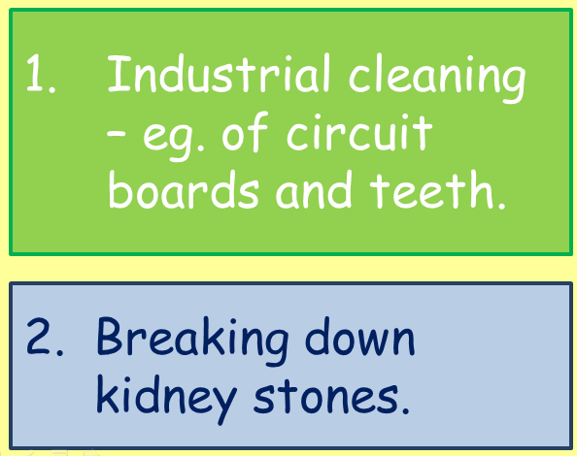
Ultrasound
Ultrasound is any sound above the range of human hearing (i.e. above 20,000Hz)
Uses
3. Industrial quality control.- eg. Detecting cracks in a metal.

Slide 60
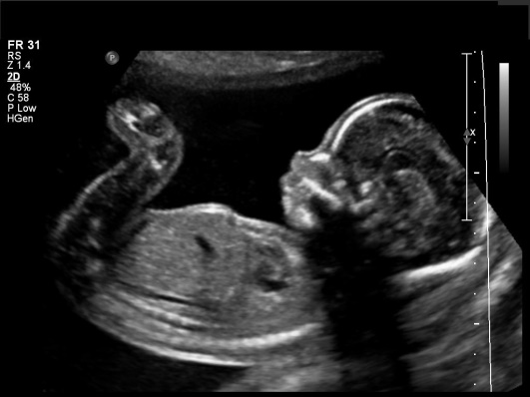
Ultrasound
Ultrasound is any sound above the range of human hearing (i.e. above 20,000Hz)
Uses
4. Pre-natal scanning of a foetus
3. Industrial quality control.- eg. Detecting cracks in a metal.

Slide 61
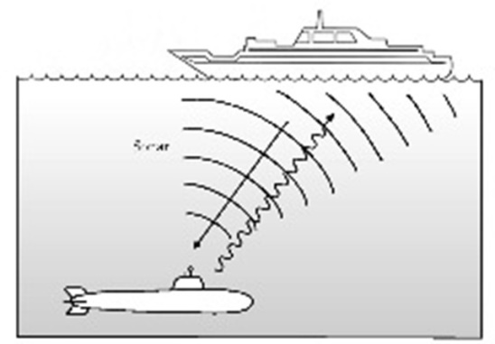
Ultrasound
Ultrasound is any sound above the range of human hearing (i.e. above 20,000Hz)
Uses
4. Pre-natal scanning of a foetus
3. Industrial quality control.- eg. Detecting cracks in a metal.
5. Range and direction finding - SONAR

Slide 62
LEARNING OBJECTIVES
Core •Describe the production of sound by vibrating sources • Describe the longitudinal nature of sound waves • State that the approximate range of audible frequencies for a healthy human ear is 20 Hz to 20 000 Hz • Show an understanding of the term ultrasound • Show an understanding that a medium is needed to transmit sound waves • Describe an experiment to determine the speed of sound in air • Relate the loudness and pitch of sound waves to amplitude and frequency • Describe how the reflection of sound may produce an echo | Supplement Describe compression and rarefaction State typical values of the speed of sound in gases, liquids and solids

Slide 63
PHYSICS – Sound

