Slide 1
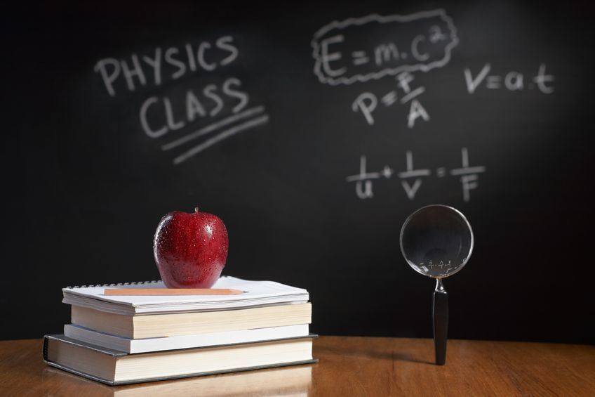
PHYSICS – Reflection and Refraction

Slide 2
LEARNING OBJECTIVES
Core •Describe the formation of an optical image by a plane mirror, and give its characteristics • Recall and use the law angle of incidence = angle of reflection Describe an experimental demonstration of the refraction of light • Use the terminology for the angle of incidence i and angle of refraction r and describe the passage of light through parallel-sided transparent material • Give the meaning of critical angle • Describe internal and total internal reflection Describe the action of a thin converging lens on a beam of light • Use the terms principal focus and focal length • Draw ray diagrams for the formation of a real image by a single lens • Describe the nature of an image using the terms enlarged/same size/diminished and upright/inverted | Supplement Describe the formation of an optical image by a plane mirror, and give its characteristics • Recall and use the law angle of incidence = angle of reflection Recall and use the definition of refractive index n in terms of speed • Recall and use the equation sin I / sin r=n • Recall and use n = n = 1 / sin c • Describe and explain the action of optical fibres particularly in medicine and communications technology Draw and use ray diagrams for the formation of a virtual image by a single lens • Use and describe the use of a single lens as a magnifying glass • Show understanding of the terms real image and virtual image

Slide 3
Reflection in a Plane Mirror
Plane mirror

Slide 4
Reflection in a Plane Mirror
Normal
Plane mirror

Slide 5
Reflection in a Plane Mirror
Normal
Incident ray
Plane mirror

Slide 6
Reflection in a Plane Mirror
Normal
Incident ray
Reflected ray
Plane mirror

Slide 7
Reflection in a Plane Mirror
Normal
Incident ray
Angle of incidence
Angle of reflection
Reflected ray
Plane mirror

Slide 8
Reflection in a Plane Mirror
Normal
Incident ray
Angle of incidence
Angle of reflection
Reflected ray
REMINDER: always use a ruler to draw light rays (light travels in straight lines) and don’t forget to include arrows showing direction of light.
Plane mirror

Slide 9
Reflection in a Plane Mirror
Normal
Incident ray
Angle of incidence
Angle of reflection
Reflected ray
Plane mirror
Laws of reflection:

Slide 10
Reflection in a Plane Mirror
Normal
Incident ray
Angle of incidence
Angle of reflection
Reflected ray
Plane mirror
Laws of reflection:
The angle of incidence is equal to the angle of reflection.

Slide 11
Reflection in a Plane Mirror
Normal
Incident ray
Angle of incidence
Angle of reflection
Reflected ray
Plane mirror
Laws of reflection:
The angle of incidence is equal to the angle of reflection.
The incident ray, the reflected ray and the normal all lie in the same plane (i.e. the two rays and the normal can all be drawn on a single sheet of flat paper).

Slide 12
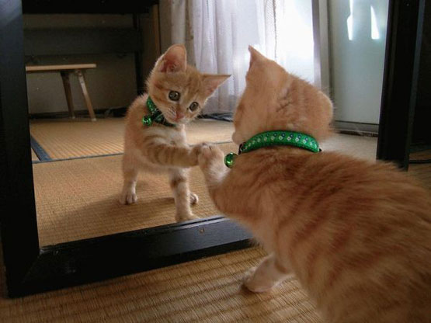
Where is the image in a Plane Mirror?

Slide 13
Where is the image in a Plane Mirror?

Slide 14
Where is the image in a Plane Mirror?

Slide 15
Where is the image in a Plane Mirror?
The image in the mirror looks the same as the object, but it is laterally inverted (back to front).

Slide 16
Where is the image in a Plane Mirror?
The image in the mirror looks the same as the object, but it is laterally inverted (back to front).
The image formed is upright, but it is a virtual image (doesn’t really exist).

Slide 17
Where is the image in a Plane Mirror?
Dotted lines show the construction of the virtual image)
The image in the mirror looks the same as the object, but it is laterally inverted (back to front).
The image formed is upright, but it is a virtual image (doesn’t really exist).

Slide 18
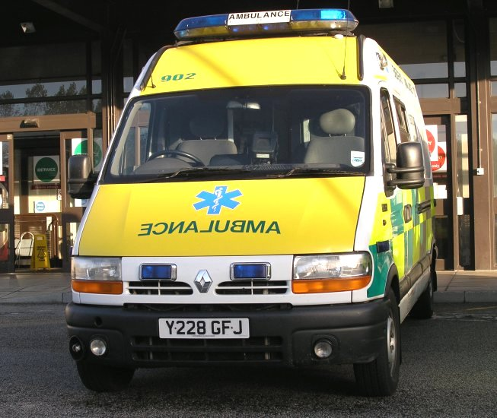
Where is the image in a Plane Mirror?
Normal view from the front.

Slide 19
Where is the image in a Plane Mirror?
Normal view from the front.
Same view as seen in the rear view mirror of a car.

Slide 20
Where is the image in a Plane Mirror?
Normal view from the front.
Same view as seen in the rear view mirror of a car.
The word AMBULANCE is laterally inverted so that it reads correctly when seen in a driving mirror.

Slide 21
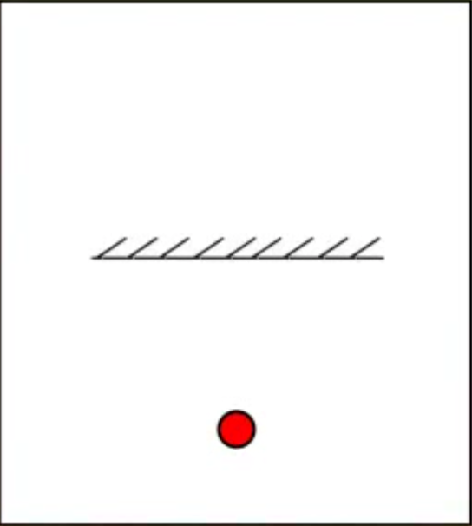
Where is the image in a Plane Mirror?
Finding this image by experiment.
Put a mirror upright on a piece of paper. Put a pin in front of the mirror – mark the position of the pin and mirror.

Slide 22
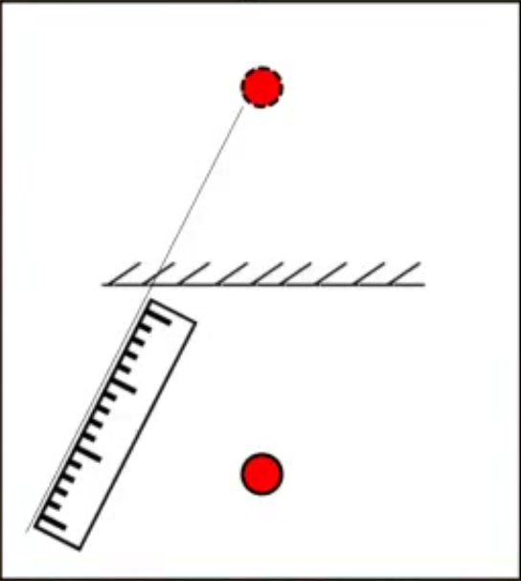
Where is the image in a Plane Mirror?
Finding this image by experiment.
Line up one edge of the ruler with the image of the pin. Draw a line to mark the position.

Slide 23
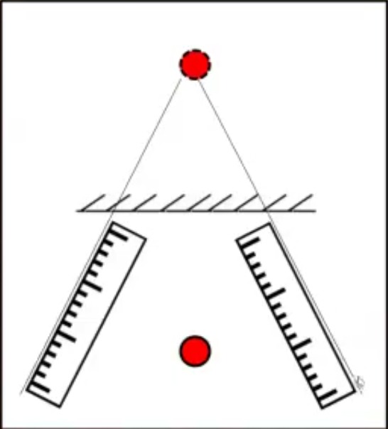
Where is the image in a Plane Mirror?
Finding this image by experiment.
Repeat with the ruler in a different position.

Slide 24
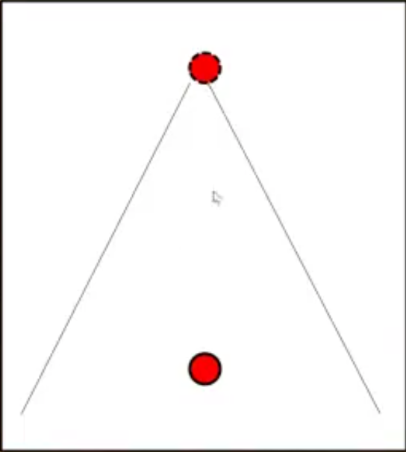
Where is the image in a Plane Mirror?
Finding this image by experiment.
Take away the ruler and mirror – where the two lines meet is the position of the image.

Slide 25
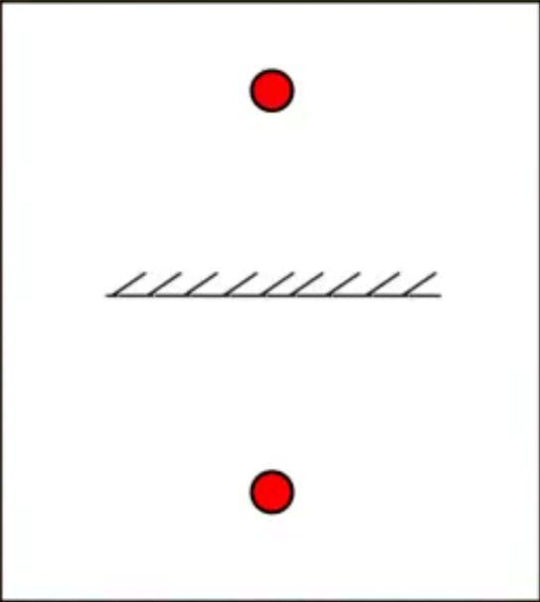
Where is the image in a Plane Mirror?
Finding this image by experiment.
Test the position by putting a second pin exactly where the image was marked. The second pin should stay in line with the mirror image where-ever you view it from = no parallax.

Slide 26
Where is the image in a Plane Mirror?
Finding this image by experiment.
Rules for mirror images:
Image is the same size as the object.
Image is as far behind the mirror as the object is in front.
X
X

Slide 27
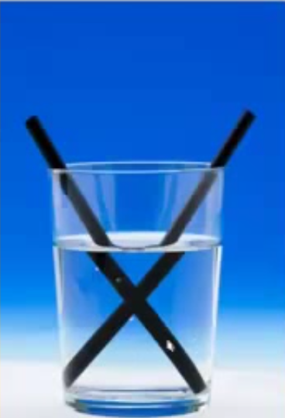
Refraction
Refraction is the bending of light when it travels from one medium to another.

Slide 28
Refraction
Refraction is the bending of light when it travels from one medium to another.
A ‘medium’ is glass, or air, or water

Slide 29
Refraction
Air
Glass block

Slide 30
Refraction
Light passing through a glass block at right angles to the surface will not be refracted. The rays will pass straight through.
Air
Glass block

Slide 31
Refraction
Air
Glass block
Normal line

Slide 32
Refraction
Angle of incidence
Incident light ray
Air
Glass block
Normal line

Slide 33
Refraction
Angle of incidence
Incident light ray
Air
Glass block
Refracted light ray
Angle of refraction
Normal line

Slide 34
Refraction
Angle of incidence
Incident light ray
Air
When passing from a less dense medium (air) to a more dense medium (glass) light bends towards the normal.
Glass block
Refracted light ray
Angle of refraction
Normal line

Slide 35
Refraction
Angle of incidence
Incident light ray
Air
Glass block
Refracted light ray
Angle of refraction
Normal line

Slide 36
Refraction
Angle of incidence
Incident light ray
Air
Glass block
Refracted light ray
Angle of refraction
The ray emerges from the block parallel to its original direction.
Normal line

Slide 37
Refraction
So why is light refracted?
Air
Glass block
Normal line

Slide 38
Refraction
So why is light refracted?
Air
Light is made up of many tiny waves
Glass block
Normal line

Slide 39
Refraction
So why is light refracted?
Air
Glass block
Light is made up of many tiny waves
When light beams pass from air into glass one side is slowed before the other. This causes the light beam to ‘bend’

Slide 40
Connecting the learning.
What happens as a ray of light enters a glass block?
It bends towards the normal.
Why?
Because the speed of light changes

Slide 41
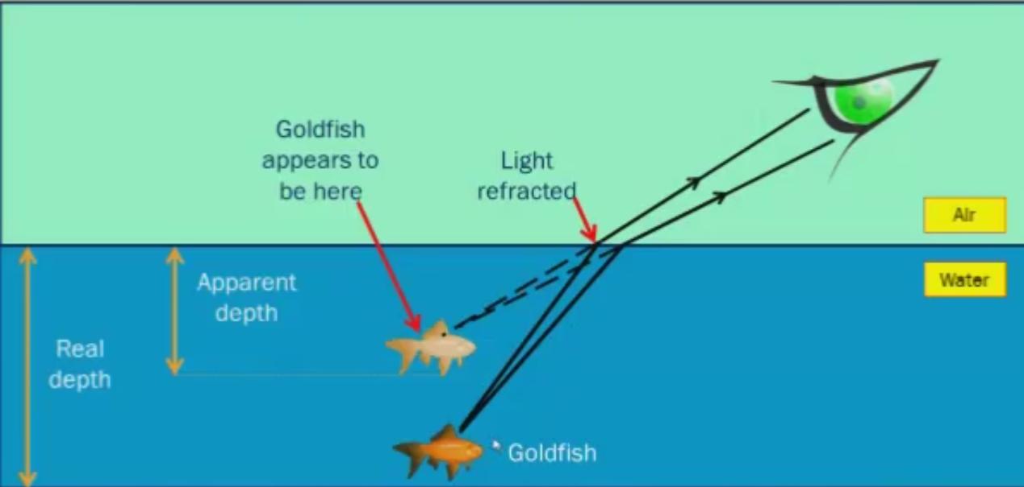
Real and Apparent Depth

Slide 42
What is the ‘refractive index’?

Slide 43
What is the ‘refractive index’?
The refractive index of a medium (glass, water) is defined as the speed of light in a vacuum divided by the speed of light in the medium.

Slide 44
What is the ‘refractive index’?
The refractive index of a medium (glass, water) is defined as the speed of light in a vacuum divided by the speed of light in the medium.
Medium | Refractive index
Vacuum | 1.0000
Air | 1.0003
Water | 1.3333
Glass | 1.5200
Diamond | 2.4170
Perspex | 1.4900
Refractive index = Speed of light in a vacuum
Speed of light in medium

Slide 45
Refraction of light by a prism.
White light

Slide 46
Refraction of light by a prism.
Refraction

Slide 47
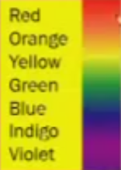
Refraction of light by a prism.

Slide 48
Refraction of light by a prism.
This effect is called dispersion

Slide 49
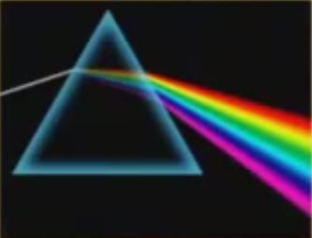
Refraction of light by a prism.
This effect is called dispersion

Slide 50
Refraction of light by a prism.
This effect is called dispersion
It happens because white is a mixture of all the colours in the rainbow

Slide 51
LEARNING OBJECTIVES
Core •Describe the formation of an optical image by a plane mirror, and give its characteristics • Recall and use the law angle of incidence = angle of reflection Describe an experimental demonstration of the refraction of light • Use the terminology for the angle of incidence i and angle of refraction r and describe the passage of light through parallel-sided transparent material • Give the meaning of critical angle • Describe internal and total internal reflection Describe the action of a thin converging lens on a beam of light • Use the terms principal focus and focal length • Draw ray diagrams for the formation of a real image by a single lens • Describe the nature of an image using the terms enlarged/same size/diminished and upright/inverted | Supplement Describe the formation of an optical image by a plane mirror, and give its characteristics • Recall and use the law angle of incidence = angle of reflection Recall and use the definition of refractive index n in terms of speed • Recall and use the equation sin I / sin r=n • Recall and use n = n = 1 / sin c • Describe and explain the action of optical fibres particularly in medicine and communications technology Draw and use ray diagrams for the formation of a virtual image by a single lens • Use and describe the use of a single lens as a magnifying glass • Show understanding of the terms real image and virtual image

Slide 52
PHYSICS – Reflection and Refraction

