Slide 1
PHYSICS – General Wave Properties

Slide 2
LEARNING OBJECTIVES
Core • Demonstrate understanding that waves transfer energy without transferring matter • Describe what is meant by wave motion as illustrated by vibration in ropes and springs and by experiments using water waves • Use the term wavefront • Give the meaning of speed, frequency, wavelength and amplitude • Distinguish between transverse and longitudinal waves and give suitable examples • Describe how waves can undergo: – reflection at a plane surface – refraction due to a change of speed – diffraction through a narrow gap • Describe the use of water waves to demonstrate reflection, refraction and diffraction | Supplement Recall and use the equation v = f λ Describe how wavelength and gap size affects diffraction through a gap • Describe how wavelength affects diffraction at an edge

Slide 3
Waves

Slide 4
Waves
When a stone is dropped into a pond, ripples begin to spread out across the surface.

Slide 5
Waves
The tiny waves carry energy – but there is no actual flow of water across the pond.

Slide 6
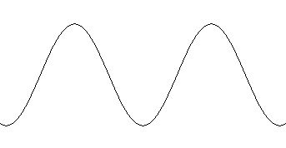
Waves
Waves are just the up and down movement in water.
Peak
Trough

Slide 7
Waves
There are other sorts of waves, such as:
Sound
Radio
Light
Waves are just the up and down movement in water.
Peak
Trough

Slide 8
Waves
There are other sorts of waves, such as:
Sound
Radio
Light
Waves are just the up and down movement in water.
Waves have features in common, and can be divided into two main types:
Transverse
Longitudinal
Peak
Trough

Slide 9
Transverse Waves
Eg. light, ultra-violet, gamma rays, radio.

Slide 10
Transverse Waves
Eg. light, ultra-violet, gamma rays, radio.
The to-and-fro movements of the wave are called oscillations. In a transverse wave these oscillations are at right angles to the direction in which the energy is travelling.

Slide 11
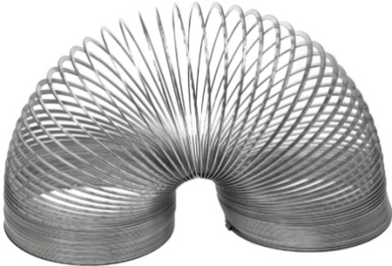
Transverse Waves
Eg. light, ultra-violet, gamma rays, radio.
The to-and-fro movements of the wave are called oscillations. In a transverse wave these oscillations are at right angles to the direction in which the energy is travelling.

Slide 12
Transverse Waves
Eg. light, ultra-violet, gamma rays, radio.
Features of transverse waves
1. Wavelength. The distance between any two corresponding points on the wave. (metres)

Slide 13
Transverse Waves
Eg. light, ultra-violet, gamma rays, radio.
Features of transverse waves
1. Wavelength. The distance between any two corresponding points on the wave. (metres)
2. Amplitude. The maximum displacement of the wave from its rest point.

Slide 14
Transverse Waves
Eg. light, ultra-violet, gamma rays, radio.
Features of transverse waves
1. Wavelength. The distance between any two corresponding points on the wave. (metres)
2. Amplitude. The maximum displacement of the wave from its rest point.
3. Speed. The speed of the wave is measured in metres per second (m/s).

Slide 15
Transverse Waves
Eg. light, ultra-violet, gamma rays, radio.
Features of transverse waves
Frequency. The number of waves passing any point in one second. The unit of frequency is the hertz (Hz). One hertz is one vibration of the wave per second. The time for one oscillation is called the period.

Slide 16
Transverse Waves
Eg. light, ultra-violet, gamma rays, radio.
Features of transverse waves
Frequency. The number of waves passing any point in one second. The unit of frequency is the hertz (Hz). One hertz is one vibration of the wave per second. The time for one oscillation is called the period.
For example, if five complete waves pass a given point in one second (i.e. five complete oscillations) then the frequency is 5 Hz.

Slide 17
Transverse Waves
Eg. light, ultra-violet, gamma rays, radio.
Features of transverse waves
Remember! The frequency (in Hz) is the number of oscillations per second.
The period (in seconds) is the time for one complete oscillation.
Frequency = 1
period

Slide 18
Transverse Waves
Eg. light, ultra-violet, gamma rays, radio.
The wave equation
Linking together speed, frequency and wavelength.

Slide 19
Transverse Waves
Eg. light, ultra-violet, gamma rays, radio.
The wave equation
Linking together speed, frequency and wavelength.
Speed = frequency x wavelength

Slide 20
Transverse Waves
Eg. light, ultra-violet, gamma rays, radio.
The wave equation
Linking together speed, frequency and wavelength.
Speed = frequency x wavelength
v = f λ
(λ = Greek letter
lambda)

Slide 21
Transverse Waves
Eg. light, ultra-violet, gamma rays, radio.
The wave equation
Linking together speed, frequency and wavelength.
Speed = frequency x wavelength
v = f λ
(λ = Greek letter
lambda)
m/s Hz m

Slide 22
Transverse Waves
Eg. light, ultra-violet, gamma rays, radio.
The wave equation
Linking together speed, frequency and wavelength.
Example 1: a wave has a wavelength of 12m. Calculate the wave speed if it has a frequency of 20 Hz.
v = f λ
v = 20 x 12
v = 240 m/s

Slide 23
Transverse Waves
Eg. light, ultra-violet, gamma rays, radio.
The wave equation
Linking together speed, frequency and wavelength.
Example 1: a wave has a wavelength of 12m. Calculate the wave speed if it has a frequency of 20 Hz.
v = f λ
v = 20 x 12
v = 240 m/s
Example 2: a wave has a frequency of 10 Hz. Calculate the wavelength if it has a wave speed of 50 m/s.
v = f λ
λ = v / f
λ = 50 / 10
λ = 5 m

Slide 24
Transverse Waves
Eg. light, ultra-violet, gamma rays, radio.
The wave equation
Linking together speed, frequency and wavelength.
v
Example 1: a wave has a wavelength of 12m. Calculate the wave speed if it has a frequency of 20 Hz.
v = f λ
v = 20 x 12
v = 240 m/s
Example 2: a wave has a frequency of 10 Hz. Calculate the wavelength if it has a wave speed of 50 m/s.
v = f λ
λ = v / f
λ = 50 / 10
λ = 5 m
f
λ

Slide 25
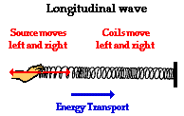
Longitudinal Waves
Eg. Sound
http://www.physicsclassroom.com/class/sound/Lesson-1/Sound-as-a-Longitudinal-Wave

Slide 26
Longitudinal Waves
Eg. Sound
http://www.physicsclassroom.com/class/sound/Lesson-1/Sound-as-a-Longitudinal-Wave
Compression
Rarefaction

Slide 27
Longitudinal Waves
Eg. Sound
http://www.physicsclassroom.com/class/sound/Lesson-1/Sound-as-a-Longitudinal-Wave
Compression
Rarefaction
In longitudinal waves the oscillations (vibrations) are backwards and forwards. The different sections are known as compressions and rarefactions.

Slide 28
Longitudinal Waves
Eg. Sound
http://www.physicsclassroom.com/class/sound/Lesson-1/Sound-as-a-Longitudinal-Wave
Compression
Rarefaction
In longitudinal waves the oscillations (vibrations) are backwards and forwards. The different sections are known as compressions and rarefactions.
The oscillations in longitudinal waves are in the direction of travel.
Sound waves are longitudinal waves.

Slide 29
Looking at Waves
We can study the properties of waves by using a ripple tank.

Slide 30
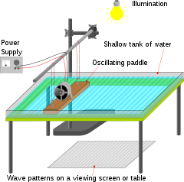
Looking at Waves
We can study the properties of waves by using a ripple tank.
http://en.wikipedia.org/wiki/Ripple_tank

Slide 31
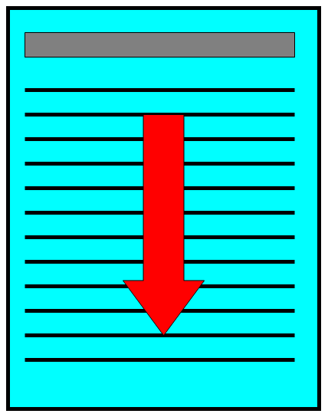
Looking at Waves
We can study the properties of waves by using a ripple tank.
Paddle vibrates to produce waves.
wavefronts
A ripple tank produces water waves that can be reflected, refracted and diffracted.
http://en.wikipedia.org/wiki/Ripple_tank

Slide 32
Looking at Waves
We can study the properties of waves by using a ripple tank.
If a plain barrier is put in the way then the waves are reflected.
http://en.wikipedia.org/wiki/Ripple_tank

Slide 33
Looking at Waves
We can study the properties of waves by using a ripple tank.
If a block is submerged in the tank then the waves are refracted.
http://en.wikipedia.org/wiki/Ripple_tank

Slide 34
Looking at Waves
We can study the properties of waves by using a ripple tank.
The block makes the water more shallow which slows the waves down.
If a block is submerged in the tank then the waves are refracted.
http://en.wikipedia.org/wiki/Ripple_tank

Slide 35
Looking at Waves
We can study the properties of waves by using a ripple tank.
If there is a gap in the barrier then the waves will be reflected – if the gap is smaller than the wavelength of the waves.
http://en.wikipedia.org/wiki/Ripple_tank

Slide 36
Looking at Waves
We can study the properties of waves by using a ripple tank.
However, if the gap in the barrier is similar in width to the wavelength of the wave, then the wavefronts are diffracted.
http://en.wikipedia.org/wiki/Ripple_tank

Slide 37
Looking at Waves
We can study the properties of waves by using a ripple tank.
If the gap in the barrier is larger than the wavelength of the waves, then the wave will pass through unchanged apart from slight diffraction at the edges.
http://en.wikipedia.org/wiki/Ripple_tank

Slide 38
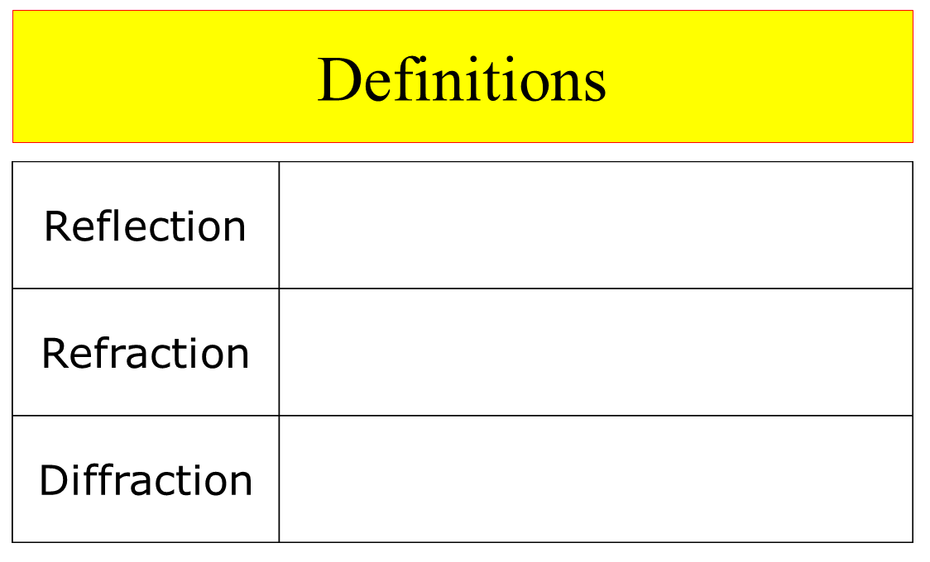
Looking at Waves

Slide 39
Looking at Waves

Slide 40
Looking at Waves

Slide 41
Looking at Waves

Slide 42
LEARNING OBJECTIVES
Core • Demonstrate understanding that waves transfer energy without transferring matter • Describe what is meant by wave motion as illustrated by vibration in ropes and springs and by experiments using water waves • Use the term wavefront • Give the meaning of speed, frequency, wavelength and amplitude • Distinguish between transverse and longitudinal waves and give suitable examples • Describe how waves can undergo: – reflection at a plane surface – refraction due to a change of speed – diffraction through a narrow gap • Describe the use of water waves to demonstrate reflection, refraction and diffraction | Supplement Recall and use the equation v = f λ Describe how wavelength and gap size affects diffraction through a gap • Describe how wavelength affects diffraction at an edge

Slide 43
PHYSICS – General Wave Properties

