Slide 1
PHYSICS – Forces 2 Moments

Slide 2
LEARNING OBJECTIVES
1.5.2 Turning effect Core • Describe the moment of a force as a measure of its turning effect and give everyday examples • Understand that increasing force or distance from the pivot increases the moment of a force • Calculate moment using the product force × perpendicular distance from the pivot • Apply the principle of moments to the balancing of a beam about a pivot 1.5.3 Conditions for equilibrium Core • Recognise that, when there is no resultant force and no resultant turning effect, a system is in equilibrium | Supplement • Apply the principle of moments to different situations • Perform and describe an experiment (involving vertical forces) to show that there is no net moment on a body in equilibrium

Slide 3
LEARNING OBJECTIVES
1.5.2 Turning effect Core • Describe the moment of a force as a measure of its turning effect and give everyday examples • Understand that increasing force or distance from the pivot increases the moment of a force • Calculate moment using the product force × perpendicular distance from the pivot • Apply the principle of moments to the balancing of a beam about a pivot 1.5.3 Conditions for equilibrium Core • Recognise that, when there is no resultant force and no resultant turning effect, a system is in equilibrium | Supplement • Apply the principle of moments to different situations • Perform and describe an experiment (involving vertical forces) to show that there is no net moment on a body in equilibrium

Slide 4
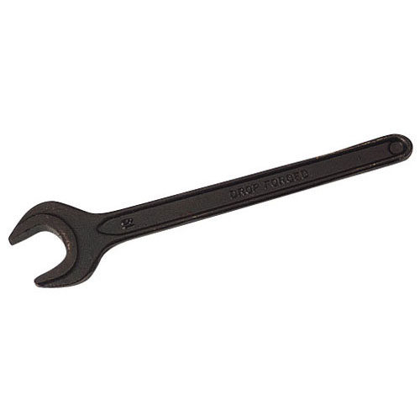
Forces and moments
Spanners are used for tightening and loosening nuts. They help to produce a larger turning effect.

Slide 5
Forces and moments
The longer the spanner, the greater the turning effect (force)
Spanners are used for tightening and loosening nuts. They help to produce a larger turning effect.

Slide 6
Forces and moments
The longer the spanner, the greater the turning effect (force)
Spanners are used for tightening and loosening nuts. They help to produce a larger turning effect.
The turning effect of a force is called a moment.

Slide 7
Forces and moments
Moment of = force x perpendicular
a force about distance from
a point the point

Slide 8
Forces and moments
Moment of = force x perpendicular
a force about distance from
a point the point
Moments may be described as clockwise or anticlockwise, and the moment of a force is also called a torque.

Slide 9
Forces and moments
Moment of = force x perpendicular
a force about distance from
a point the point
Don’t forget that the unit of Force ie the Newton (N)
Moments may be described as clockwise or anticlockwise, and the moment of a force is also called a torque.

Slide 10
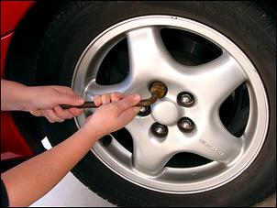
Forces and moments
To increase the force applied to undoing a wheel nut, extend the length of the spanner – you can do this by inserting a length of pipe over the end.

Slide 11
Let’s look at a few examples of calculations involving moments.
4m
X
5N
Moment about X = 5 x 4 = 20N
(clockwise)

Slide 12
Let’s look at a few examples of calculations involving moments.
3N
X
5m
Moment about X = 3 x 5 = 15N
(anticlockwise)
4m
X
5N
Moment about X = 5 x 4 = 20N
(clockwise)

Slide 13
Let’s look at a few examples of calculations involving moments.
3N
X
5m
Moment about X = 3 x 5 = 15N
(anticlockwise)
4m
Principle of moments
X
5N
Moment about X = 5 x 4 = 20N
(clockwise)

Slide 14
LEARNING OBJECTIVES
1.5.2 Turning effect Core • Describe the moment of a force as a measure of its turning effect and give everyday examples • Understand that increasing force or distance from the pivot increases the moment of a force • Calculate moment using the product force × perpendicular distance from the pivot • Apply the principle of moments to the balancing of a beam about a pivot 1.5.3 Conditions for equilibrium Core • Recognise that, when there is no resultant force and no resultant turning effect, a system is in equilibrium | Supplement • Apply the principle of moments to different situations • Perform and describe an experiment (involving vertical forces) to show that there is no net moment on a body in equilibrium

Slide 15
The Principle of Moments
This beam is in a state of balance.

Slide 16
The Principle of Moments
This beam is in a state of balance.
In order to be balanced, the clockwise forces must be equal to the anticlockwise forces.
We say that the beam is in a state of equilibrium.

Slide 17
The Principle of Moments
This beam is in a state of balance.
In order to be balanced, the clockwise forces must be equal to the anticlockwise forces.
We say that the beam is in a state of equilibrium.
The Principle of Moments states that:
“If an object is in equilibrium, the sum of the clockwise moments about any point is equal to the sum of the anticlockwise moments about that point.”

Slide 18
The Principle of Moments
Let’s look at some worked examples
1m
2m
X
20N
10N
Anticlockwise moment
= 20 x 1 = 20Nm
Clockwise moment
= 10 x 2 = 20Nm

Slide 19
The Principle of Moments
Let’s look at some worked examples
1m
2m
0.5m
X
20N
20N
5N
Anticlockwise moment
= 20 x 1 = 20Nm
Combined clockwise moment
= (5 x 2) + (20 x 0.5) = 20Nm

Slide 20
What force does the trailer exert on the hitching point, and what force do the rear tyres exert on the road?
The Principle of Moments
Hitching point
Rear tyres (consider as a single force)

Slide 21
What force does the trailer exert on the hitching point, and what force do the rear tyres exert on the road?
The Principle of Moments
Centre of mass of trailer
3m
6m
400 kN

Slide 22
What force does the trailer exert on the hitching point, and what force do the rear tyres exert on the road?
The Principle of Moments
Centre of mass of trailer
X
3m
6m
400 kN
A
At the hitching point, the downward force of the trailer on the hitch is equal to the upward force of the hitch on the trailer (X).

Slide 23
What force does the trailer exert on the hitching point, and what force do the rear tyres exert on the road?
The Principle of Moments
Centre of mass of trailer
X
Y
3m
6m
400 kN
A
B
At the hitching point, the downward force of the trailer on the hitch is equal to the upward force of the hitch on the trailer (X).
The downward force of the rear tyres on the road is equal to the upward force of the road on the tyres (Y).

Slide 24
What force does the trailer exert on the hitching point, and what force do the rear tyres exert on the road?
The Principle of Moments
Centre of mass of trailer
X
Y
3m
6m
400 kN
A
B
To find X, look at the moments about point B
Clockwise moment = X x 9m
Anticlockwise moment = 400kN x 6m = 2400kN m
X x 9m = 2400 kN m
So: X = 266.7 kN
So: downward force on hitching point = 266.7kN

Slide 25
What force does the trailer exert on the hitching point, and what force do the rear tyres exert on the road?
The Principle of Moments
Centre of mass of trailer
X
Y
3m
6m
400 kN
A
B
To find Y:
Total upward force = Total downward force
So: X + Y = 400kN
So: 266.7 + Y = 400kN
So: Y = 400kN - 266.7kN
Y = 133.3kN
So: the downward force from rear tyres = 133.3kN

Slide 26
LEARNING OBJECTIVES
1.5.2 Turning effect Core • Describe the moment of a force as a measure of its turning effect and give everyday examples • Understand that increasing force or distance from the pivot increases the moment of a force • Calculate moment using the product force × perpendicular distance from the pivot • Apply the principle of moments to the balancing of a beam about a pivot 1.5.3 Conditions for equilibrium Core • Recognise that, when there is no resultant force and no resultant turning effect, a system is in equilibrium | Supplement • Apply the principle of moments to different situations • Perform and describe an experiment (involving vertical forces) to show that there is no net moment on a body in equilibrium

Slide 27
PHYSICS – Forces 2

