Slide 1

PHYSICS – Forces 1

Slide 2
LEARNING OBJECTIVES
1.5.1 Effects of forces Core • Recognise that a force may produce a change in size and shape of a body • Plot and interpret extension-load graphs and describe the associated experimental procedure • Describe the ways in which a force may change the motion of a body • Find the resultant of two or more forces acting along the same line • Recognise that if there is no resultant force on a body it either remains at rest or continues at constant speed in a straight line • Understand friction as the force between two surfaces which impedes motion and results in heating • Recognise air resistance as a form of friction | Supplement • State Hooke’s Law and recall and use the expression F = k x, where k is the spring constant • Recognise the significance of the ‘limit of proportionality’ for an extension-load graph • Recall and use the relation between force, mass and acceleration (including the direction), F = ma • Describe qualitatively motion in a circular path due to a perpendicular force

Slide 3
LEARNING OBJECTIVES
1.5.1 Effects of forces Core • Recognise that a force may produce a change in size and shape of a body • Plot and interpret extension-load graphs and describe the associated experimental procedure • Describe the ways in which a force may change the motion of a body • Find the resultant of two or more forces acting along the same line • Recognise that if there is no resultant force on a body it either remains at rest or continues at constant speed in a straight line • Understand friction as the force between two surfaces which impedes motion and results in heating • Recognise air resistance as a form of friction | Supplement • State Hooke’s Law and recall and use the expression F = k x, where k is the spring constant • Recognise the significance of the ‘limit of proportionality’ for an extension-load graph • Recall and use the relation between force, mass and acceleration (including the direction), F = ma • Describe qualitatively motion in a circular path due to a perpendicular force

Slide 4

What is a force?
A force is a “push” or a “pull”. Some common examples:
WEIGHT – pulls things downwards

Slide 5
What is a force?
A force is a “push” or a “pull”. Some common examples:
An equal and opposite force, perpendicular to the surface (at right angles to) prevents the man from penetrating the surface

Slide 6
What is a force?
A force is a “push” or a “pull”. Some common examples:
AIR RESISTANCE (drag) – acts against anything moving through air
WEIGHT – pulls things downwards
FRICTION – acts against anything moving
UPTHRUST – keeps things afloat

Slide 7
Forces are vector quantities because they have both size and direction.

Slide 8
Forces are vector quantities because they have both size and direction.
SI units
Forces are measured in newtons (N)

Slide 9

Forces are vector quantities because they have both size and direction.
SI units
Forces are measured in newtons (N)
Small forces can be measured using a spring balance (or newton meter)

Slide 10
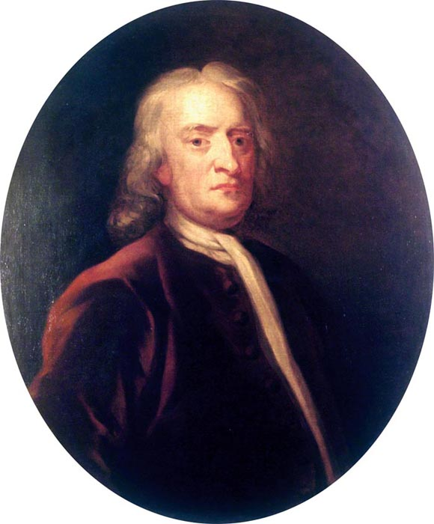
Newton’s first law of motion
If no external force is acting on it, and object will:
If stationary, remain stationary
If moving, keep moving at a steady speed in a straight line.

Slide 11
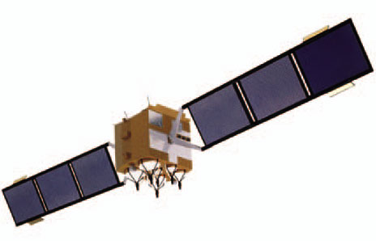
Newton’s first law of motion
If no external force is acting on it, and object will:
If stationary, remain stationary
If moving, keep moving at a steady speed in a straight line.
In space, where there are no external forces, a satellite will continue to move at a steady speed in a straight line …. for ever!

Slide 12
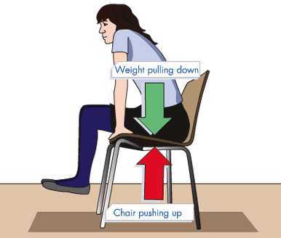
Balanced forces
If forces are in balance, then they cancel each other out, and the object behaves as if there is no force on it at all

Slide 13
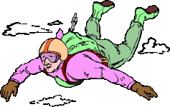
Balanced forces
If forces are in balance, then they cancel each other out, and the object behaves as if there is no force on it at all
When terminal velocity is reached, the skydiver is falling at a steady speed. The force of air resistance is exactly balanced by the air resistance pushing upwards.

Slide 14
Balanced or unbalanced forces?
What will happen in each case?
A
B
C
D

Slide 15
Balanced and Unbalanced Forces
Balanced forces:
If the forces acting on an object are balanced then the object will either remain stationary or continue to move with a constant speed.

Slide 16
Balanced and Unbalanced Forces
Balanced forces:
If the forces acting on an object are balanced then the object will either remain stationary or continue to move with a constant speed.
Unbalanced forces:
If the forces acting on an object are unbalanced then the object will change its speed. It will begin to move, speed up, slow down or stop.

Slide 17
Friction and Stopping Forces

Slide 18

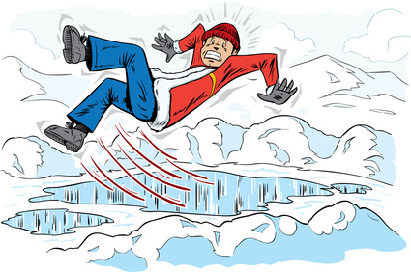
Friction and Stopping Forces
Although it is sometimes unwanted, friction can really help us – for example in car braking systems, and giving shoes grip on the ground.

Slide 19
Friction and Stopping Forces
Although it is sometimes unwanted, friction can really help us – for example in car braking systems, and giving shoes grip on the ground.
As the block is gently pulled, friction stops it moving – increase the force and the block will start to slip = starting or static friction.

Slide 20
Friction and Stopping Forces
Although it is sometimes unwanted, friction can really help us – for example in car braking systems, and giving shoes grip on the ground.
When the block starts to move, the friction drops. Moving or dynamic friction is less than static friction. This friction HEATS materials up.

Slide 21



Stopping distance
The distance needed for a car, travelling at a given speed, to stop (m).
Stopping distance = Thinking distance + Braking Distance

Slide 22


Thinking Distance
Before we react to a danger our brain takes time to think. The distance travelled during this time is the Thinking Distance (m)
0.6 s
Mmh, a level crossing! I should stop now!

Slide 23
Braking Distance
Cars don’t stop straight away. They travel a certain distance from when you start braking to when they stop. This is the Braking Distance.
Just in time!

Slide 24
LEARNING OBJECTIVES
1.5.1 Effects of forces Core • Recognise that a force may produce a change in size and shape of a body • Plot and interpret extension-load graphs and describe the associated experimental procedure • Describe the ways in which a force may change the motion of a body • Find the resultant of two or more forces acting along the same line • Recognise that if there is no resultant force on a body it either remains at rest or continues at constant speed in a straight line • Understand friction as the force between two surfaces which impedes motion and results in heating • Recognise air resistance as a form of friction | Supplement • State Hooke’s Law and recall and use the expression F = k x, where k is the spring constant • Recognise the significance of the ‘limit of proportionality’ for an extension-load graph • Recall and use the relation between force, mass and acceleration (including the direction), F = ma • Describe qualitatively motion in a circular path due to a perpendicular force

Slide 25
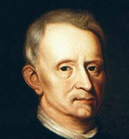
Hooke’s Law and forces acting on a stretched spring.

Slide 26
Robert Hooke was born in 1635 and he devised an equation describing elasticity.
Hooke’s Law and forces acting on a stretched spring.

Slide 27

Robert Hooke was born in 1635 and the 1660’s he devised an equation describing elasticity.
Hooke’s Law and forces acting on a stretched spring.
Hooke discovered that the amount a spring stretches is proportional to the amount of force applied to it.

Slide 28
Robert Hooke was born in 1635 and the 1660’s he devised an equation describing elasticity.
Hooke’s Law and forces acting on a stretched spring.
Hooke discovered that the amount a spring stretches is proportional to the amount of force applied to it.
That is, if you double the load the extension will double.
= Hooke’s Law

Slide 29
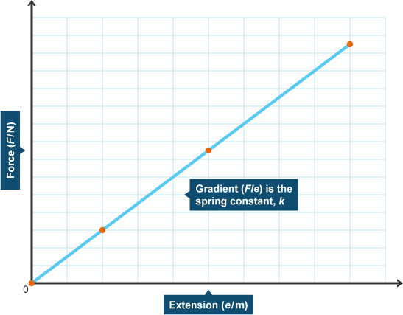
Robert Hooke was born in 1635 and the 1660’s he devised an equation describing elasticity.
Hooke’s Law and forces acting on a stretched spring.
Hooke discovered that the amount a spring stretches is proportional to the amount of force applied to it.
That is, if you double the load the extension will double.
= Hooke’s Law

Slide 30
Robert Hooke was born in 1635 and the 1660’s he devised an equation describing elasticity.
Hooke’s Law and forces acting on a stretched spring.
Hooke discovered that the amount a spring stretches is proportional to the amount of force applied to it.
For any spring, dividing the load (force) by the extension gives a value called the spring constant (K), provided that the spring is not stretched beyond its elastic limit.
That is, if you double the load the extension will double.
= Hooke’s Law

Slide 31
Robert Hooke was born in 1635 and the 1660’s he devised an equation describing elasticity.
Hooke’s Law and forces acting on a stretched spring.
Spring constant:
Load = spring constant x extension F = k x x
For any spring, dividing the load (force) by the extension gives a value called the spring constant (K), provided that the spring is not stretched beyond its elastic limit.

Slide 32
Robert Hooke was born in 1635 and the 1660’s he devised an equation describing elasticity.
Hooke’s Law and forces acting on a stretched spring.
Spring constant:
Load = spring constant x extension F = k x x
For any spring, dividing the load (force) by the extension gives a value called the spring constant (K), provided that the spring is not stretched beyond its elastic limit.
X
Up to point ‘X’ the extension is proportional to the load. Point ‘X’ is the limit or proportionality

Slide 33
Robert Hooke was born in 1635 and the 1660’s he devised an equation describing elasticity.
Hooke’s Law and forces acting on a stretched spring.
Beyond point ‘X’ the spring continues to behave elastically and returns to its original length when the force is removed. At the elastic limit the spring behaves in a ‘plastic’ way and does not return to its original length – it is permanently stretched.
For any spring, dividing the load (force) by the extension gives a value called the spring constant (K), provided that the spring is not stretched beyond its elastic limit.
X
Up to point ‘X’ the extension is proportional to the load. Point ‘X’ is the limit or proportionality

Slide 34
LEARNING OBJECTIVES
1.5.1 Effects of forces Core • Recognise that a force may produce a change in size and shape of a body • Plot and interpret extension-load graphs and describe the associated experimental procedure • Describe the ways in which a force may change the motion of a body • Find the resultant of two or more forces acting along the same line • Recognise that if there is no resultant force on a body it either remains at rest or continues at constant speed in a straight line • Understand friction as the force between two surfaces which impedes motion and results in heating • Recognise air resistance as a form of friction | Supplement • State Hooke’s Law and recall and use the expression F = k x, where k is the spring constant • Recognise the significance of the ‘limit of proportionality’ for an extension-load graph • Recall and use the relation between force, mass and acceleration (including the direction), F = ma • Describe qualitatively motion in a circular path due to a perpendicular force

Slide 35

Force, mass and acceleration

Slide 36
Force, mass and acceleration are related by the formula:

Slide 37
Force, mass and acceleration are related by the formula:
FORCE (N) = MASS (kg) x ACCELERATION (m/s²)

Slide 38
Force, mass and acceleration are related by the formula:
FORCE (N) = MASS (kg) x ACCELERATION (m/s²)
Newton’s second law of motion

Slide 39
Force, mass and acceleration are related by the formula:
FORCE (N) = MASS (kg) x ACCELERATION (m/s²)
F
m x a

Slide 40

Force, mass and acceleration are related by the formula:
FORCE (N) = MASS (kg) x ACCELERATION (m/s²)
Now an example try we must!
F
m x a

Slide 41
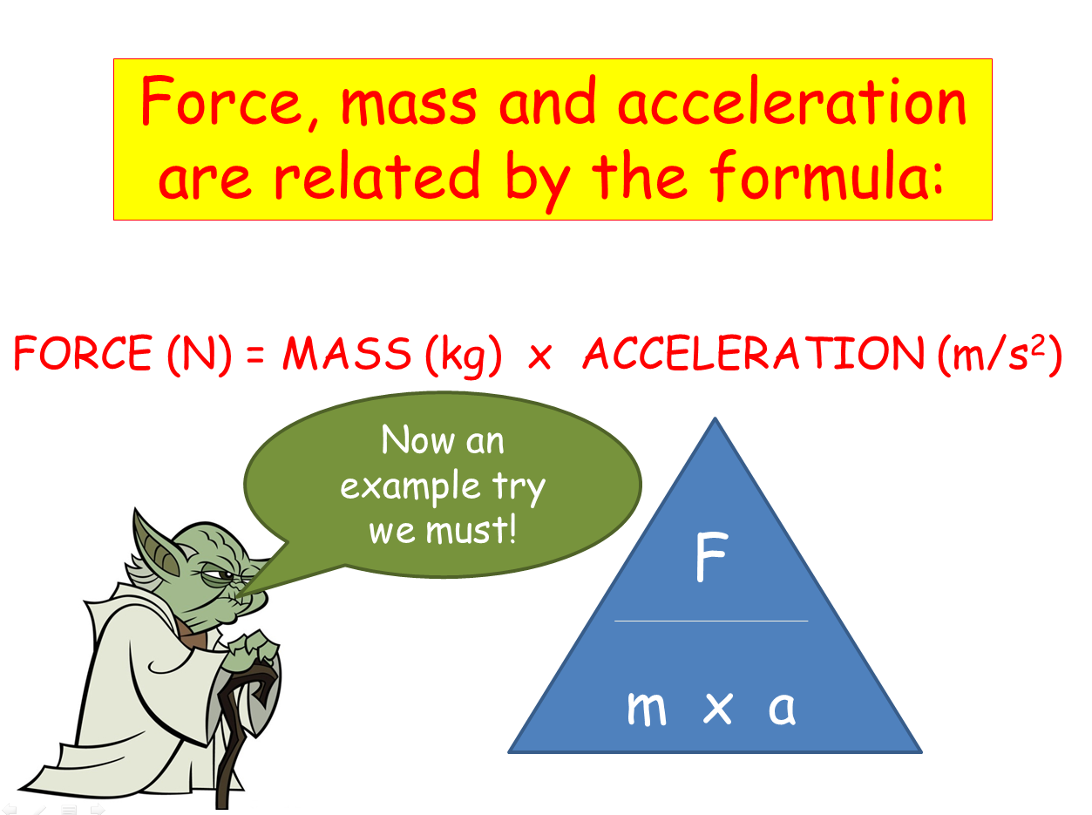

Mass = 3kg
Frictional force = 12N
Motor force = 20N

Slide 42
Mass = 3kg
Frictional force = 12N
Motor force = 20N
Resultant force = 20 – 12 = 8N (to the right)
Acceleration = F / m
a = 8 / 3 = 2.67m/s²

Slide 43
LEARNING OBJECTIVES
1.5.1 Effects of forces Core • Recognise that a force may produce a change in size and shape of a body • Plot and interpret extension-load graphs and describe the associated experimental procedure • Describe the ways in which a force may change the motion of a body • Find the resultant of two or more forces acting along the same line • Recognise that if there is no resultant force on a body it either remains at rest or continues at constant speed in a straight line • Understand friction as the force between two surfaces which impedes motion and results in heating • Recognise air resistance as a form of friction | Supplement • State Hooke’s Law and recall and use the expression F = k x, where k is the spring constant • Recognise the significance of the ‘limit of proportionality’ for an extension-load graph • Recall and use the relation between force, mass and acceleration (including the direction), F = ma • Describe qualitatively motion in a circular path due to a perpendicular force

Slide 44
PHYSICS – Forces 1

