Slide 1
Igcse chemistry lesson 3.2

Slide 2
Section 1
Principles of Chemistry
States of matter
Atoms
Atomic structure
Relative formula mass
Chemical formulae and chemical equations
Ionic compounds
Covalent substances
Metallic crystals
Electrolysis

Slide 3
Lesson 3.2
Relative formula mass
Chemical formulae and Chemical equations
1.18 write word equations and balanced chemical equations to represent the reactions studied
in this specification
1.19 use the state symbols (s), (l), (g) and (aq) in chemical equations to represent solids,
liquids, gases and aqueous solutions respectively
1.20 understand how the formulae of simple compounds can be obtained experimentally,
including metal oxides, water and salts containing water of crystallisation
1.21 calculate empirical and molecular formulae from experimental data
1.22 calculate reacting masses using experimental data and chemical equations
1.23 carry out mole calculations using volumes and molar concentrations.

Slide 4
Calculating reacting masses
For example, look at this equation:
CaCO₃ → CaO + CO₂

Slide 5
Calculating reacting masses
For example, look at this equation:
CaCO₃ → CaO + CO₂
If we start off with 100g of calcium carbonate, how much calcium oxide will we get?

Slide 6
Calculating reacting masses
For example, look at this equation:
CaCO₃ → CaO + CO₂
If we start off with 100g of calcium carbonate, how much calcium oxide will we get?
Guess what – we need to look at the values for M_{r} again!

Slide 7
Calculating reacting masses
For example, look at this equation:
CaCO₃ → CaO + CO₂
100 56 + 44
Can you see that, in terms of M_{r}, both sides of the equation balance – it has to be this way, so check your calculations carefully.

Slide 8
Calculating reacting masses
For example, look at this equation:
CaCO₃ → CaO + CO₂
100 56 + 44
Can you see that, in terms of M_{r}, both sides of the equation balance – it has to be this way, so check your calculations carefully.
So in this instance, 100g of calcium carbonate would give 56g of calcium oxide.

Slide 9
Calculating reacting masses
CaCO₃ → CaO + CO₂
Suppose we had 27g of calcium oxide, how much calcium oxide would we get?

Slide 10
Calculating reacting masses
CaCO₃ → CaO + CO₂
Suppose we had 27g of calcium oxide, how much calcium oxide would we get?
27g of CaCO₃ → 27 x 56 = 15.12g
100

Slide 11
Calculating reacting masses
Ready for another example?

Slide 12
Calculating reacting masses
Ready for another example?
How much aluminium oxide would be needed to produce 270 tonnes of Aluminium?
Here’s the equation:
2Al₂O₃ → 4Al + 3O₂

Slide 13
Calculating reacting masses
Ready for another example?
How much aluminium oxide would be needed to produce 270 tonnes of Aluminium?
Here’s the equation:
2Al₂O₃ → 4Al + 3O₂
Insert M_{r} 204 108 96

Slide 14
Calculating reacting masses
Ready for another example?
How much aluminium oxide would be needed to produce 270 tonnes of Aluminium?
Here’s the equation:
2Al₂O₃ → 4Al + 3O₂
Insert M_{r} 204 108 96 CHECK!

Slide 15
Calculating reacting masses
Ready for another example?
How much aluminium oxide would be needed to produce 270 tonnes of Aluminium?
Here’s the equation:
2Al₂O₃ → 4Al + 3O₂
Insert M_{r} 204 108 96 √

Slide 16
Calculating reacting masses
Ready for another example?
How much aluminium oxide would be needed to produce 270 tonnes of Aluminium?
Here’s the equation:
2Al₂O₃ → 4Al + 3O₂
Insert M_{r} 204 108 96 √
So, 108 tonnes is produced by 204 tonnes of Al₂O₃

Slide 17
Calculating reacting masses
Ready for another example?
How much aluminium oxide would be needed to produce 270 tonnes of Aluminium?
Here’s the equation:
2Al₂O₃ → 4Al + 3O₂
Insert M_{r} 204 108 96 √
So, 108 tonnes is produced by 204 tonnes of Al₂O₃
270 tonnes would be produced by 270 x 204 tonnes
108

Slide 18
Calculating reacting masses
Ready for another example?
How much aluminium oxide would be needed to produce 270 tonnes of Aluminium?
Here’s the equation:
2Al₂O₃ → 4Al + 3O₂
Insert M_{r} 204 108 96 √
= 510 tonnes

Slide 19
Lesson 3.2
Relative formula mass
Chemical formulae and Chemical equations
1.18 write word equations and balanced chemical equations to represent the reactions studied
in this specification
1.19 use the state symbols (s), (l), (g) and (aq) in chemical equations to represent solids,
liquids, gases and aqueous solutions respectively
1.20 understand how the formulae of simple compounds can be obtained experimentally,
including metal oxides, water and salts containing water of crystallisation
1.21 calculate empirical and molecular formulae from experimental data
1.22 calculate reacting masses using experimental data and chemical equations
1.23 carry out mole calculations using volumes and molar concentrations.

Slide 20
Molar solutions
Do you remember our old friend the ‘mole’? Let’s just refresh our memories:

Slide 21
The mole
The mole is a measure widely used in chemistry

Slide 22
The mole
One mole is the relative formula mass (M_{r}) of a compound, or relative atomic mass (A_{r}) of an element, expressed in grams

Slide 23
The mole
For example, the A_{r} of carbon is 12.

Slide 24
The mole
For example, the A_{r} of carbon is 12.
So the mass of one mole of carbon is 12g.

Slide 25
Molar solutions
If we dissolve 1 mole of a substance in 1dm³ of water we get a molar solution.

Slide 26
Molar solutions
If we dissolve 1 mole of a substance in 1dm³ of water we get a molar solution.
For example, sodium hydroxide (NaOH) has a M_{r} of 40, so 1 mole has a mass of 40g.

Slide 27
Molar solutions
If we dissolve 1 mole of a substance in 1dm³ of water we get a molar solution.
For example, sodium hydroxide (NaOH) has a M_{r} of 40, so 1 mole has a mass of 40g.
If we dissolve 40g NaOH in 1dm³ of water we get a molar solution (1M).

Slide 28
Molar solutions
If we dissolve 80g of NaOH in 1dm³ of water we get a 2M solution.

Slide 29
Molar solutions
If we dissolve 80g of NaOH in 1dm³ of water we get a 2M solution.
We call this the concentration of a solution, and it is given by:
concentration = number of moles
volume in dm³

Slide 30
Molar solutions
If we dissolve 80g of NaOH in 1dm³ of water we get a 2M solution.
We call this the concentration of a solution, and it is given by:
concentration = number of moles
volume in dm³

Slide 31
Molar solutions
Suppose we dissolve 20g of NaOH in 1dm³ of water, what is the concentration?

Slide 32
Molar solutions
Suppose we dissolve 20g of NaOH in 1dm³ of water, what is the concentration?
number of moles = mass = 20 = 0.5
Mr 40

Slide 33
Molar solutions
Suppose we dissolve 20g of NaOH in 1dm³ of water, what is the concentration?
number of moles = mass = 20 = 0.5
Mr 40
concentration = no. of moles = 0.5
volume 1
= 0.5M

Slide 34
Molar solutions
Suppose we dissolve 64g of NaOH in 500cm³ of water, what is the concentration?

Slide 35
Molar solutions
Suppose we dissolve 64g of NaOH in 500cm³ of water, what is the concentration?
number of moles = mass = 64 = 1.6
Mr 40

Slide 36
Molar solutions
Suppose we dissolve 64g of NaOH in 500cm³ of water, what is the concentration?
number of moles = mass = 64 = 1.6
Mr 40
concentration = no. of moles = 1.6
volume 0.5
= 3.2M

Slide 37
Molar solutions
concentration = no. of moles
volume
no. of moles = concentration x volume
volume = no. of moles
concentration

Slide 38
Molar solutions
Last example – I promise!
What is the volume of a 4M solution containing 2 moles?

Slide 39
Molar solutions
Last example – I promise!
What is the volume of a 4M solution containing 2 moles?
volume = number of moles
concentration

Slide 40
Molar solutions
Last example – I promise!
What is the volume of a 4M solution containing 2 moles?
volume = number of moles
concentration
= 2 = 0.5dm³ (500cm³)
4

Slide 41
Molar solutions
You may see concentration written as:
4mol/dm³
or
4M

Slide 42
Section 1
Principles of Chemistry
States of matter
Atoms
Atomic structure
Relative formula mass
Chemical formulae and chemical equations
Ionic compounds
Covalent substances
Metallic crystals
Electrolysis

Slide 43
1.24 describe the formation of ions by the gain or loss of electrons.
1.25 understand oxidation as the loss of electrons and reduction as the gain of electrons.
1.26 recall the charges of common ions.
1.27 deduce the charge of an ion from the electronic configuration of the atom from which the ion is formed.
1.28 explain using dot and cross diagrams, the formation of ionic compounds by electron transfer, limited to combinations of elements from Groups 1,2,3 and 5,6,7
1.29 understand ionic bonding as a strong electrostatic attraction between oppositely charged ions.
1.30 understand that ionic compounds have high melting points and boiling points because of strong electrostatic forces between oppositely charged ions.
Lesson 3.2
f) Ionic Compounds
g) Covalent compounds

Slide 44
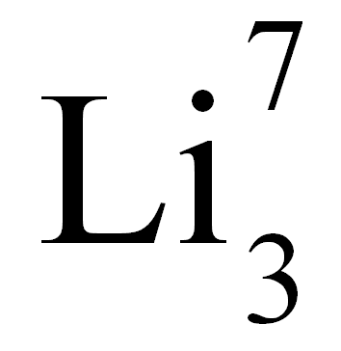
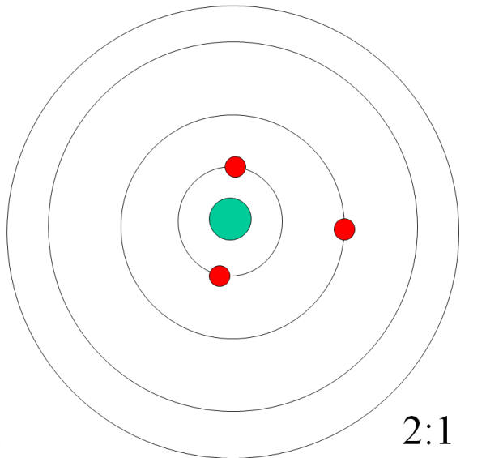
Lithium has an atomic number of 3 so has 3 electrons.
The first 2 electrons go into the first orbit (shell) and the remaining electron goes into the second orbit.
The electron configuration (arrangement) can also be written in this format.

Slide 45
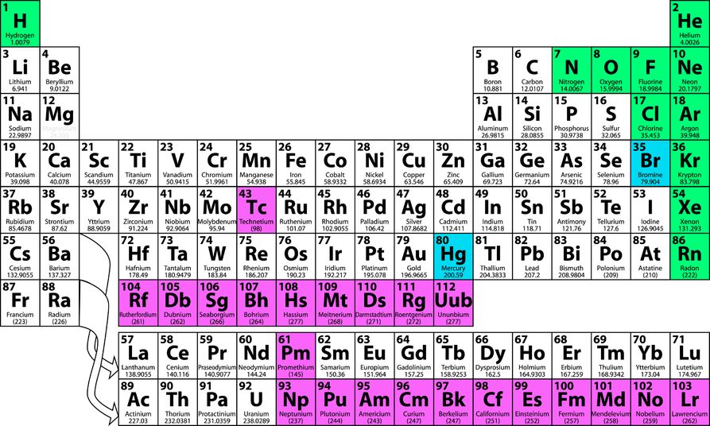
The Group Number tells you how many electrons there are in the outer shell (orbit) of an element.
For example, oxygen is in Group 6, so has 6 electrons in its outermost shell (2:6)

Slide 46
Atoms are at their most stable when they have a full outer shell or orbit.

Slide 47
Atoms are at their most stable when they have a full outer shell or orbit.
To become stable, lithium could either gain seven electrons, or lose one –what’s easier? Obviously to lose one.

Slide 48
Atoms are at their most stable when they have a full outer shell or orbit.
To become stable, lithium could either gain seven electrons, or lose one –what’s easier? Obviously to lose one.
If it loses one electron the charges now become unbalanced – lithium will now have two electrons (-2) and three protons (+3). The overall charge is now +1

Slide 49
Ion formation
A charged atom is known as an ion
The lithium ion has a charge of +1 and is written as Li⁺
All metals form positive ions
Non-metals form negative ions

Slide 50
Ion formation
Let’s look at an example of a metal ion formation:

Slide 51
Ion formation
Let’s look at an example of a metal ion formation:
Aluminium – a Group 3 metal (remember?)
Atomic number = 13
Number of protons =13
Number of electrons = 13
Electron configuration = 2:8:3

Slide 52
Ion formation
Electron configuration = 2:8:3
To become stable Al needs to lose 3 electrons from its outermost shell. It will now have:
13 protons (13+)
10 electrons (10-)
So the overall charge is 3+
This is written as Al⁺³ (the aluminium ion)

Slide 53
Ion formation
Let’s look at an example of a non-metal ion formation:
oxygen – a Group 6 non-metal
Atomic number = 8
Number of protons = 8
Number of electrons = 8
Electron configuration = 2:6

Slide 54
Ion formation
Electron configuration = 2:6
To become stable oxygen needs to gain 2 electrons. It will now have:
8 protons (8+)
10 electrons (10-)
So the overall charge is 2-
This is written as O²⁻ (the oxide ion)

Slide 55
Ion formation and the Periodic Table
+1
+2
+3
-3
-2
-1

Slide 56
Common ions
Cations | Anions
Na⁺ | Cl⁻
Mg⁺² | O⁻²
Ca⁺² | N⁻³
K⁺ | F⁻

Slide 57
Oxidation and Reduction
Oxidation
Is
Loss of electrons
Reduction
Is
Gain of electrons

Slide 58
Oxidation and Reduction
Oxidation
Is
Loss of electrons
Reduction
Is
Gain of electrons
So - metals are oxidised when they form ions (they lose electrons)
non-metals are reduced when they form ions (they gain electrons)

Slide 59
Ionic bonds form between metals and non-metals
Ionic bonding

Slide 60
Ionic bonds form between metals and non-metals
Metal atoms lose electrons to form positive ions
Ionic bonding

Slide 61
Ionic bonds form between metals and non-metals
Metal atoms lose electrons to form positive ions
Non-metal atoms gain electrons to form negative ions
Ionic bonding

Slide 62
Ionic bonds form between metals and non-metals
Metal atoms lose electrons to form positive ions
Non-metal atoms gain electrons to form negative ions
The oppositely charged ions attract one another
Ionic bonding

Slide 63
Sodium and Chlorine
-
+
11+
17+
11+ and 10- = 1+
Na⁺
17+ and 18- = 1-
Cl⁻
Click to view animation
Click for another example

Slide 64
Magnesium and Oxygen
2+
2-
12+
8+
12+ and 10- = 2+
Mg²⁺
8+ and 10- = 2-
O²⁻
Click for animation
Click for another example

Slide 65
Magnesium and Chlorine
-
-
2+
17+
12+
17+
17+ and 18- = 1-
Cl⁻
12+ and 10- = 2+
Mg²⁺
17+ and 18- = 1-
Cl⁻
Click to view animation

Slide 66
Giant Ionic Structures
Giant Ionic Structure
A regular lattice (GIANT IONIC LATTICE) held together by the strong forces of attraction between oppositely charged ions. This results in them having high melting and boiling points.
+
-
+
-
-
+
-
+
+
+
-
+
-
-
-
+
-
+
+
+
-
+
-

Slide 67
Giant Ionic Structures
Giant Ionic Structure
A regular lattice (GIANT IONIC LATTICE) held together by the strong forces of attraction between oppositely charged ions. This results in them having high melting and boiling points.
+
-
+
-
-
+
-
+
+
+
-
+
-
-
-
+
-
+
+
+
-
+
-
Ionic compounds also conduct electricity when molten or in solution because the charged ions are free to move about.

Slide 68
1.31 describe the formation of a covalent bond by the sharing of a pair of electrons between two atoms.
1.32 understand covalent bonding as a strong attraction between the bonding pair of electrons and the nuclei of the atoms involved in the bond.
1.33 explain, using dot and cross diagrams, the formation of covalent compounds by electron sharing for the following substances:
Hydrogen, chlorine, hydrogen chloride, water, methane, ammonia, oxygen, nitrogen, carbon dioxide, ethane, ethene.
1.34 recall that substances with simple molecular substances are gases or liquids, or solids with low melting points.
1.35 explain why substances with simple molecular structure have low melting points in terms of the relatively weak forces between the molecules.
1.36 explain the high melting points of substances with giant covalent structures in terms of the breaking of many strong covalent bonds.
Lesson 3.2
f) Ionic Compounds
g) Covalent compounds

Slide 69
Covalent Bonding
Covalent bonds form between non-metal atoms
Covalent bonds involve sharing a pair of electrons

Slide 70
Hydrogen and Hydrogen
H
H
H₂
Click for another example
Click for animation

Slide 71
Nitrogen and Hydrogen (Ammonia)
H
H
N
NH₃
H
Click for another example
Click for animation

Slide 72
Hydrogen and Oxygen
O
H₂O
H
H
Click for animation

Slide 73
Covalent compounds
Now it’s your turn! Use the dot and cross method to show the formation of covalent bonds in the following compounds:
Chlorine Cl₂
Hydrogen chloride HCl
Methane CH₄
Oxygen O₂
Nitrogen N₂
Carbon dioxide CO₂
Ethane C₂H₆
Ethene C₂H₄

Slide 74
Giant covalent structures
DIAMOND – A form of carbon. A giant lattice structure where each carbon atom forms four covalent bonds with other carbon atoms. The large number of covalent bonds results in diamond having a VERY HIGH MELTING POINT.

Slide 75
Giant covalent structures
DIAMOND – A form of carbon. A giant lattice structure where each carbon atom forms four covalent bonds with other carbon atoms. The large number of covalent bonds results in diamond having a VERY HIGH MELTING POINT.
GRAPHITE – A form of carbon. A giant lattice structure in which each carbon atom forms three covalent bonds with other carbon atoms, in a layered structure in which the layers slide past each other. Weak forces of attraction between layers.

Slide 76
Giant covalent structures
DIAMOND – A form of carbon. A giant lattice structure where each carbon atom forms four covalent bonds with other carbon atoms. The large number of covalent bonds results in diamond having a VERY HIGH MELTING POINT.
GRAPHITE – A form of carbon. A giant lattice structure in which each carbon atom forms three covalent bonds with other carbon atoms, in a layered structure in which the layers slide past each other. Weak forces of attraction between layers.
Electrons are free to move between layers, so graphite conducts electricity.

Slide 77
Properties of ionic and covalent compounds
Ionic | Covalent
Usually solid at room temperature | Usually liquid or gas at room temperature

Slide 78
Properties of ionic and covalent compounds
Ionic | Covalent
Usually solid at room temperature | Usually liquid or gas at room temperature
Usually high melting and boiling points | Usually low melting and boiling points

Slide 79
Properties of ionic and covalent compounds
Ionic | Covalent
Usually solid at room temperature | Usually liquid or gas at room temperature
Usually high melting and boiling points | Usually low melting and boiling points
Usually soluble in water | Usually insoluble in water

Slide 80
Properties of ionic and covalent compounds
Ionic | Covalent
Usually solid at room temperature | Usually liquid or gas at room temperature
Usually high melting and boiling points | Usually low melting and boiling points
Usually soluble in water | Usually insoluble in water
Conduct electricity when melted or dissolved in water | Do not conduct electricity

Slide 81
End of Lesson 3 (part 2)
In this lesson we have covered:
Reacting masses
Molar solutions
Ionic bonding
Covalent bonding

