Slide 1
PHYSICS – Digital electronics

Slide 2
LEARNING OBJECTIVES
LEARNING OBJECTIVES
Core • | Supplement Explain and use the terms analogue and digital in terms of continuous variation and high/low states • Describe the action of NOT, AND, OR, NAND and NOR gates • Recall and use the symbols for logic gates • Design and understand simple digital circuits combining several logic gates • Use truth tables to describe the action of individual gates and simple combinations of gates

Slide 3
All very logical I think!
Logic Gates

Slide 4
All very logical I think!
Logic Gates
So what are logic gates?
A logic gate is an electronic switch

Slide 5
All very logical I think!
Logic Gates
So what are logic gates?
A logic gate is an electronic switch
Logic gates are found in everyday items such as washing machines, security lamps and video recorders.

Slide 6
All very logical I think!
Logic Gates
So what are logic gates?
A logic gate is an electronic switch
Logic gates are found in everyday items such as washing machines, security lamps and video recorders.
Logic gates depend upon switches being on (1) or off (0)

Slide 7
Logic Gates
A
B
Switch
Switch
Gate

Slide 8
Logic Gates
A
B
Switch
Switch
Gate
For the bulb in the circuit above to light up, both switches A and B need to be ON (closed). If either A or B is OFF (open) then the bulb will not work. A truth table gives us all possible combinations of the switches.

Slide 9
Logic Gates
A
B
Truth table
Inputs |  | Output
A | B | Q
0 | 0 | 0
1 | 0 | 0
0 | 1 | 0
1 | 1 | 1
Switch
Switch
Gate
For the bulb in the circuit above to light up, both switches A and B need to be ON (closed). If either A or B is OFF (open) then the bulb will not work. A truth table gives us all possible combinations of the switches.
In the truth table:
0 = OFF
1 = ON

Slide 10
Just a minute – what’s all this analogue and digital stuff?

Slide 11
Just a minute – what’s all this analogue and digital stuff?
A thermistor is an analogue device – it’s resistance varies over a continuous range.

Slide 12
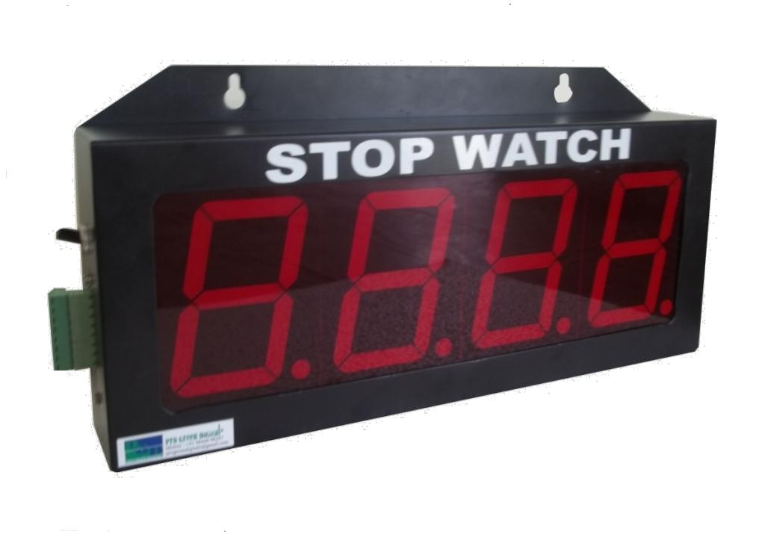
Just a minute – what’s all this analogue and digital stuff?
A stop clock, such as the one shown here, is a digital device because the strips that make up the display can only be on (1) of off (0)

Slide 13
A stop clock, such as the one shown here, is a digital device because the strips that make up the display can only be on (1) of off (0)

Slide 14
Logic gates

Slide 15
Logic gates
AND gate
Truth table
Inputs |  | Output
A | B | Q
0 | 0 | 0
1 | 0 | 0
0 | 1 | 0
1 | 1 | 1
Input A
AND
Output Q
Input B
Two inputs, one output.
For the output to be HIGH (on), both inputs must be HIGH.

Slide 16
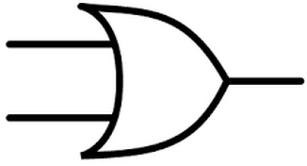
Logic gates
OR gate
Truth table
Inputs |  | Output
A | B | Q
0 | 0 | 0
1 | 0 | 1
0 | 1 | 1
1 | 1 | 1
Input A
OR
Output Q
Input B
Two inputs, one output.
For the output to be HIGH (on), at least one of the inputs must be HIGH (can be both).

Slide 17
Logic gates
NOT gate
Truth table
Input | Output
A | Q
0 | 1
1 | 0
OR
Input A
NOT
Output Q
One input, one output.
For the output to be HIGH (on), the input must be LOW (and vice versa)

Slide 18
Logic gates
NAND gate
Truth table
Inputs |  | Output
A | B | Q
1 | 1 | 0
1 | 0 | 1
0 | 1 | 1
0 | 0 | 1
Input A
NAND
Output Q
Input B
Two inputs, one output.
For the output to be HIGH (on), both inputs A and B must NOT be HIGH.
This is equivalent to an AND gate with its output inverted by a NOT gate.

Slide 19
Logic gates
NOR gate
Truth table
Inputs |  | Output
A | B | Q
1 | 1 | 0
1 | 0 | 0
0 | 1 | 0
0 | 0 | 1
Input A
NOR
Output Q
Input B
Two inputs, one output.
For the output to be HIGH (on), neither inputs A or B is HIGH.
This is equivalent to an OR gate with its output inverted by a NOT gate.

Slide 20
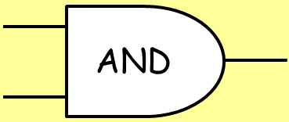
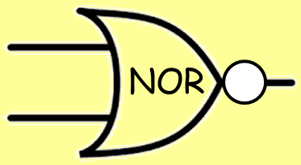
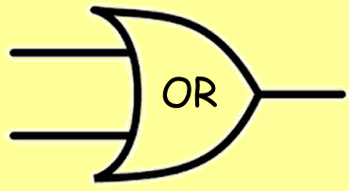
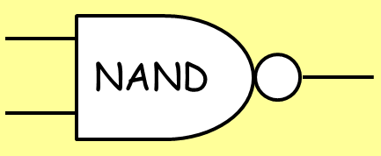
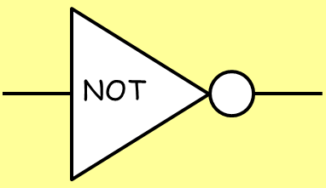
AND
OR
NOT
NAND
NOR

Slide 21
Simple circuits using Logic gates

Slide 22
Simple circuits using Logic gates
Tape recorder
Record button
AND
Recording circuits
Play button
The Play and the Record button have to be pressed simultaneously in order for the recording circuits to begin working.

Slide 23
Simple circuits using Logic gates
During the day the light sensor output is high.
Security light
Light sensor
1
0
Lamp
0
Relay
0
Body heat sensor
0/1
The relay controls a separate circuit with the lamp in it.
During the day the body heat sensor can be either high or low – the AND gate will not be triggered.

Slide 24
Simple circuits using Logic gates
When it is dark the light sensor output is low.
Security light
Light sensor
0
1
Lamp
1
Relay
1
Body heat sensor
1
The AND gate receives two high inputs and triggers the relay which causes the lamp to switch on.
When it is dark, if someone approaches the body heat sensor is triggered and becomes high

Slide 25
Simple circuits using Logic gates
The alarm can be tested at any time by closing the test switch → HIGH (1)
A low temperature indicator – eg. In a greenhouse.
+5V
Test switch
When the greenhouse is warm enough, the input from the temperature sensor is HIGH (1).
0V
Temperature sensor
1
0
Alarm
0

Slide 26
Simple circuits using Logic gates
The alarm can be tested at any time by closing the test switch → HIGH (1)
A low temperature indicator – eg. In a greenhouse.
+5V
When the greenhouse cools, the input from the temperature sensor is LOW (0). The NOT gate changes this to a ‘1’ and the alarm is switched on.
Test switch
0V
Temperature sensor
0
1
Alarm
1

Slide 27
Simple circuits using Logic gates
A night-time rain alarm.
Light sensor
During the day, the output from the light sensor is always HIGH (1) so the output from the NOT gate is always LOW (0) and the alarm is not switched on.
1
0
Moisture sensor
0
0/1
Alarm

Slide 28
Simple circuits using Logic gates
A night-time rain alarm.
Light sensor
In darkness the output from the light sensor is LOW (0). This means that the output from the NOT switch is HIGH (1). If rain falls on the moisture sensor then its output becomes HIGH (1). The AND gate receives two HIGH inputs, so the alarm is switched on.
0
1
Moisture sensor
1
1
Alarm

Slide 29
LEARNING OBJECTIVES
LEARNING OBJECTIVES
Core • | Supplement Explain and use the terms analogue and digital in terms of continuous variation and high/low states • Describe the action of NOT, AND, OR, NAND and NOR gates • Recall and use the symbols for logic gates • Design and understand simple digital circuits combining several logic gates • Use truth tables to describe the action of individual gates and simple combinations of gates

Slide 30
PHYSICS – Digital electronics

