Slide 1
PHYSICS – Electric circuits

Slide 2
LEARNING OBJECTIVES
Core •Draw and interpret circuit diagrams containing sources, switches, resistors (fixed and variable), heaters, thermistors, light-dependent resistors, lamps, ammeters, voltmeters, galvanometers, magnetising coils, transformers, bells, fuses and relays Understand that the current at every point in a series circuit is the same Give the combined resistance of two or more resistors in series State that, for a parallel circuit, the current from the source is larger than the current in each branch State that the combined resistance of two resistors in parallel is less than that of either resistor by itself State the advantages of connecting lamps in parallel in a lighting circuit Describe the action of a variable potential divider (potentiometer) • Describe the action of thermistors and light- dependent resistors and show understanding of their use as input transducers • Describe the action of a relay and show understanding of its use in switching circuits | Supplement Draw and interpret circuit diagrams containing diodes Calculate the combined e.m.f. of several sources in series • Recall and use the fact that the sum of the p.d.s across the components in a series circuit is equal to the total p.d. across the supply • Recall and use the fact that the current from the source is the sum of the currents in the separate branches of a parallel circuit • Calculate the effective resistance of two resistors in parallel Describe the action of a diode and show understanding of its use as a rectifier • Recognise and show understanding of circuits operating as light-sensitive switches and temperature-operated alarms (to include the use of a relay)

Slide 3
Draw and interpret circuit diagrams containing sources, switches, resistors (fixed and variable), heaters, thermistors, light-dependent resistors, lamps, ammeters, voltmeters, galvanometers, magnetising coils, transformers, bells, fuses and relays
Draw and interpret circuit diagrams containing diodes

Slide 4
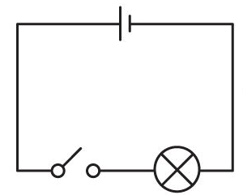
Draw and interpret circuit diagrams containing sources, switches, resistors (fixed and variable), heaters, thermistors, light-dependent resistors, lamps, ammeters, voltmeters, galvanometers, magnetising coils, transformers, bells, fuses and relays
Draw and interpret circuit diagrams containing diodes

Slide 5
Draw and interpret circuit diagrams containing sources, switches, resistors (fixed and variable), heaters, thermistors, light-dependent resistors, lamps, ammeters, voltmeters, galvanometers, magnetising coils, transformers, bells, fuses and relays
Components
Draw and interpret circuit diagrams containing diodes

Slide 6
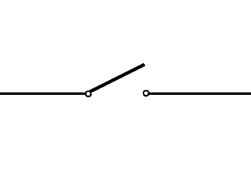
Draw and interpret circuit diagrams containing sources, switches, resistors (fixed and variable), heaters, thermistors, light-dependent resistors, lamps, ammeters, voltmeters, galvanometers, magnetising coils, transformers, bells, fuses and relays
Components
Draw and interpret circuit diagrams containing diodes
Switch
Resistor (fixed)

Slide 7
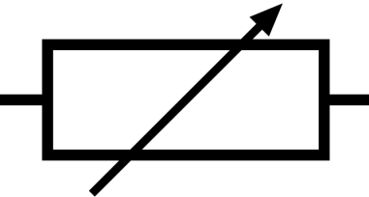
Draw and interpret circuit diagrams containing sources, switches, resistors (fixed and variable), heaters, thermistors, light-dependent resistors, lamps, ammeters, voltmeters, galvanometers, magnetising coils, transformers, bells, fuses and relays
Components
Draw and interpret circuit diagrams containing diodes
Switch
Resistor (fixed)
Resistor (variable)
Heater

Slide 8
Draw and interpret circuit diagrams containing sources, switches, resistors (fixed and variable), heaters, thermistors, light-dependent resistors, lamps, ammeters, voltmeters, galvanometers, magnetising coils, transformers, bells, fuses and relays
Components
Draw and interpret circuit diagrams containing diodes
Cell
Battery
Resistor (variable)
Heater

Slide 9
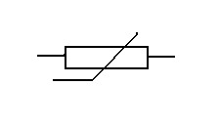
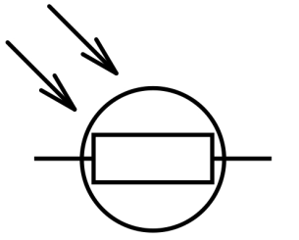
Draw and interpret circuit diagrams containing sources, switches, resistors (fixed and variable), heaters, thermistors, light-dependent resistors, lamps, ammeters, voltmeters, galvanometers, magnetising coils, transformers, bells, fuses and relays
Components
Draw and interpret circuit diagrams containing diodes
Cell
Battery
Thermistor
Light dependent resistor (LDR)

Slide 10
Draw and interpret circuit diagrams containing sources, switches, resistors (fixed and variable), heaters, thermistors, light-dependent resistors, lamps, ammeters, voltmeters, galvanometers, magnetising coils, transformers, bells, fuses and relays
Components
Draw and interpret circuit diagrams containing diodes
Filament lamp
Filament lamp
Thermistor
Light dependent resistor (LDR)

Slide 11
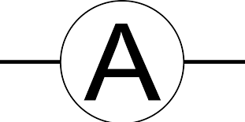
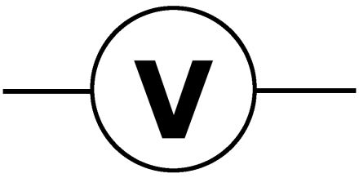
Draw and interpret circuit diagrams containing sources, switches, resistors (fixed and variable), heaters, thermistors, light-dependent resistors, lamps, ammeters, voltmeters, galvanometers, magnetising coils, transformers, bells, fuses and relays
Components
Draw and interpret circuit diagrams containing diodes
Filament lamp
Filament lamp
Ammeter
Voltmeter

Slide 12
Draw and interpret circuit diagrams containing sources, switches, resistors (fixed and variable), heaters, thermistors, light-dependent resistors, lamps, ammeters, voltmeters, galvanometers, magnetising coils, transformers, bells, fuses and relays
Components
Draw and interpret circuit diagrams containing diodes
Galvanometer
Magnetising coil
Ammeter
Voltmeter

Slide 13
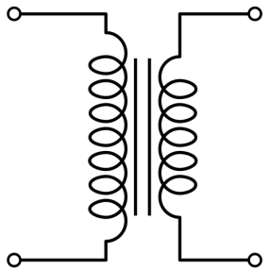
Draw and interpret circuit diagrams containing sources, switches, resistors (fixed and variable), heaters, thermistors, light-dependent resistors, lamps, ammeters, voltmeters, galvanometers, magnetising coils, transformers, bells, fuses and relays
Components
Draw and interpret circuit diagrams containing diodes
Galvanometer
Magnetising coil
Transformer
Bell

Slide 14
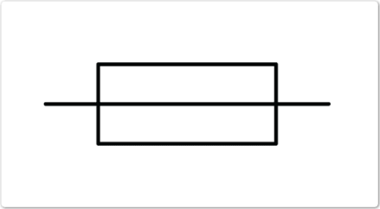
Draw and interpret circuit diagrams containing sources, switches, resistors (fixed and variable), heaters, thermistors, light-dependent resistors, lamps, ammeters, voltmeters, galvanometers, magnetising coils, transformers, bells, fuses and relays
Components
Draw and interpret circuit diagrams containing diodes
Fuse
Relay (and switch)
Transformer
Bell

Slide 15
Draw and interpret circuit diagrams containing sources, switches, resistors (fixed and variable), heaters, thermistors, light-dependent resistors, lamps, ammeters, voltmeters, galvanometers, magnetising coils, transformers, bells, fuses and relays
Components
Draw and interpret circuit diagrams containing diodes
Fuse
Relay (and switch)
DC Power Supply
AC Power Supply

Slide 16
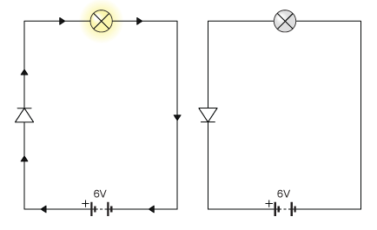
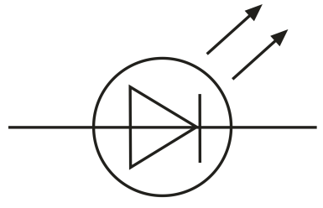
Draw and interpret circuit diagrams containing sources, switches, resistors (fixed and variable), heaters, thermistors, light-dependent resistors, lamps, ammeters, voltmeters, galvanometers, magnetising coils, transformers, bells, fuses and relays
Components
Draw and interpret circuit diagrams containing diodes
Diode
Light emitting diode
Diodes only allow current to flow in one direction. They can be used to protect damage to polarised components.

Slide 19
Series and Parallel Circuits

Slide 20
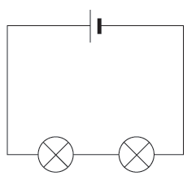
Series and Parallel Circuits
Series
Components are in a single loop, and the current flows from one to the next without any branches.

Slide 21
Series and Parallel Circuits
Series
Components are in a single loop, and the current flows from one to the next without any branches.
If more bulbs are put into the circuit then the bulbs will be dimmer than before.

Slide 22
Series and Parallel Circuits
Series
Components are in a single loop, and the current flows from one to the next without any branches.
If more bulbs are put into the circuit then the bulbs will be dimmer than before.
If one bulb breaks then the circuit is broken and all components stop working.

Slide 23
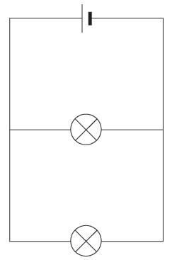
Series and Parallel Circuits
Series
Parallel
Components are in a single loop, and the current flows from one to the next without any branches.
If more bulbs are put into the circuit then the bulbs will be dimmer than before.
If one bulb breaks then the circuit is broken and all components stop working.
Components are connected on different branches of the wire

Slide 24
Series and Parallel Circuits
Series
Parallel
Components are in a single loop, and the current flows from one to the next without any branches.
If more bulbs are put into the circuit then the bulbs will be dimmer than before.
If one bulb breaks then the circuit is broken and all components stop working.
Components are connected on different branches of the wire.
If more bulbs are added then the lamps stay bright – they take full voltage.

Slide 25
Series and Parallel Circuits
Series
Parallel
Components are in a single loop, and the current flows from one to the next without any branches.
If more bulbs are put into the circuit then the bulbs will be dimmer than before.
If one bulb breaks then the circuit is broken and all components stop working.
Components are connected on different branches of the wire.
If more bulbs are added then the lamps stay bright – they take full voltage.
If one bulb breaks the components on different branches keep working. Our home circuits are parallel.

Slide 26
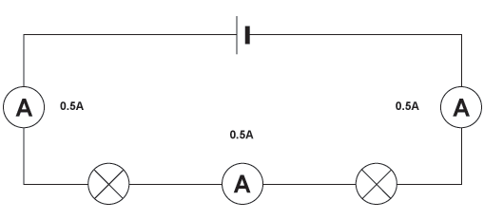
Current in Series and Parallel circuits
Ammeters can be placed anywhere in a series circuit and will all give the same reading.
http://www.bbc.co.uk/bitesize/ks3/science/energy_electricity_forces/electric_current_voltage/revision/6/

Slide 27
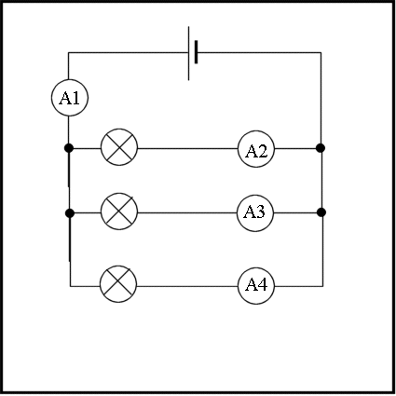
Current in Series and Parallel circuits
In a parallel circuit the current through each component depends upon its resistance.

Slide 28
Current in Series and Parallel circuits
In a parallel circuit the current through each component depends upon its resistance.
5.5A
1.5A
3A
1A
The total current flowing around the circuit is equal to the total of all the currents in the separate branches.

Slide 29
Current in Series and Parallel circuits
In a parallel circuit the current through each component depends upon its resistance.
5.5A
1.5A
3A
1A
The total current flowing around the circuit is equal to the total of all the currents in the separate branches.
A1 = A2 + A3 + A4

Slide 30
Current in Series and Parallel circuits
In a parallel circuit the current through each component depends upon its resistance.
5.5A
1.5A
3A
1A
The total current flowing around the circuit is equal to the total of all the currents in the separate branches.
A1 = A2 + A3 + A4
5.5 = 1.5 + 3 + 1

Slide 31
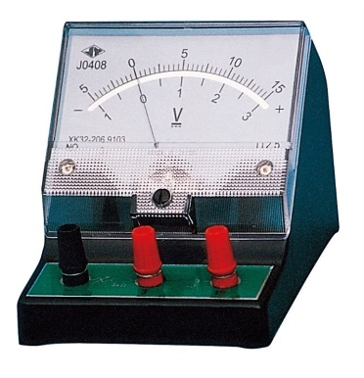
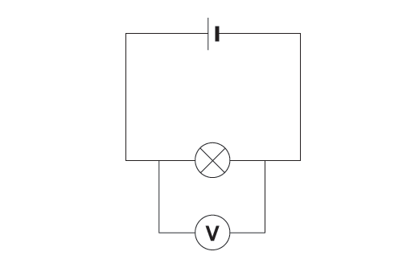
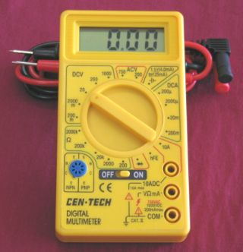
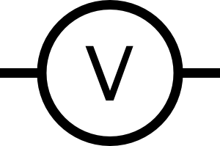
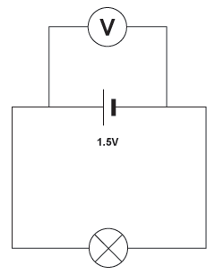
Voltage is measured using a VOLTMETER
Voltage in Series and Parallel circuits
To measure the voltage across a component in a circuit the voltmeter must be placed in parallel with it.

Slide 32
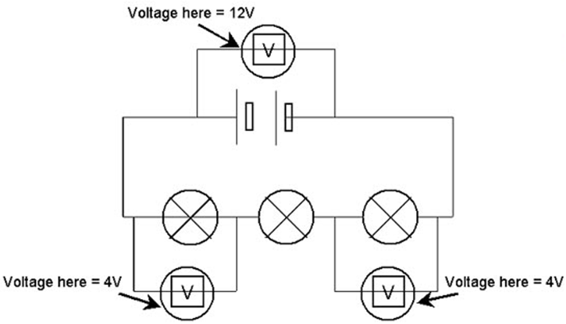
Voltage is measured using a VOLTMETER
Voltage in Series and Parallel circuits
In a series circuit the total voltage (PD) of the supply is shared between the various components, so the voltages around a series circuit always add up to equal the source voltage.

Slide 33
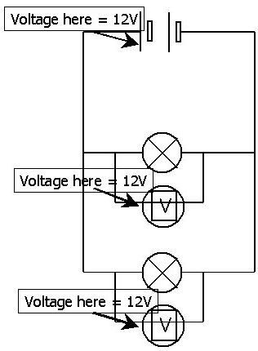
Voltage is measured using a VOLTMETER
Voltage in Series and Parallel circuits
In a parallel circuit all components get the full source voltage, so the voltage is the same across all components
In a series circuit the total voltage (PD) of the supply is shared between the various components, so the voltages around a series circuit always add up to equal the source voltage.

Slide 34
Resistance in Series and Parallel circuits

Slide 35
Resistance in Series and Parallel circuits
In series

Slide 36
Resistance in Series and Parallel circuits
In series
If resistors are connected in series, the current through each resistor is the same.
I₁ = I₂ = I₃
I₁
I₂
I₃

Slide 37
Resistance in Series and Parallel circuits
In series
If resistors are connected in series, the current through each resistor is the same.
I₁ = I₂ = I₃
V_{T}
V₁
V₂
V₃
I₁
I₂
I₃
If resistors are connected in series, the potential difference across all resistors is equal to the sum of the potential differences across each resistor.
V_{T} = V₁ + V₂ + V₃

Slide 38
Resistance in Series and Parallel circuits
In series
If resistors are connected in series, the current through each resistor is the same.
I₁ = I₂ = I₃
V_{T}
V₁
V₂
V₃
R₁
R₂
R₃
I₁
I₂
I₃
If resistors are connected in series, the potential difference across all resistors is equal to the sum of the potential differences across each resistor.
V_{T} = V₁ + V₂ + V₃
The total resistance of a number of resistors in series is equal to the sum of all the individual resistances.
R_{T} = R₁ + R₂ + R₃

Slide 39
Resistance in Series and Parallel circuits
In parallel

Slide 40
Resistance in Series and Parallel circuits
In parallel
I_{T}
If resistors are connected in parallel, the total current is equal to the sum of the currents through each resistor.
I_{T} = I₁ + I₂ + I₃
I₁
I₂
I₃

Slide 41
Resistance in Series and Parallel circuits
In parallel
I_{T}
If resistors are connected in parallel, the total current is equal to the sum of the currents through each resistor.
I_{T} = I₁ + I₂ + I₃
I₁
V₁
I₂
V₂
I₃
V₃
If resistors are connected in parallel, the potential difference across all resistors is the same.
V₁ = V₂ = V₃

Slide 42
Resistance in Series and Parallel circuits
In parallel
I_{T}
If resistors are connected in parallel, the total current is equal to the sum of the currents through each resistor.
I_{T} = I₁ + I₂ + I₃
I₁
V₁
R₁
I₂
V₂
R₂
I₃
V₃
R₃
If resistors are connected in parallel, the potential difference across all resistors is the same.
V₁ = V₂ = V₃
The total resistance of a number of resistors in parallel is given by the formula:
1/R_{T} = 1/R₁ + 1/R₂ + 1/R₃

Slide 43
Resistance in Series and Parallel circuits
In parallel
The total resistance of a number of resistors in parallel is given by the formula:
1/R_{T} = 1/R₁ + 1/R₂ + 1/R₃
R₁
R₂
R₃
For example, if:
R₁ = 18Ω
R₂ = 12Ω
R₃ = 6Ω
1/R_{T} = 1/18 + 1/12 + 1/6
= 2/36 + 3/36 + 6/36 = 11/36
R_{T} = 36/11 = 3.27Ω

Slide 44
LEARNING OBJECTIVES
Core •Draw and interpret circuit diagrams containing sources, switches, resistors (fixed and variable), heaters, thermistors, light-dependent resistors, lamps, ammeters, voltmeters, galvanometers, magnetising coils, transformers, bells, fuses and relays Understand that the current at every point in a series circuit is the same Give the combined resistance of two or more resistors in series State that, for a parallel circuit, the current from the source is larger than the current in each branch State that the combined resistance of two resistors in parallel is less than that of either resistor by itself State the advantages of connecting lamps in parallel in a lighting circuit Describe the action of a variable potential divider (potentiometer) • Describe the action of thermistors and light- dependent resistors and show understanding of their use as input transducers • Describe the action of a relay and show understanding of its use in switching circuits | Supplement Draw and interpret circuit diagrams containing diodes Calculate the combined e.m.f. of several sources in series • Recall and use the fact that the sum of the p.d.s across the components in a series circuit is equal to the total p.d. across the supply • Recall and use the fact that the current from the source is the sum of the currents in the separate branches of a parallel circuit • Calculate the effective resistance of two resistors in parallel Describe the action of a diode and show understanding of its use as a rectifier • Recognise and show understanding of circuits operating as light-sensitive switches and temperature-operated alarms (to include the use of a relay)

Slide 45
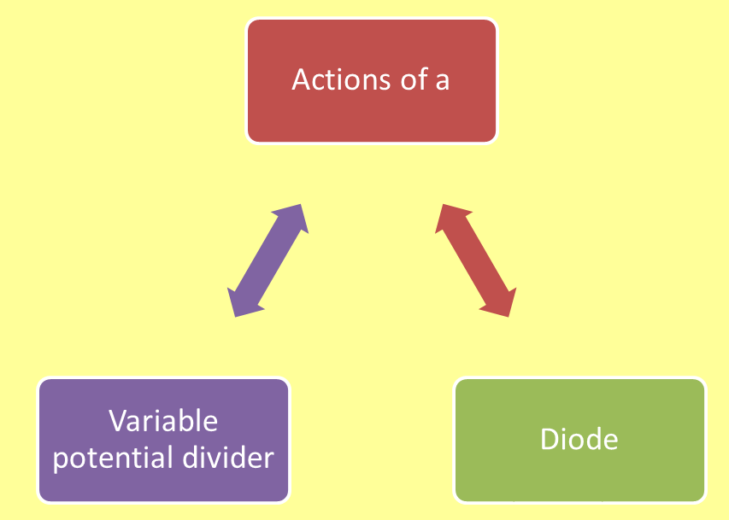

Slide 46
What is a variable potential divider?

Slide 47
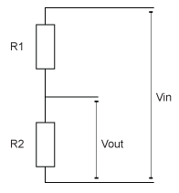
What is a variable potential divider?
Potential dividers divide up the voltage within a circuit, so that parts of the circuit only receive the voltage they require. They usually consist of two or more resistors in series across a power supply.

Slide 48
What is a variable potential divider?
Potential dividers divide up the voltage within a circuit, so that parts of the circuit only receive the voltage they require. They usually consist of two or more resistors in series across a power supply.
10Ω
6V
In this example, the lower resistor has half the total resistance of the two resistors, so its share of the voltage from the battery is also a half.
10Ω
3V

Slide 49
What is a variable potential divider?
10Ω
If one of the resistors is replaced by a variable resistor then the output voltage can be varied. In this example, it can range from 0 to 3V, depending upon the setting of the variable resistor.
A circuit such as this one could be used as a radio volume control.
6V
0-10 kΩ
0-3V

Slide 50
What is a diode, and how does it rectify?

Slide 51
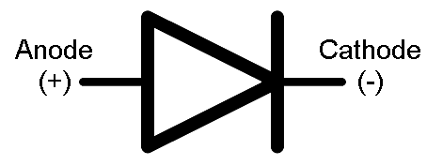
What is a diode, and how does it rectify?
A diode is an electrical component that allows current to flow in one direction only. It is polarised with two leads – the anode and the cathode.

Slide 52
What is a diode, and how does it rectify?
If the anode is connected to a higher voltage than the cathode, then the current will flow from anode to cathode. This is called forward bias.
A diode is an electrical component that allows current to flow in one direction only. It is polarised with two leads – the anode and the cathode.

Slide 53
What is a diode, and how does it rectify?
If the anode is connected to a higher voltage than the cathode, then the current will flow from anode to cathode. This is called forward bias.
If the diode is reversed, so that the voltage at the cathode is higher than the voltage at the anode, the diode will not conduct electricity. This is called reverse bias.
A diode is an electrical component that allows current to flow in one direction only. It is polarised with two leads – the anode and the cathode.

Slide 54
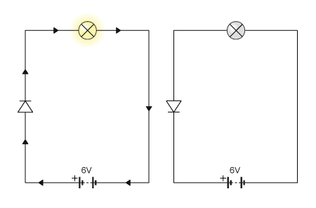
What is a diode, and how does it rectify?
Forward bias – the diode has extremely low resistance, so a current flows through it and the bulb lights up.

Slide 55
What is a diode, and how does it rectify?
Forward bias – the diode has extremely low resistance, so a current flows through it and the bulb lights up.
Reverse bias– the diode has extremely high resistance, so the current does not flow through it and the bulb does not light up.

Slide 56
What is a diode, and how does it rectify?
Rectification – diodes can be used to convert AC (alternating current) to DC (direct current).
The diode lets the forward part of the AC through, but blocks the backward part.
We can see how the circuit changes the AC input using the trace on a cathode ray oscilloscope (CRO).

Slide 57
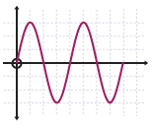
What is a diode, and how does it rectify?
Rectification – diodes can be used to convert AC (alternating current) to DC (direct current).
The diode lets the forward part of the AC through, but blocks the backward part.
We can see how the circuit changes the AC input using the trace on a cathode ray oscilloscope (CRO).

Slide 58
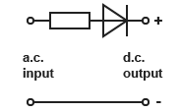
What is a diode, and how does it rectify?
Rectification – diodes can be used to convert AC (alternating current) to DC (direct current).
The diode lets the forward part of the AC through, but blocks the backward part.
We can see how the circuit changes the AC input using the trace on a cathode ray oscilloscope (CRO).

Slide 59
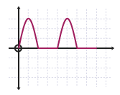
What is a diode, and how does it rectify?
Rectification – diodes can be used to convert AC (alternating current) to DC (direct current).
The diode lets the forward part of the AC through, but blocks the backward part.
We can see how the circuit changes the AC input using the trace on a cathode ray oscilloscope (CRO).

Slide 60
What is a diode, and how does it rectify?
Rectification – diodes can be used to convert AC (alternating current) to DC (direct current).
The diode lets the forward part of the AC through, but blocks the backward part.
We can see how the circuit changes the AC input using the trace on a cathode ray oscilloscope (CRO).
This is called half-wave rectification.

Slide 61
LEARNING OBJECTIVES
Core •Draw and interpret circuit diagrams containing sources, switches, resistors (fixed and variable), heaters, thermistors, light-dependent resistors, lamps, ammeters, voltmeters, galvanometers, magnetising coils, transformers, bells, fuses and relays Understand that the current at every point in a series circuit is the same Give the combined resistance of two or more resistors in series State that, for a parallel circuit, the current from the source is larger than the current in each branch State that the combined resistance of two resistors in parallel is less than that of either resistor by itself State the advantages of connecting lamps in parallel in a lighting circuit Describe the action of a variable potential divider (potentiometer) • Describe the action of thermistors and light- dependent resistors and show understanding of their use as input transducers • Describe the action of a relay and show understanding of its use in switching circuits | Supplement Draw and interpret circuit diagrams containing diodes Calculate the combined e.m.f. of several sources in series • Recall and use the fact that the sum of the p.d.s across the components in a series circuit is equal to the total p.d. across the supply • Recall and use the fact that the current from the source is the sum of the currents in the separate branches of a parallel circuit • Calculate the effective resistance of two resistors in parallel Describe the action of a diode and show understanding of its use as a rectifier • Recognise and show understanding of circuits operating as light-sensitive switches and temperature-operated alarms (to include the use of a relay)

Slide 62
Describe the action of thermistors and light- dependent resistors and show understanding of their use as input transducers

Slide 63
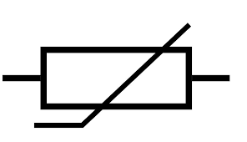
Describe the action of thermistors and light- dependent resistors and show understanding of their use as input transducers
Thermistor
Light dependent resistor
A transducer is an electronic device that converts energy from one form into another.

Slide 64
Describe the action of thermistors and light- dependent resistors and show understanding of their use as input transducers
Thermistor
Light dependent resistor
A transducer is an electronic device that converts energy from one form into another.
Thermistor – resistance decreases as the temperature increases.
At low temperatures the resistance of a thermistor is high and little current can flow through them.
At high temperatures the resistance of a thermistor is low and more current can flow through them.

Slide 65
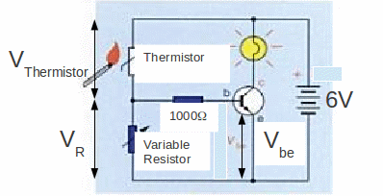
Describe the action of thermistors and light- dependent resistors and show understanding of their use as input transducers
Thermistor
Light dependent resistor
A transducer is an electronic device that converts energy from one form into another.
Thermistor used in a fire-alarm circuit
Thermistor – resistance decreases as the temperature increases.
At low temperatures the resistance of a thermistor is high and little current can flow through them.
At high temperatures the resistance of a thermistor is low and more current can flow through them.
www.astarmathsandphysics.com
At room temperature, thermistor has a high resistance and voltage to the transistor is too low. As temperature rises, resistance falls, so more current flows to the transistor and the alarm is switched on.

Slide 66
Describe the action of thermistors and light- dependent resistors and show understanding of their use as input transducers
Thermistor
Light dependent resistor
A transducer is an electronic device that converts energy from one form into another.
Light dependent resistor (LDR) – resistance decreases as the light intensity increases.
In the dark and at low light levels the resistance of an LDR is high, and little current can flow through
In bright light the resistance of an LDR is low, and current can flow through it.

Slide 67
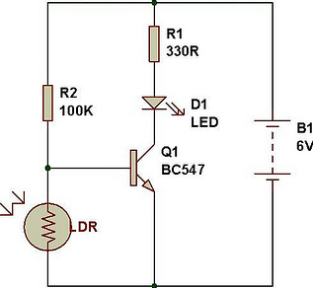
Describe the action of thermistors and light- dependent resistors and show understanding of their use as input transducers
Thermistor
Light dependent resistor
A transducer is an electronic device that converts energy from one form into another.
LDR used in a security light circuit
Light dependent resistor (LDR) – resistance decreases as the light intensity increases.
In the dark and at low light levels the resistance of an LDR is high, and little current can flow through
In bright light the resistance of an LDR is low, and current can flow through it.
www.buildcircuit.com
In daylight the LDR has a low resistance and a low share of the battery voltage – too low to switch the transistor on. In darkness the LDR resistance increases, so does its share of the battery voltage. This is now sufficient to switch the transistor on, and the bulb lights up

Slide 68
And finally …..
RELAYS!

Slide 69
A relay is a device which uses a low current circuit to switch a high current circuit on or off.
And finally …..
RELAYS!

Slide 70
A relay is a device which uses a low current circuit to switch a high current circuit on or off.
And finally …..
RELAYS!
For example, a very big relay is used in cars for switching the starter motor, because it draws a very big current.

Slide 71
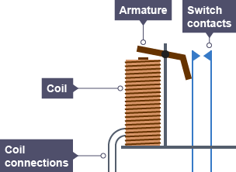
A relay is a device which uses a low current circuit to switch a high current circuit on or off.
And finally …..
RELAYS!
For example, a very big relay is used in cars for switching the starter motor, because it draws a very big current.
Low current circuit
High current circuit

Slide 72
A relay is a device which uses a low current circuit to switch a high current circuit on or off.
And finally …..
RELAYS!
For example, a very big relay is used in cars for switching the starter motor, because it draws a very big current.
When the switch in the low current circuit is closed, it turns the electromagnet on which attracts the iron armature.
1
Low current circuit
High current circuit

Slide 73
A relay is a device which uses a low current circuit to switch a high current circuit on or off.
And finally …..
RELAYS!
For example, a very big relay is used in cars for switching the starter motor, because it draws a very big current.
When the switch in the low current circuit is closed, it turns the electromagnet on which attracts the iron armature.
The armature pivots and closes the switch contacts in the high current circuit.
2
1
Low current circuit
High current circuit

Slide 74
A relay is a device which uses a low current circuit to switch a high current circuit on or off.
And finally …..
RELAYS!
For example, a very big relay is used in cars for switching the starter motor, because it draws a very big current.
When the switch in the low current circuit is closed, it turns the electromagnet on which attracts the iron armature.
The armature pivots and closes the switch contacts in the high current circuit.
When the low current switch is opened the electromagnet stops pulling the armature and the high current circuit is broken again.
2
3
1
Low current circuit
High current circuit

Slide 75
LEARNING OBJECTIVES
Core •Draw and interpret circuit diagrams containing sources, switches, resistors (fixed and variable), heaters, thermistors, light-dependent resistors, lamps, ammeters, voltmeters, galvanometers, magnetising coils, transformers, bells, fuses and relays Understand that the current at every point in a series circuit is the same Give the combined resistance of two or more resistors in series State that, for a parallel circuit, the current from the source is larger than the current in each branch State that the combined resistance of two resistors in parallel is less than that of either resistor by itself State the advantages of connecting lamps in parallel in a lighting circuit Describe the action of a variable potential divider (potentiometer) • Describe the action of thermistors and light- dependent resistors and show understanding of their use as input transducers • Describe the action of a relay and show understanding of its use in switching circuits | Supplement Draw and interpret circuit diagrams containing diodes Calculate the combined e.m.f. of several sources in series • Recall and use the fact that the sum of the p.d.s across the components in a series circuit is equal to the total p.d. across the supply • Recall and use the fact that the current from the source is the sum of the currents in the separate branches of a parallel circuit • Calculate the effective resistance of two resistors in parallel Describe the action of a diode and show understanding of its use as a rectifier • Recognise and show understanding of circuits operating as light-sensitive switches and temperature-operated alarms (to include the use of a relay)

Slide 76
PHYSICS – Electric circuits

