Slide 1
PHYSICS – The Nuclear Atom

Slide 2
LEARNING OBJECTIVES
Core • Describe the structure of an atom in terms of a positive nucleus and negative electrons Describe the composition of the nucleus in terms of protons and neutrons State the charges of protons and neutrons Use the term proton number Z Use the term nucleon number A Use the term nuclide and use the nuclide notation A ZX Use and explain the term isotope | Supplement Describe how the scattering of α-particles by thin metal foils provides evidence for the nuclear atom State the meaning of nuclear fission and nuclear fusion Balance equations involving nuclide notation

Slide 3
Atoms
Atomic structure

Slide 4
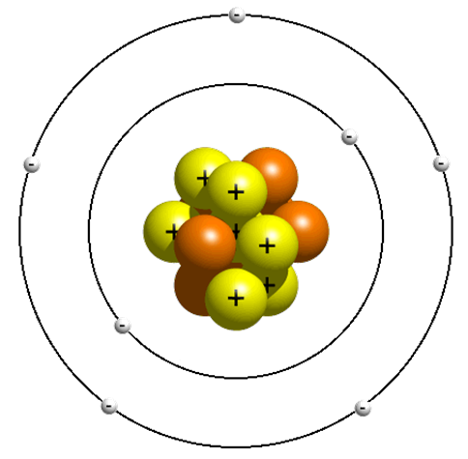
Atoms
Atomic structure
The Nucleus

Slide 5
Atoms
Atomic structure
The Nucleus
1) It’s in the middle of the atom

Slide 6
Atoms
Atomic structure
The Nucleus
It’s in the middle of the atom
It contains protons and neutrons

Slide 7
Atoms
Atomic structure
The Nucleus
It’s in the middle of the atom
It contains protons and neutrons
It has a positive charge because of the protons.

Slide 8
Atoms
Atomic structure
The Nucleus
It’s in the middle of the atom
It contains protons and neutrons
It has a positive charge because of the protons.
Almost the whole mass of the atom is concentrated in the nucleus.

Slide 9
Atoms
Atomic structure
The Electrons

Slide 10
Atoms
Atomic structure
The Electrons
1) Move around the nucleus.

Slide 11
Atoms
Atomic structure
The Electrons
Move around the nucleus
They’re negatively charged. .

Slide 12
Atoms
Atomic structure
The Electrons
Move around the nucleus
They’re negatively charged.
They’re tiny, but they cover a lot of space..

Slide 13
Atoms
Atomic structure
The Electrons
Move around the nucleus
They’re negatively charged.
They’re tiny, but they cover a lot of space..
The volume their orbits occupy determines how big the atom is.

Slide 14
Atoms
Atomic structure
The Electrons
Move around the nucleus
They’re negatively charged.
They’re tiny, but they cover a lot of space..
The volume their orbits occupy determines how big the atom is.
They have virtually no mass.

Slide 15
Atoms
Atomic structure
The Electrons
Move around the nucleus
They’re negatively charged.
They’re tiny, but they cover a lot of space..
The volume their orbits occupy determines how big the atom is.
They have virtually no mass.
They occupy shells around the nucleus.

Slide 16
Atoms
Atomic structure
The Electrons
Move around the nucleus
They’re negatively charged.
They’re tiny, but they cover a lot of space..
The volume their orbits occupy determines how big the atom is.
They have virtually no mass.
They occupy shells around the nucleus.
These shells explain the whole of chemistry.

Slide 17
Atoms
Atomic structure
Summary
Particle | Mass | Charge
Proton | 1 | +1
Neutron | 1 | 0
Electron | 1/2000 | -1

Slide 18
Atoms
Electron Shell Rules
2nd
1) Electrons always occupy SHELLS or ENERGY LEVELS.
1st

Slide 19
Atoms
Electron Shell Rules
2nd
Electrons always occupy SHELLS or ENERGY LEVELS.
The LOWEST energy levels are ALWAYS FILLED FIRST.
1st

Slide 20
Atoms
Electron Shell Rules
2nd
Electrons always occupy SHELLS or ENERGY LEVELS.
The LOWEST energy levels are ALWAYS FILLED FIRST.
Only a certain number of electrons are allowed in each shell:
1st shell: 2
2nd shell: 8
3rd shell: 8
1st

Slide 21
Atoms
Electron Shell Rules
2nd
Electrons always occupy SHELLS or ENERGY LEVELS.
The LOWEST energy levels are ALWAYS FILLED FIRST.
Only a certain number of electrons are allowed in each shell:
1st shell: 2
2nd shell: 8
3rd shell: 8
4) Atoms are much HAPPIER when they have FULL electron shells.
1st

Slide 22
Atoms
Electron Shell Rules
2nd
Electrons always occupy SHELLS or ENERGY LEVELS.
The LOWEST energy levels are ALWAYS FILLED FIRST.
Only a certain number of electrons are allowed in each shell:
1st shell: 2
2nd shell: 8
3rd shell: 8
Atoms are much HAPPIER when they have FULL electron shells.
In most atoms the OUTER SHELL is NOT FULL and this makes the atom want to REACT.
1st

Slide 23
Atoms
Electron Shell Rules
2nd
Electrons always occupy SHELLS or ENERGY LEVELS.
The LOWEST energy levels are ALWAYS FILLED FIRST.
Only a certain number of electrons are allowed in each shell:
1st shell: 2
2nd shell: 8
3rd shell: 8
Atoms are much HAPPIER when they have FULL electron shells.
In most atoms the OUTER SHELL is NOT FULL and this makes the atom want to REACT.
1st
So, how do we know how many electrons, protons and neutrons there are?

Slide 24
Atoms
Atomic Number and Mass Number
We just need to know these two simple numbers

Slide 25
Atoms
Atomic Number and Mass Number
We just need to know these two simple numbers
23
Na
11

Slide 26
Atoms
Atomic Number and Mass Number
We just need to know these two simple numbers
THE MASS NUMBER
23
Na
- Total of Protons and Neutrons
11

Slide 27
Atoms
Atomic Number and Mass Number
We just need to know these two simple numbers
THE MASS NUMBER
23
Na
- Total of Protons and Neutrons
THE ATOMIC NUMBER
11
- Number of Protons (and electrons)

Slide 28
Atoms
Atomic Number and Mass Number
We just need to know these two simple numbers
THE MASS NUMBER
23
Na
- Total of Protons and Neutrons
THE ATOMIC NUMBER
11
- Number of Protons (and electrons)
The atomic number tells you how many protons there are.

Slide 29
Atoms
Atomic Number and Mass Number
We just need to know these two simple numbers
THE MASS NUMBER
23
Na
- Total of Protons and Neutrons
THE ATOMIC NUMBER
11
- Number of Protons (and electrons)
The atomic number tells you how many protons there are.
This also tells you how many electrons there are.

Slide 30
Atoms
Atomic Number and Mass Number
We just need to know these two simple numbers
THE MASS NUMBER
23
Na
- Total of Protons and Neutrons
THE ATOMIC NUMBER
11
- Number of Protons (and electrons)
The atomic number tells you how many protons there are.
This also tells you how many electrons there are.
To get the number of neutrons – just subtract the atomic number from the mass number.

Slide 31
Atoms
Atomic Number and Mass Number
We just need to know these two simple numbers
THE MASS NUMBER
23
Na
- Total of Protons and Neutrons
THE ATOMIC NUMBER
11
- Number of Protons (and electrons)
The atomic number tells you how many protons there are.
This also tells you how many electrons there are.
To get the number of neutrons – just subtract the atomic number from the mass number.
The mass number is always the biggest number. It tells you the relative mass of the atom.

Slide 32
Atoms
Atomic Number and Mass Number
We just need to know these two simple numbers
THE MASS NUMBER
23
Na
- Total of Protons and Neutrons
THE ATOMIC NUMBER
11
- Number of Protons (and electrons)
The atomic number tells you how many protons there are.
This also tells you how many electrons there are.
To get the number of neutrons – just subtract the atomic number from the mass number.
The mass number is always the biggest number. It tells you the relative mass of the atom.
The mass number is always roughly double the atomic number.

Slide 33
Atoms
Atomic Number and Mass Number
We just need to know these two simple numbers
THE MASS NUMBER
23
Na
- Total of Protons and Neutrons
THE ATOMIC NUMBER
11
- Number of Protons (and electrons)
The atomic number tells you how many protons there are.
This also tells you how many electrons there are.
To get the number of neutrons – just subtract the atomic number from the mass number.
The mass number is always the biggest number. It tells you the relative mass of the atom.
The mass number is always roughly double the atomic number.
Which means there’s about the same number of protons as neutrons in any nucleus.

Slide 34
Atoms
Atomic Number and Mass Number
Also known as the NUCLEON NUMBER (A)

Slide 35
Atoms
Atomic Number and Mass Number
Also known as the NUCLEON NUMBER (A)
Also known as the
PROTON NUMBER (Z)

Slide 36
Atoms
Atomic Number and Mass Number
Also known as the NUCLEON NUMBER (A)
Also known as the
PROTON NUMBER (Z)
This is known as the NUCLIDE NOTATION
Each different type of atom is called a NUCLIDE
A
X
Z

Slide 37
Atoms
Supplement
Atomic Number and Mass Number
Also known as the NUCLEON NUMBER (A)
Also known as the
PROTON NUMBER (Z)
238
U
92

Slide 38
Atoms
Supplement
Atomic Number and Mass Number
Also known as the NUCLEON NUMBER (A)
Also known as the
PROTON NUMBER (Z)
238
234
U
Th
92
90

Slide 39
Atoms
Supplement
Atomic Number and Mass Number
Also known as the NUCLEON NUMBER (A)
Also known as the
PROTON NUMBER (Z)
238
234
+
4
U
Th
He
92
90
2

Slide 40
ISOTOPES
Different forms of the same element

Slide 41
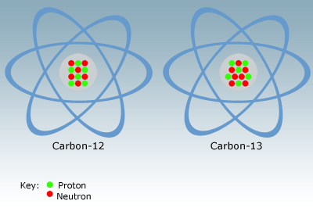
ISOTOPES
Different forms of the same element
What’s the difference between these two?

Slide 42
ISOTOPES
Different forms of the same element
What’s the difference between these two?
In the nucleus, this one has 6 protons and 6 neutrons.

Slide 43
ISOTOPES
Different forms of the same element
What’s the difference between these two?
Isotopes are atoms with the same number of protons but a different number of neutrons.
In the nucleus, this one has 6 protons and 6 neutrons.
In the nucleus, this one has 6 protons and 7 neutrons.

Slide 44
ISOTOPES
Different forms of the same element
Isotopes have the same atomic number, but different mass numbers
What’s the difference between these two?
Isotopes are atoms with the same number of protons but a different number of neutrons.
In the nucleus, this one has 6 protons and 6 neutrons.
In the nucleus, this one has 6 protons and 7 neutrons.

Slide 45
ISOTOPES
C
13
12
C
6
6
Different forms of the same element
Isotopes have the same atomic number, but different mass numbers
What’s the difference between these two?
Isotopes are atoms with the same number of protons but a different number of neutrons.
In the nucleus, this one has 6 protons and 6 neutrons.
In the nucleus, this one has 6 protons and 7 neutrons.

Slide 46
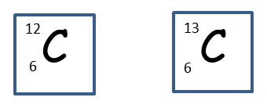
ISOTOPES
Different forms of the same element
What are the features of isotopes?

Slide 47
ISOTOPES
Different forms of the same element
Most elements have different isotopes but there’s usually only one or two stable ones.
What are the features of isotopes?

Slide 48
ISOTOPES
Different forms of the same element
Most elements have different isotopes but there’s usually only one or two stable ones.
What are the features of isotopes?
The other isotopes tend to be radioactive, which means that they decay into other elements and give out radiation. This is where all radioactivity comes from – unstable radioactive isotopes undergoing nuclear decay and spitting out high energy particles.

Slide 49
ATOMIC STRUCTURE
Supplement
WHAT EVIDENCE IS THERE?

Slide 50
ATOMIC STRUCTURE
Supplement
WHAT EVIDENCE IS THERE?

Slide 51
ATOMIC STRUCTURE
Supplement
WHAT EVIDENCE IS THERE?
1911 Rutherford, Geiger and Marsden
Beam of alpha particles
Gold foil
Alpha source
Alpha detector

Slide 52
ATOMIC STRUCTURE
Supplement
WHAT EVIDENCE IS THERE?
1911 Rutherford, Geiger and Marsden
Beam of alpha particles
Gold foil
Alpha source
Most alpha particles passed straight through the gold atoms, but a few bounced off at large angles. Conclusion: atom is largely empty space, but positive charge and most mass concentrated in a tiny nucleus at the centre.
Alpha detector

Slide 53
ATOMIC STRUCTURE
Supplement
WHAT EVIDENCE IS THERE?
1911 Rutherford, Geiger and Marsden
+
Beam of alpha particles
Gold foil
Most alpha particles are undeflected
Alpha source
+
Some alpha particles are deflected slightly
Most alpha particles passed straight through the gold atoms, but a few bounced off at large angles. Conclusion: atom is largely empty space, but positive charge and most mass concentrated in a tiny nucleus at the centre.
+
A few alpha particles bounce off the nucleus
Alpha detector

Slide 54
ATOMIC STRUCTURE
Supplement
Fission = splitting the atom
Stray neutron
Uranium 235 nucleus
A neutron strikes a nucleus of Uranium 235 – this becomes unstable, splits into two lighter nuclei and releases 2 or 3 neutrons.

Slide 55
ATOMIC STRUCTURE
Supplement
Fission = splitting the atom
Stray neutron
Uranium 235 nucleus
The emitted neutrons go on to split other nuclei, and so on … the result is a chain reaction, releasing huge amounts of energy
A neutron strikes a nucleus of Uranium 235 – this becomes unstable, splits into two lighter nuclei and releases 2 or 3 neutrons.

Slide 56
ATOMIC STRUCTURE
Supplement
Energy can be released by fusing (joining together) very light nuclei to make heavier ones. For example, two hydrogen nuclei can be joined together to form helium.
Fusion = joining hydrogen nuclei
+
+
Hydrogen-2
Hydrogen-3
Fusion
+
+ energy
+
Neutron
Helium

Slide 57
ATOMIC STRUCTURE
Supplement
Energy can be released by fusing (joining together) very light nuclei to make heavier ones. For example, two hydrogen nuclei can be joined together to form helium.
Fusion = joining hydrogen nuclei
Fusion is very difficult to achieve – the gas must be much hotter than any temperatures normally achieved on Earth to overcome the natural repulsion of the fast-moving nuclei.
+
+
Hydrogen-2
Hydrogen-3
Fusion
+
+ energy
+
Neutron
Helium

Slide 58
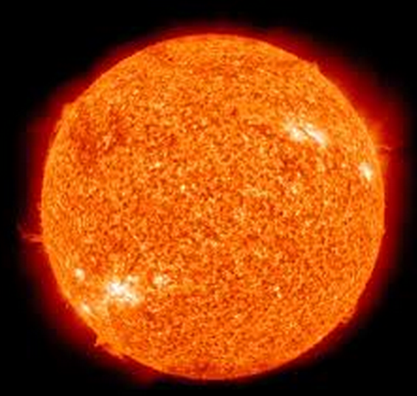
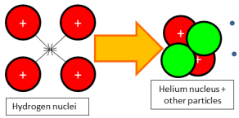
ATOMIC STRUCTURE
Supplement
Energy can be released by fusing (joining together) very light nuclei to make heavier ones. For example, two hydrogen nuclei can be joined together to form helium.
Fusion = joining hydrogen nuclei
Fusion is very difficult to achieve – the gas must be much hotter than any temperatures normally achieved on Earth to overcome the natural repulsion of the fast-moving nuclei.
+
+
Hydrogen-2
Hydrogen-3
Fusion
Fusion occurs naturally on the Sun, where four hydrogen nuclei fuse to form helium
+
+ energy
+
Neutron
Helium

Slide 59
LEARNING OBJECTIVES
Core • Describe the structure of an atom in terms of a positive nucleus and negative electrons Describe the composition of the nucleus in terms of protons and neutrons State the charges of protons and neutrons Use the term proton number Z Use the term nucleon number A Use the term nuclide and use the nuclide notation A ZX Use and explain the term isotope | Supplement Describe how the scattering of α-particles by thin metal foils provides evidence for the nuclear atom State the meaning of nuclear fission and nuclear fusion Balance equations involving nuclide notation

Slide 60
PHYSICS – The Nuclear Atom

