Slide 1
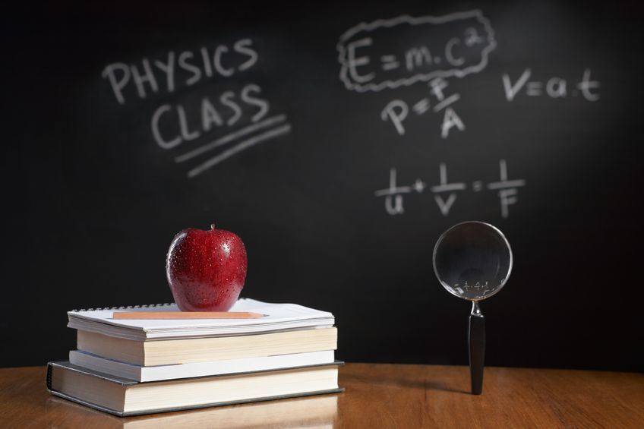
PHYSICS – Speed, velocity and acceleration

Slide 2
LEARNING OBJECTIVES
1.2 Motion Core • Define speed and calculate average speed from total time / total distance • Plot and interpret a speed-time graph or a distance- time graph • Recognise from the shape of a speed-time graph when a body is – at rest – moving with constant speed – moving with changing speed • Calculate the area under a speed-time graph to work out the distance travelled for motion with constant acceleration • Demonstrate understanding that acceleration and deceleration are related to changing speed including qualitative analysis of the gradient of a speed-time graph State that the acceleration of free fall for a body near to the Earth is constant | Supplement • Distinguish between speed and velocity • Define and calculate acceleration using time taken change of velocity • Calculate speed from the gradient of a distance-time graph • Calculate acceleration from the gradient of a speed-time graph • Recognise linear motion for which the acceleration is constant • Recognise motion for which the acceleration is not constant • Understand deceleration as a negative acceleration • Describe qualitatively the motion of bodies falling in a uniform gravitational field with and without air resistance (including reference to terminal velocity)

Slide 3
A
Average speed+= Distance moved
Time taken

Slide 4
A
Average speed+= Distance moved
Time taken
Distance measured in metres (m)
Time measured in seconds (s)
Speed - metres per second (m/s)

Slide 5
A
Average speed+= Distance moved
Time taken
Example:
Car travels 50m
time 2s
speed = 50/2 = 25 m/s
25 m.s⁻¹

Slide 6
So if that’s speed, what is velocity?

Slide 7
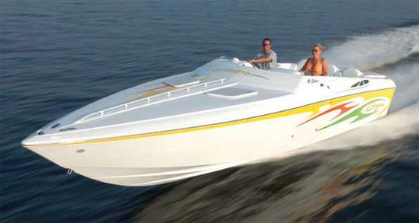
Velocity is speed in a given direction.

Slide 8
Velocity is speed in a given direction.
Velocity is 25m/s due west

Slide 9
Example:

Slide 10
Example:

Slide 11
Example:

Slide 12
Example:
Cyclist +10m/s to the right

Slide 13
Example:
Cyclist +10m/s to the right
-10m/s to the left

Slide 14
What’s your vector Victor?

Slide 15
What’s your vector Victor?
Quantities such as velocity are called vectors because they have size and direction

Slide 16
Acceleration is the rate at which an object increases speed or velocity.

Slide 17
Acceleration is the rate at which an object increases speed or velocity.
Acceleration = change in velocity
time taken

Slide 18
Acceleration is the rate at which an object increases speed or velocity.
Acceleration = change in velocity
time taken
Also written as: a = v - u
t

Slide 19
Acceleration is the rate at which an object increases speed or velocity.
Acceleration = change in velocity
time taken
Velocity measured in m/s
Time measured in s
Acceleration measured in m/s/s or m/s²

Slide 20
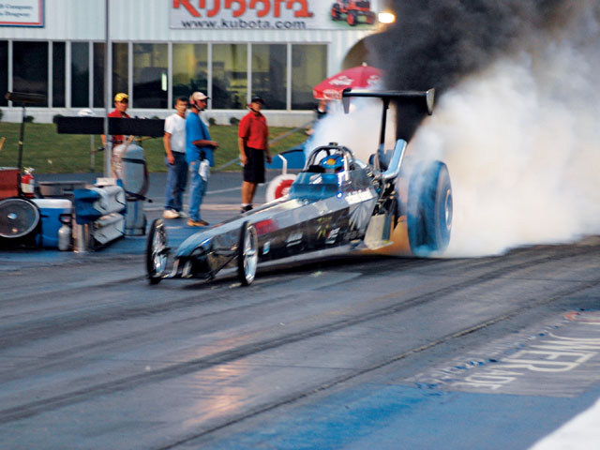
Example: a drag car increases its velocity from zero to 60m/s in 3s.
a = v - u
t

Slide 21
Example: a drag car increases its velocity from zero to 60m/s in 3s.
a = v - u
t
a = 60 – 0
3

Slide 22
Example: a drag car increases its velocity from zero to 60m/s in 3s.
a = v - u
t
a = 60 – 0
3
a = 60 = 20m/s⁻²
3

Slide 23
Example: a drag car increases its velocity from zero to 60m/s in 3s.
a = v - u
t
a = 60 – 0
3
a = 60 = 20m/s⁻²
3
Don’t forget that acceleration is a vector – it has size and direction

Slide 24
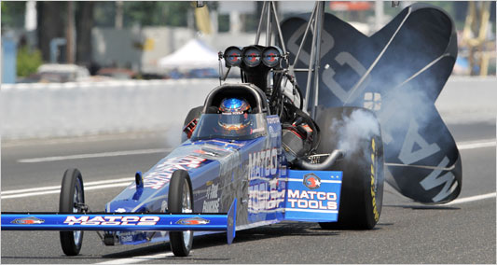
Deceleration (retardation)
Deceleration is negative acceleration – the object is slowing down.
Eg. – 4m/s²

Slide 25
Constant acceleration example
6s
A
B
Car passes point A with a velocity of 10m/s. It has a steady (constant) acceleration of 4m/s². What is the velocity when it passes point B?

Slide 26
Constant acceleration example
6s
A
B
Car passes point A with a velocity of 10m/s. It has a steady (constant) acceleration of 4m/s². What is the velocity when it passes point B?
Solution: car gains 4m/s of velocity every second. In 6s it gains an extra 24m/s.

Slide 27
Constant acceleration example
6s
A
B
Car passes point A with a velocity of 10m/s. It has a steady (constant) acceleration of 4m/s². What is the velocity when it passes point B?
Solution: car gains 4m/s of velocity every second. In 6s it gains an extra 24m/s.
Final velocity = initial velocity + extra velocity

Slide 28
Constant acceleration example
6s
A
B
Car passes point A with a velocity of 10m/s. It has a steady (constant) acceleration of 4m/s². What is the velocity when it passes point B?
Solution: car gains 4m/s of velocity every second. In 6s it gains an extra 24m/s.
Final velocity = initial velocity + extra velocity
Final velocity = 10 + 24 = 34m/s

Slide 29
Motion graphs

Slide 30
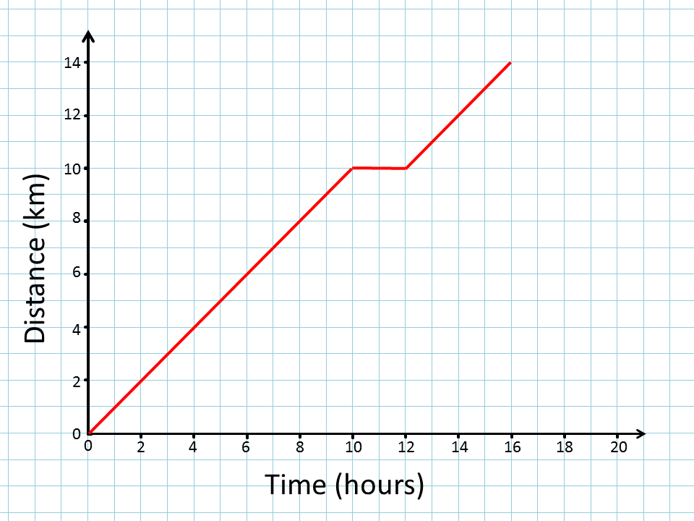

Slide 31
Travelling at constant speed

Slide 32
Stationary
Travelling at constant speed

Slide 33
Travelling at constant speed
Stationary
Travelling at constant speed

Slide 34
Speed = distance
time

Slide 35
Speed = distance
time

Slide 36
Speed = distance
time

Slide 37
Speed = distance
time
Speed = 8 = 1 km/h
8

Slide 38
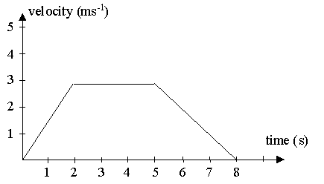
Acceleration from velocity : time graph

Slide 39
Acceleration from velocity : time graph
Steady acceleration

Slide 40
Acceleration from velocity : time graph
Steady velocity
Steady acceleration

Slide 41
Acceleration from velocity : time graph
Steady velocity
Steady deceleration
Steady acceleration

Slide 42
Acceleration from velocity : time graph
Acceleration = V - U
t

Slide 43
Acceleration from velocity : time graph
Acceleration = V - U
t

Slide 44
Acceleration from velocity : time graph
Acceleration = 3 – 0 / 2
= 1.5 m/s/s (m.s⁻²)

Slide 45
Velocity-time graphs
Acceleration can be calculated by the gradient of a velocity:time graph. (Remember gradient is the difference up divided by the difference across)
80
60
40
20
0
Calculate the acceleration for each of the 4 sections of the graph.
Velocity
m/s
Time/s
10 20 30 40 50

Slide 46
Velocity-time graphs
Acceleration can be calculated by the gradient of a velocity:time graph. (Remember gradient is the difference up divided by the difference across)
80
60
40
20
0
Acceleration = V - U
t
Calculate the acceleration for each of the 4 sections of the graph.
Velocity
m/s
Time/s
10 20 30 40 50

Slide 47
Velocity-time graphs
Acceleration can be calculated by the gradient of a velocity:time graph. (Remember gradient is the difference up divided by the difference across)
80
60
40
20
0
Calculate the acceleration for each of the 4 sections of the graph.
Velocity
m/s
Acceleration = 40 - 0 = 4m/s²
10
Time/s
10 20 30 40 50

Slide 48
Velocity-time graphs
Acceleration can be calculated by the gradient of a velocity:time graph. (Remember gradient is the difference up divided by the difference across)
80
60
40
20
0
Calculate the acceleration for each of the 4 sections of the graph.
Velocity
m/s
Acceleration = 0 (no change in velocity)
Time/s
10 20 30 40 50

Slide 49
Velocity-time graphs
Acceleration can be calculated by the gradient of a velocity:time graph. (Remember gradient is the difference up divided by the difference across)
80
60
40
20
0
Calculate the acceleration for each of the 4 sections of the graph.
Velocity
m/s
Acceleration = 20 - 0 = 2m/s²
10
Time/s
10 20 30 40 50

Slide 50
Velocity-time graphs
Acceleration can be calculated by the gradient of a velocity:time graph. (Remember gradient is the difference up divided by the difference across)
80
60
40
20
0
Calculate the acceleration for each of the 4 sections of the graph.
Velocity
m/s
Acceleration = 0 - 60 = -3m/s²
20
Time/s
10 20 30 40 50

Slide 51
Velocity-time graphs
On a velocity – time (or speed – time) graph, the area under the line is numerically equal to the distance travelled.
80
60
40
20
0
Velocity
m/s
Time/s
10 20 30 40 50

Slide 52
Velocity-time graphs
On a velocity – time (or speed – time) graph, the area under the line is numerically equal to the distance travelled.
80
60
40
20
0
Remember that the area of a
triangle is ½ x base x height.
Velocity
m/s
Time/s
10 20 30 40 50

Slide 53
Velocity-time graphs
On a velocity – time (or speed – time) graph, the area under the line is numerically equal to the distance travelled.
80
60
40
20
0
Remember that the area of a
triangle is ½ x base x height.
Velocity
m/s
Area = 200m²
Time/s
10 20 30 40 50

Slide 54
Velocity-time graphs
On a velocity – time (or speed – time) graph, the area under the line is numerically equal to the distance travelled.
80
60
40
20
0
Remember that the area of a
triangle is ½ x base x height.
Area = 400m²
Velocity
m/s
Area = 200m²
Time/s
10 20 30 40 50

Slide 55
Velocity-time graphs
On a velocity – time (or speed – time) graph, the area under the line is numerically equal to the distance travelled.
80
60
40
20
0
Remember that the area of a
triangle is ½ x base x height.
Area = 400m²
Velocity
m/s
Area = 200m²
Area = 400m²
Time/s
10 20 30 40 50

Slide 56
Velocity-time graphs
On a velocity – time (or speed – time) graph, the area under the line is numerically equal to the distance travelled.
80
60
40
20
0
Remember that the area of a
triangle is ½ x base x height.
Area = 100m²
Area = 400m²
Velocity
m/s
Area = 200m²
Area = 400m²
Time/s
10 20 30 40 50

Slide 57
Velocity-time graphs
On a velocity – time (or speed – time) graph, the area under the line is numerically equal to the distance travelled.
80
60
40
20
0
Remember that the area of a
triangle is ½ x base x height.
Area = 100m²
Area = 400m²
Velocity
m/s
Area = 200m²
Area = 400m²
Area = 600m²
Time/s
10 20 30 40 50

Slide 58
Velocity-time graphs
On a velocity – time (or speed – time) graph, the area under the line is numerically equal to the distance travelled.
80
60
40
20
0
Remember that the area of a
triangle is ½ x base x height.
Area = 100m²
Area = 400m²
Velocity
m/s
Area = 200m²
Area = 400m²
Area = 600m²
Time/s
10 20 30 40 50
The total distance travelled = 200 + 400 + 400 + 100 + 600 = 1700m

Slide 59
Free fall

Slide 60
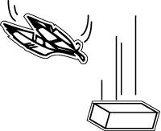
Acceleration of free fall (g)
Which object will hit the ground first?

Slide 61
Acceleration of free fall (g)
Which object will hit the ground first?
Obviously the brick (because the feather is slowed much more by the air)

Slide 62
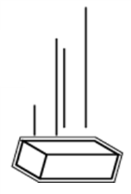
Acceleration of free fall (g)
No air resistance, objects both fall with the same downward acceleration.
In a vacuum
In air

Slide 63
Acceleration of free fall (g)
No air resistance, objects both fall with the same downward acceleration.
Acceleration of free fall = 9.8m/s²
Given the symbol ‘g’
In a vacuum
In air

Slide 64
Acceleration of free fall (g)
No air resistance, objects both fall with the same downward acceleration.
Often rounded to 10m/s²
Acceleration of free fall = 9.8m/s²
Given the symbol ‘g’
In a vacuum
In air

Slide 65
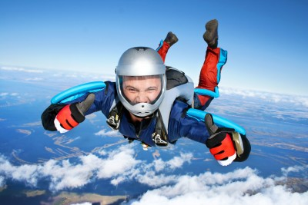
Acceleration and gravity

Slide 66
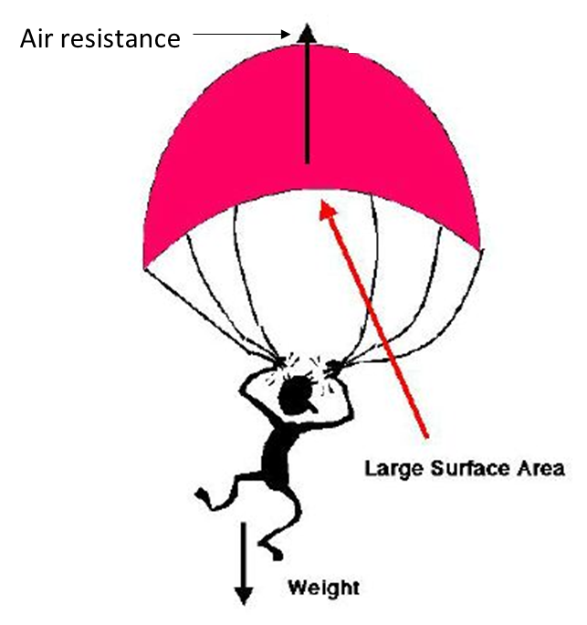
Acceleration and gravity
Falling objects accelerate towards the ground at 10m/s² due to gravity. The force of gravity always acts towards the centre of the Earth.
The atmosphere creates an upward force that slows down falling objects. This is known as air resistance or drag.

Slide 67
Acceleration and gravity
Falling objects accelerate towards the ground at 10m/s² due to gravity. The force of gravity always acts towards the centre of the Earth.
The atmosphere creates an upward force that slows down falling objects. This is known as air resistance or drag.

Slide 68
Acceleration and gravity
Falling objects accelerate towards the ground at 10m/s² due to gravity. The force of gravity always acts towards the centre of the Earth.
The atmosphere creates an upward force that slows down falling objects. This is known as air resistance or drag.
The larger the surface area of the object, the larger the drag force

Slide 69
Acceleration and gravity
Speed (m/s)
Drag
At first the force of gravity is larger than the drag force, so the object accelerates.
A
Weight
Time (s)

Slide 70
Acceleration and gravity
Drag
B
As speed increases, so does drag; the acceleration decreases
Speed (m/s)
Weight
Time (s)

Slide 71
Acceleration and gravity
Drag
Terminal velocity
C
Speed (m/s)
Weight
When drag equals the force due to gravity there is no resultant force and the acceleration is zero. The object continues at terminal velocity.
Time (s)

Slide 72
LEARNING OBJECTIVES
1.2 Motion Core • Define speed and calculate average speed from total time / total distance • Plot and interpret a speed-time graph or a distance- time graph • Recognise from the shape of a speed-time graph when a body is – at rest – moving with constant speed – moving with changing speed • Calculate the area under a speed-time graph to work out the distance travelled for motion with constant acceleration • Demonstrate understanding that acceleration and deceleration are related to changing speed including qualitative analysis of the gradient of a speed-time graph State that the acceleration of free fall for a body near to the Earth is constant | Supplement • Distinguish between speed and velocity • Define and calculate acceleration using time taken change of velocity • Calculate speed from the gradient of a distance-time graph • Calculate acceleration from the gradient of a speed-time graph • Recognise linear motion for which the acceleration is constant • Recognise motion for which the acceleration is not constant • Understand deceleration as a negative acceleration • Describe qualitatively the motion of bodies falling in a uniform gravitational field with and without air resistance (including reference to terminal velocity)

Slide 73
PHYSICS – Speed, velocity and acceleration

